Slide 1



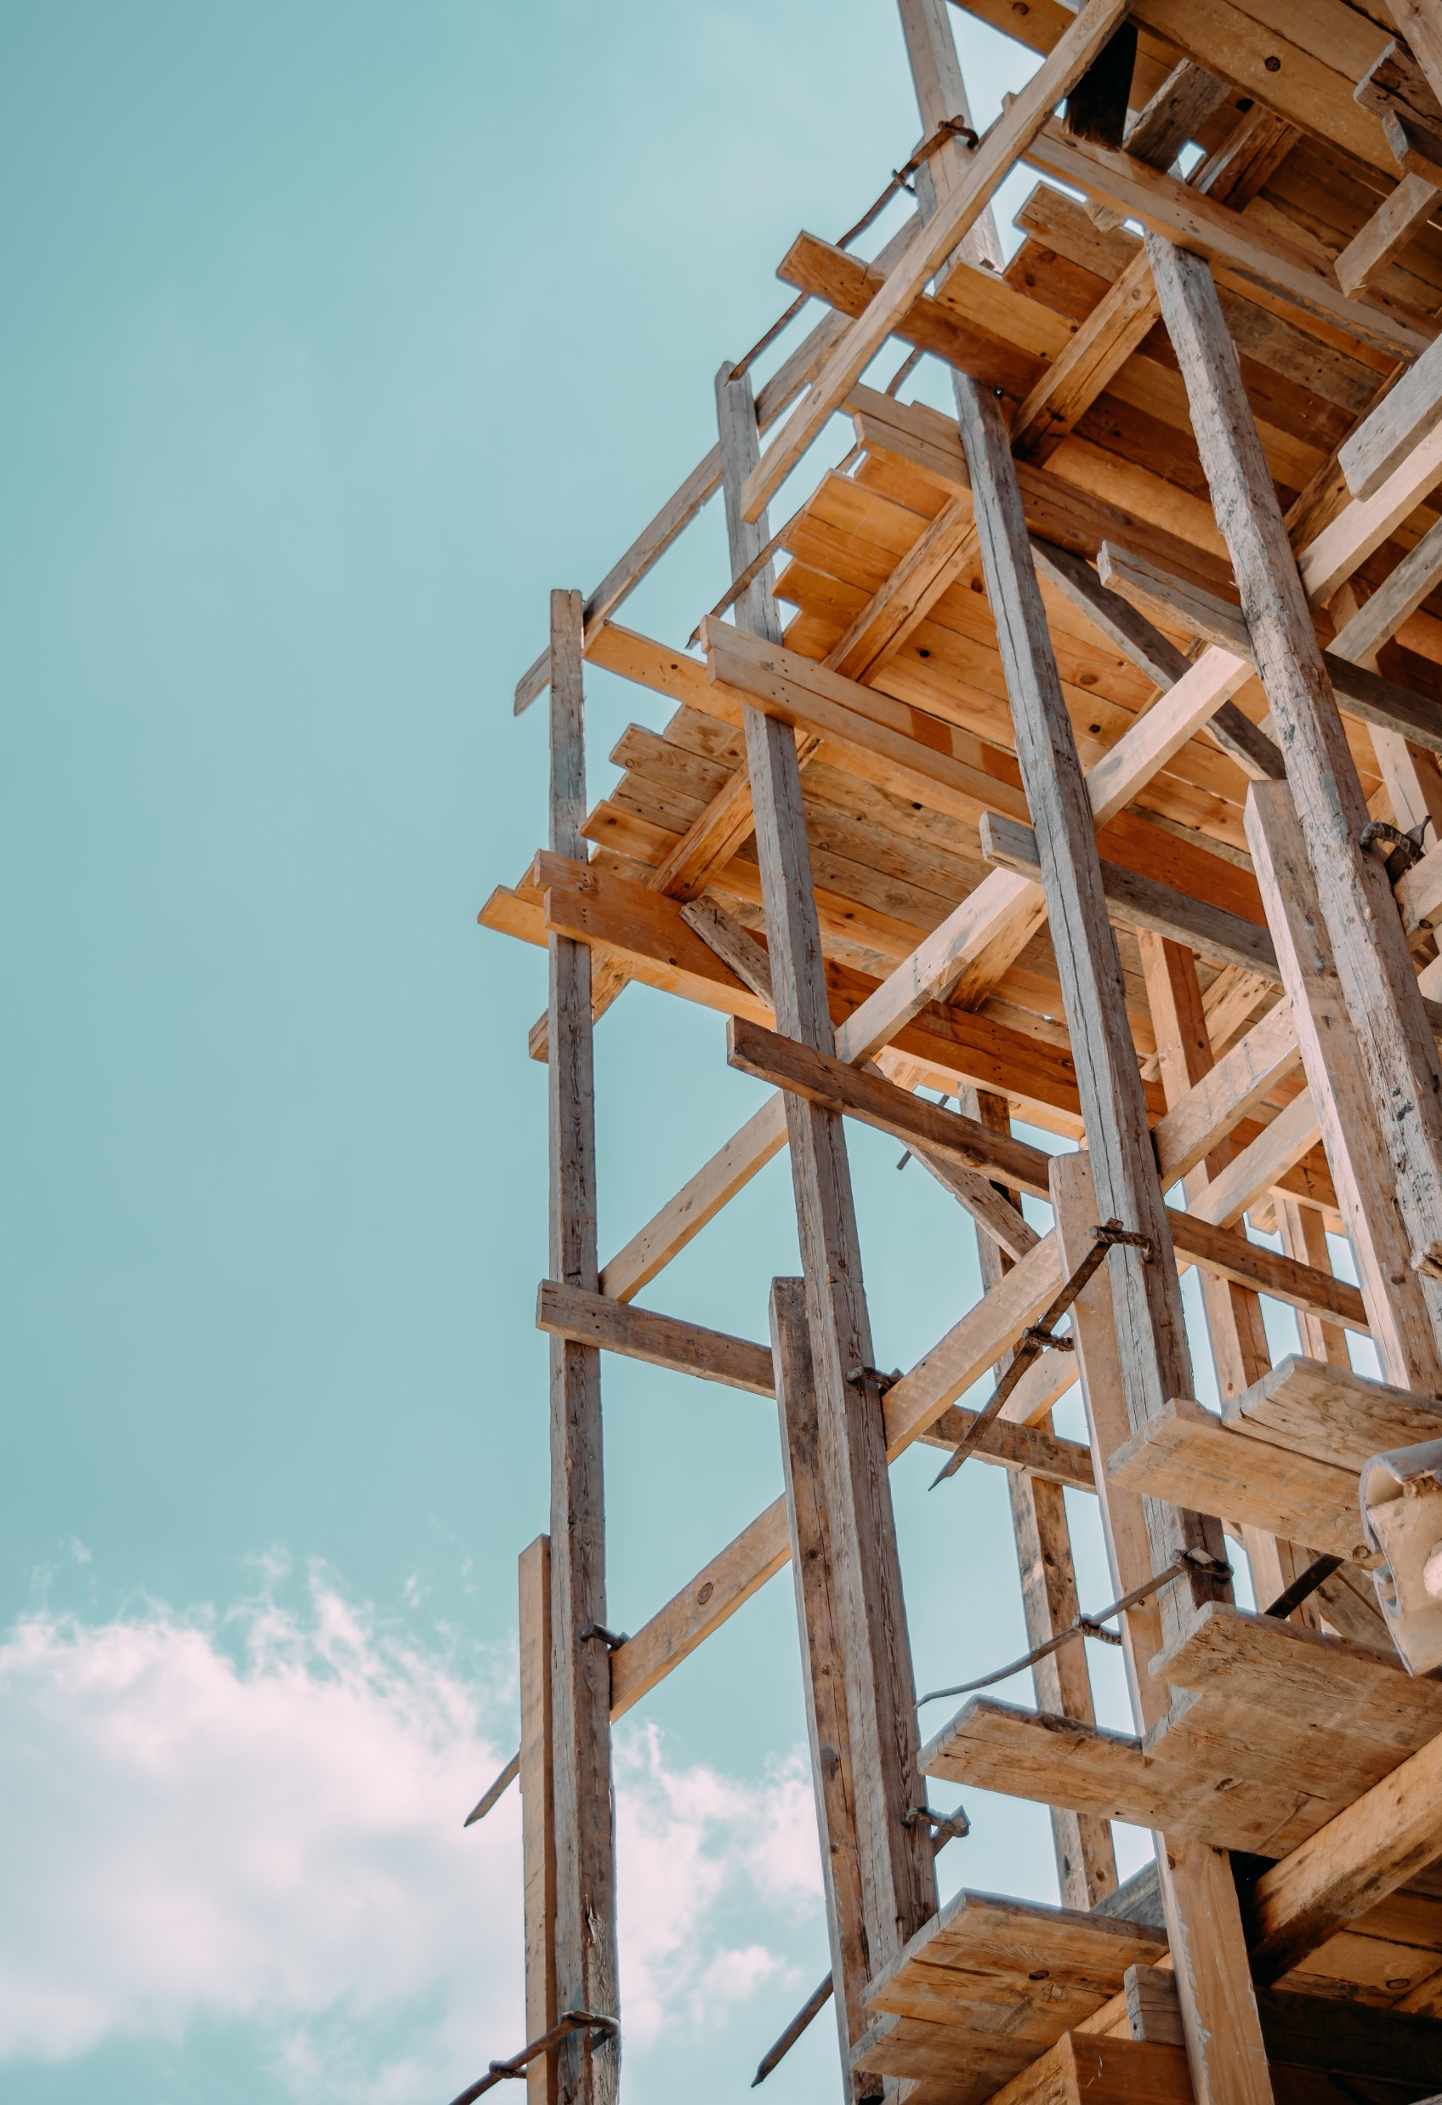

NSERC Alliance Grant Project ‘NEXT-GENERATION WOOD CONSTRUCTION’
T1-1A: Seismic performance assessment of balloon mass timber walls
A CWCRN Initiative
Approaches for modeling base in the mass timber balloon-type walls
Amir Ghahremani Baghmisheh
PhD Candidate
UBC

Slide 2
Objectives
1. Assess the seismic performance of balloon-type CLT wall systems.
2. Develop a full-scale testing program for hold-downs and walls to evaluate the connection and system behavior of balloon walls.
3. Determine force modification factors, namely Rd and Ro, and height limits for the balloon wall system to enable future implementation in the National Building Code of Canada (NBCC).
4. Develop a design guideline for balloon wall systems subjected to lateral loads, intended for future implementation in CSA O86.

Slide 3
Methodology
Phase 1: Develop numerical models and design archetypes
Phase 2: Develop full-scale testing program on high-capacity hold downs
Phase 3: Develop full-scale testing program on balloon wall systems
Phase 4: Quantify seismic performance of archetypes using CCMC/NRC and FEMA P-695 procedure
Phase 5: Develop design guideline for hold down connections and balloon wall systems

Slide 4
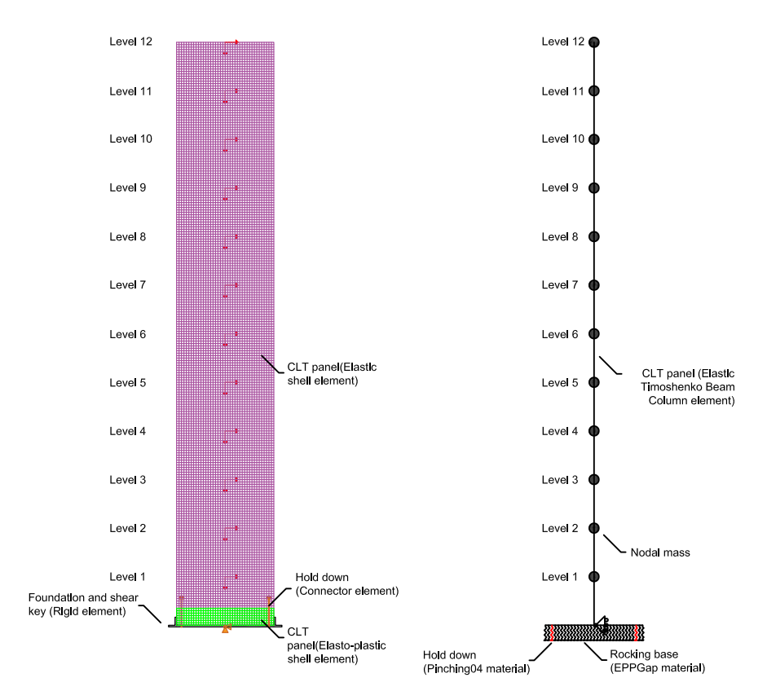
Phase 1
Develop robust detailed and simplified model of single wall:
CLT layers | 5-ply | 7-ply | 9-ply
E1 (MPa) | 7020 | 6686 | 6500
E2 (MPa) | 5400 | 5143 | 5000
E3 (MPa) | 234 | 223 | 217
G12 (MPa) | 438.8 | 417.9 | 406.3
G13 (MPa) | 438.8 | 417.9 | 406.3
G23 (MPa) | 43.9 | 41.8 | 40.6
Fc (MPa) | 25.3 | 24.1 | 23.4

Slide 5
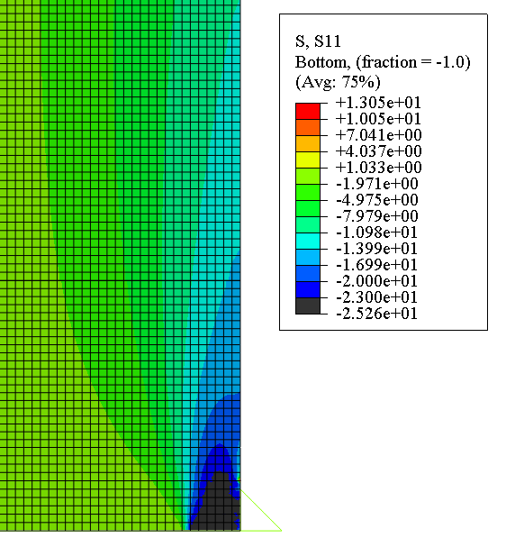
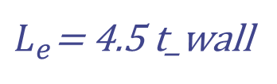
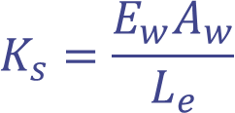
Refined and simplified Models
Calibrating Simplified Model
$$K_{s}=\frac{E_{w}A_{w}}{L_{e}}$$
$L_{e}$= 4.5 t_wall
Notes:
Calibrated Lp=4.5 t

Slide 6
Parametric study
Evaluate effects of various parameters on the local and global response by pushover analyses
Effects of wall aspect ratio
Effects of axial load
Effects of wall thickness
Effects of hold down strength and stiffness

Slide 7
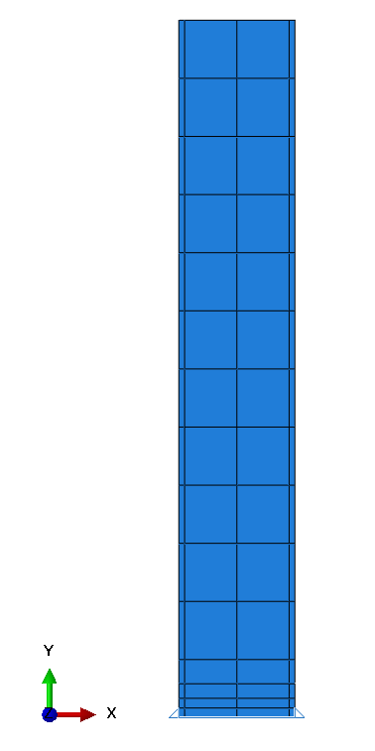
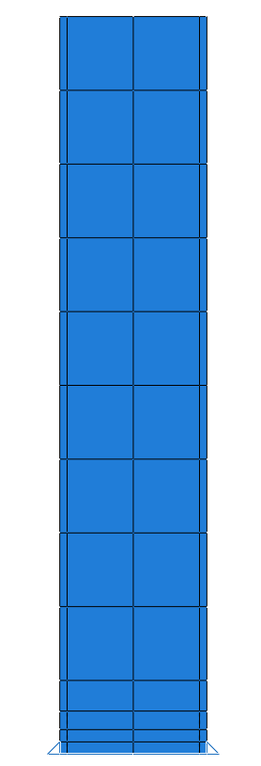
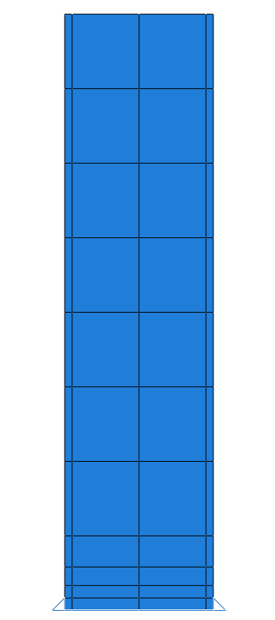
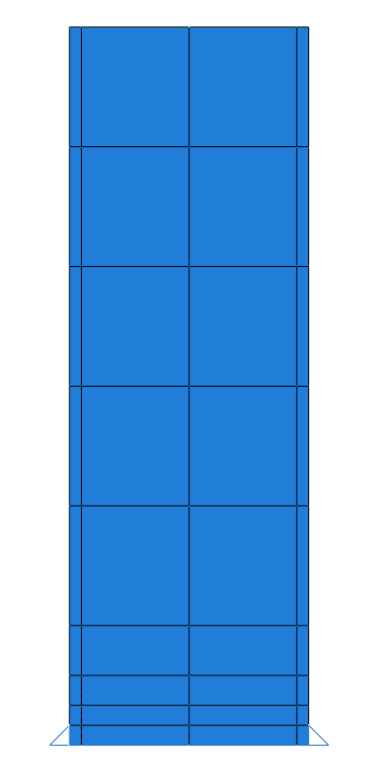
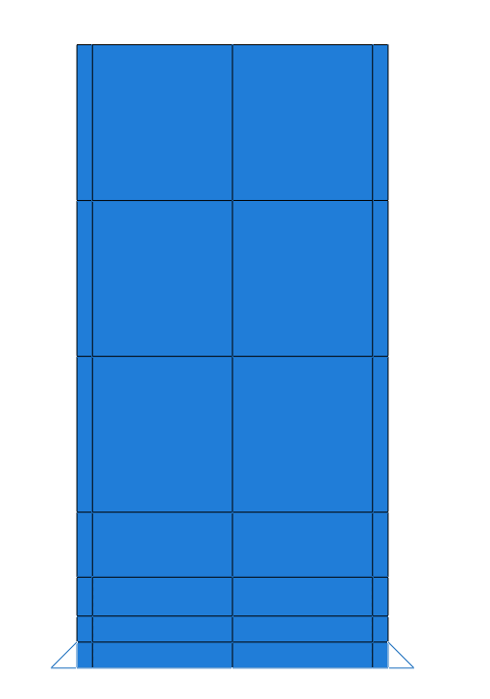
Effects of wall aspect ratio
Aspect ratio: 6
Aspect ratio: 5
Aspect ratio: 4
Aspect ratio: 3
36 m
Aspect ratio: 2
30 m
24 m
18 m
12 m

Slide 8
Effects of wall aspect ratio
3 m wall
6 m wall
Constants: CLT thickness, axial load, hold down strength and stiffness

Slide 9
Effects of axial load
Without axial load: Self-weight of CLT
With axial load: Self-weight of CLT + 2.8 kPa (Dead load) x 8 (Tributary width)
Constants: CLT thickness: 9ply, Aspect ratio: 6, hold down strength and stiffness

Slide 10
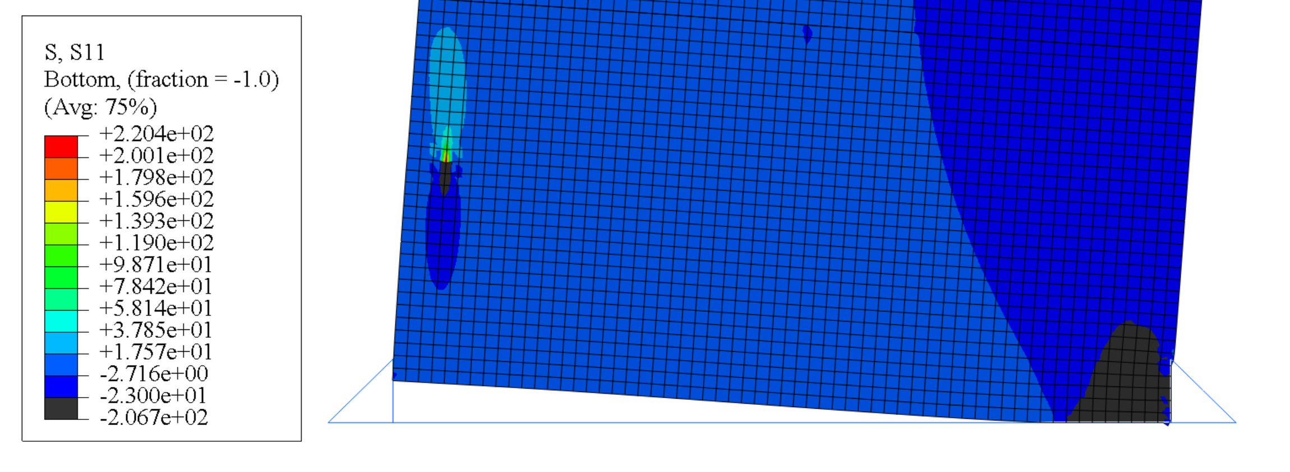
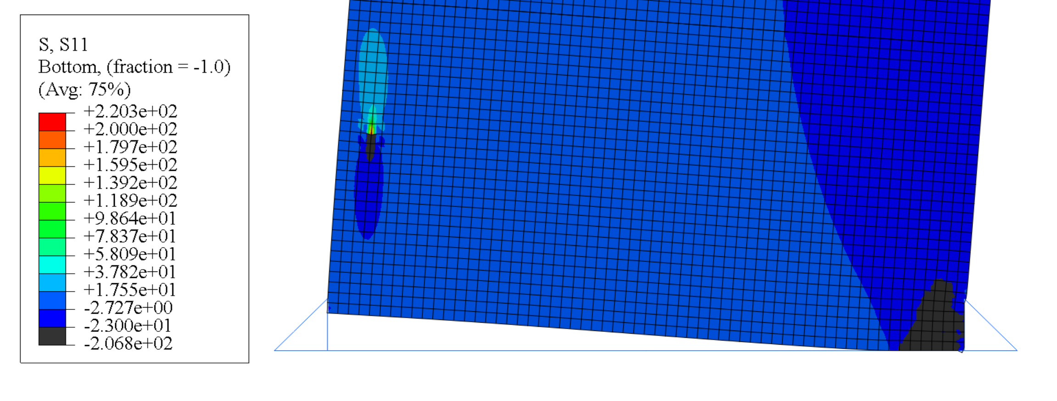
Effects of axial load
Comparing ABAQUS models with and without axial load
With gravity
850 mm
Without gravity
Lp = 700 mm
Vertical stress distribution at 2.5% roof drift

Slide 11
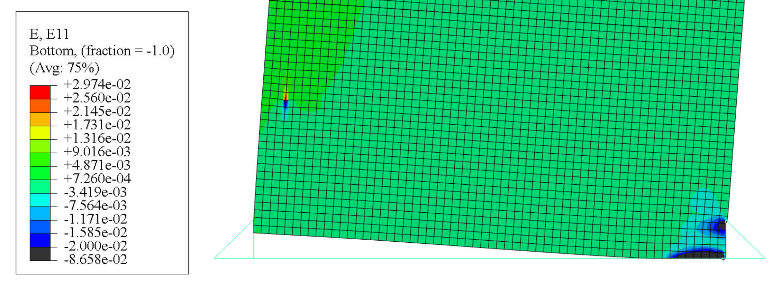
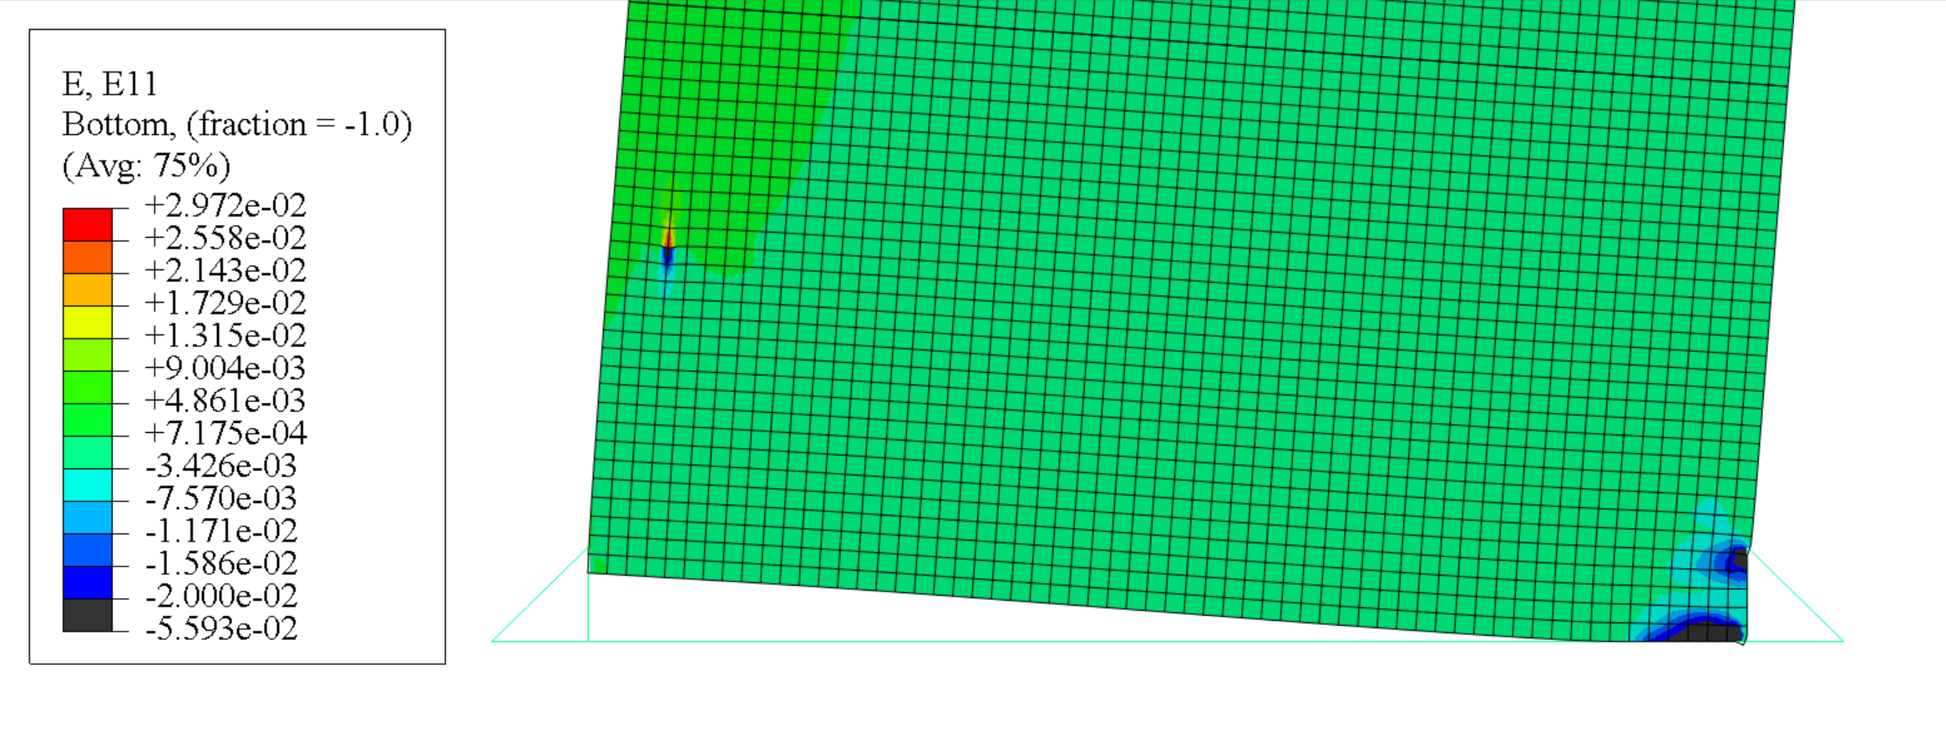
Effects of axial load (gravity)
Comparing ABAQUS models with and without axial force (gravity)
With gravity
Without gravity
Vertical strain distribution at 2.5% roof drift

Slide 12
Effects of wall thickness
Wall thickness: 5 ply, 7 ply, and 9 ply
Constants: Aspect ratio: 6, Axial load: Self-weight, hold down strength and stiffness

Slide 13
Effects of hold down strength
Constants: Aspect ratio: 6, CLT thickness: 9ply, axial load: Self-weight

Slide 14
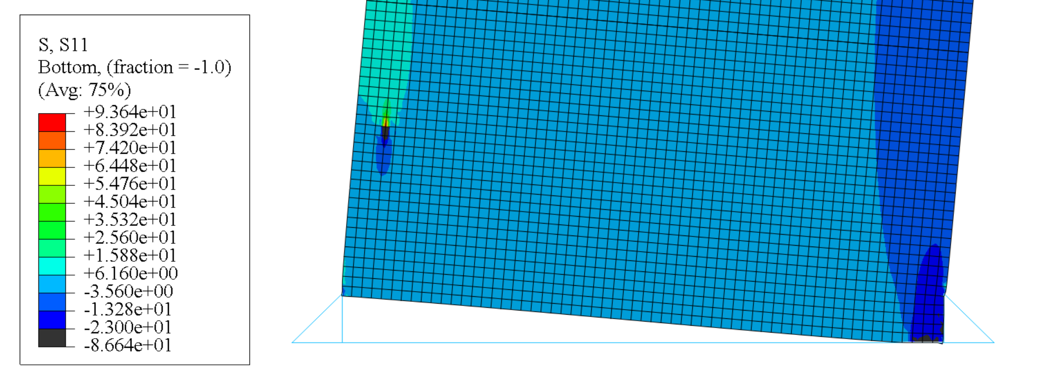
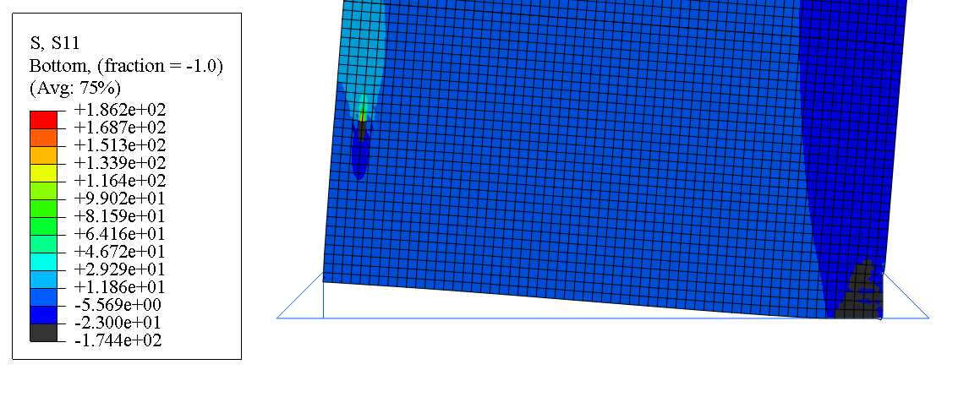
Effects of hold down strength
Vertical stress distribution for different hold down yield strength
250 mm
650 mm
Lc = 350 mm = 0.06 L
Lc = 600 mm = 0.1 L
Fy = 2000 kN
Fy = 4000 kN
Vertical stress distribution at hold down failure instant

Slide 15
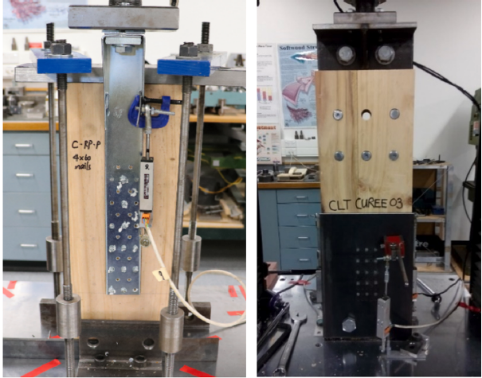
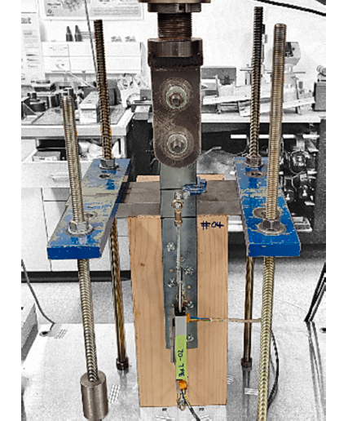
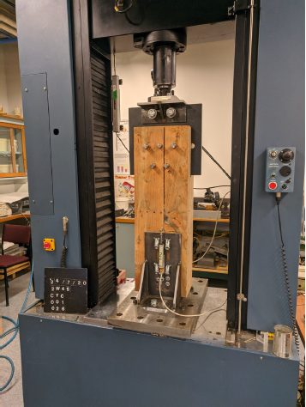
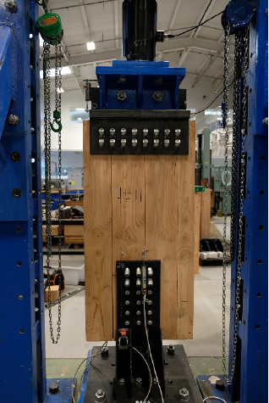
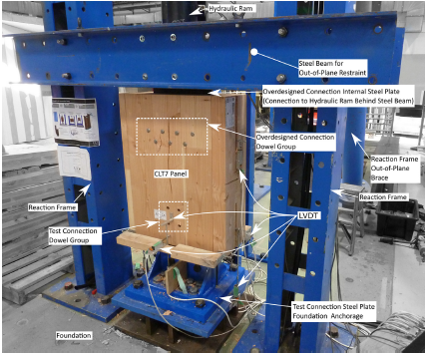
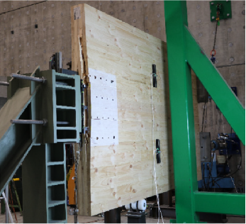
Phase 2: Hold down tests
Hold down connections with dowel-type fasteners
Nailed HD
Nailed HD
Mixed angle STS HD
(Dong et al. 2020)
(Krauss et al. 2023)
(Wright et al. 2023)
Mixed angle STS HD
Doweled HD
Doweled HD
(Wright et al. 2023)
(Brown and Li 2021)
(Ottenhaus et al. 2018)
Peak load = 1100 kN
Notes:
The test results revealed that the hold-downs reached their initial peak at a small displacement, corresponding to the capacity of inclined screws, followed by a drop due to the withdrawal of inclined screws. A second peak was observed at a larger displacement, where 90-degree screws reached their capacity.
The combination of inclined and 90-degree screws was found to provide relatively high stiffness and relatively high ductility
Doweled HD can also reach high capacity. a drawback of dowelled hold-downs is the significant crushing within the timber member, which can be challenging to repair after a major earthquake.

Slide 16
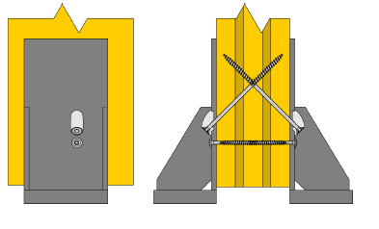
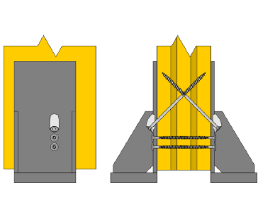
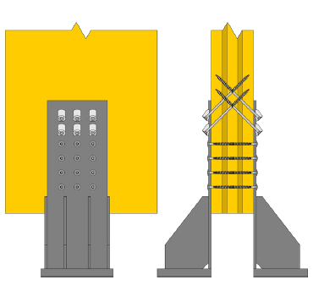
Phase 2: Hold down tests
Full-scale testing of medium-capacity and high-capacity hold downs
Test Objectives:
Develop test database on HD
Characterize strength, stiffness, ductility and energy dissipation of HDs
Develop strength and stiffness perdition equations
Identify accuracy of prediction equation for larger HDs (group effect)
Identify capacity protection factor
Wright et al. (2021)
Notes:
HDs must be carefully detailed to provide sufficient strength, stiffness, ductility and deformation capacity so that CLT shear walls meet the performance criteria under major earthquakes.
identify the optimal combination of 90-degree and inclined screws that ensures a smooth transition in the backbone curve of the hold down.
Current equations use European Yield Models strength predictions are sometimes not accurate, especially for the peak strengths.
Current connection stiffness predictions equations in the design standard are not accurate.
Capacity protection factor are needed for capacity design of timber shear wall structures.

Slide 17
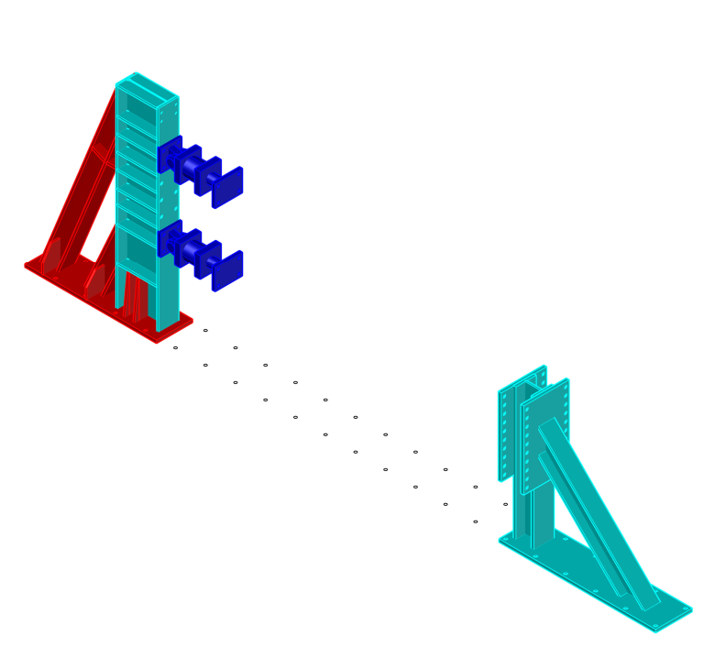
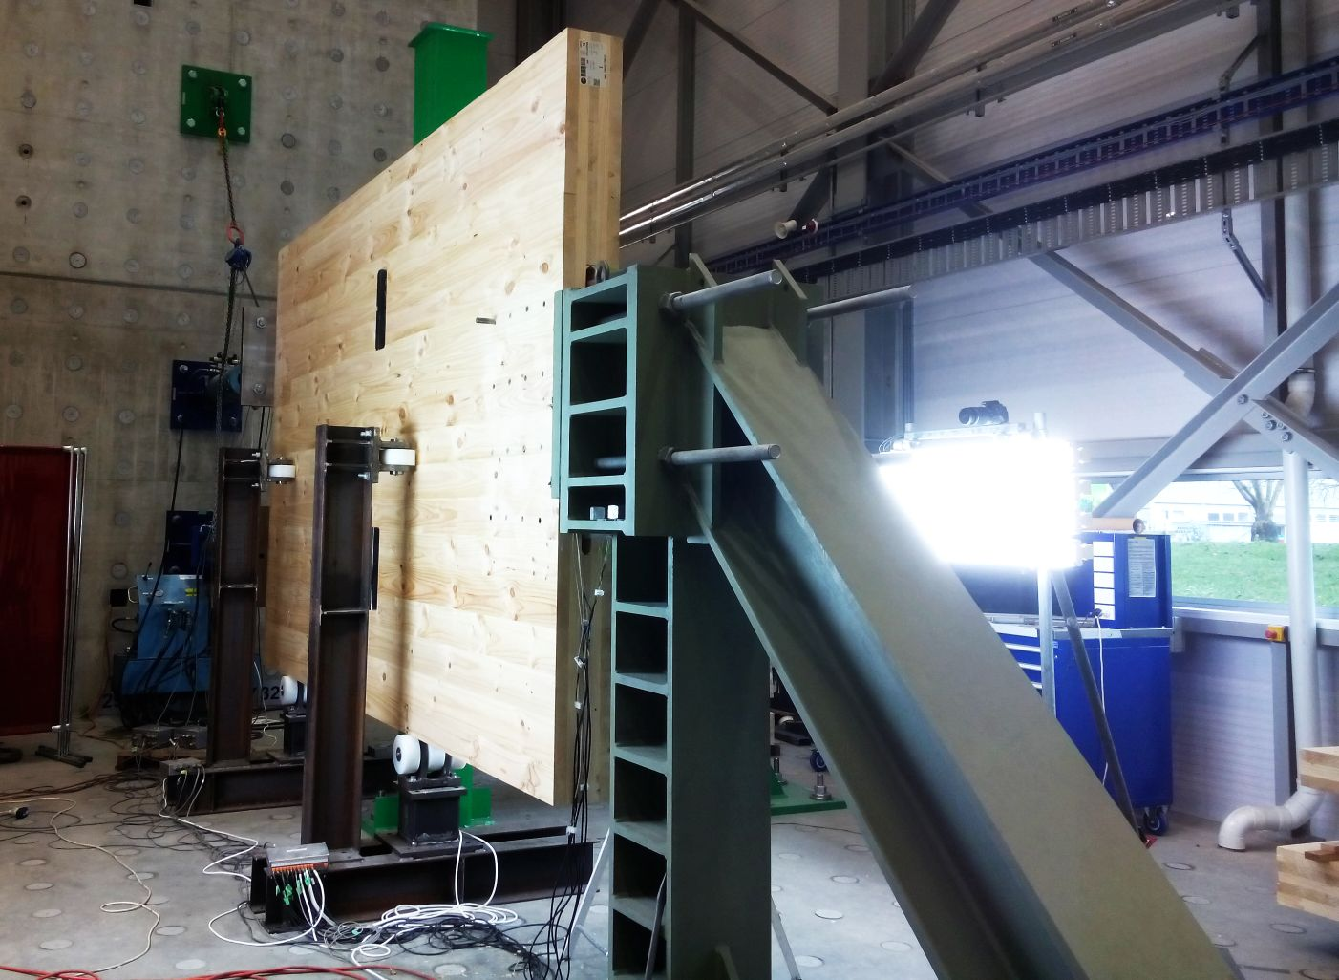
Phase 2: Hold down tests
Setup preparation for medium-capacity and high-capacity hold down tests (In Progress)
1000 kN
1000 kN
Wright et al. (2021)
Connection Peak load: 1100 kN

Slide 18
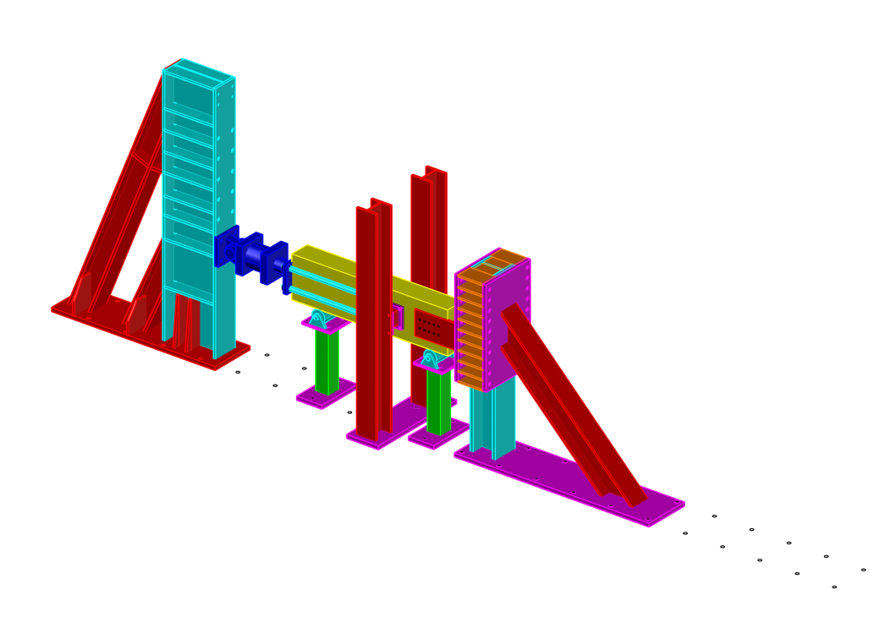
Phase 2: Hold down tests
Setup preparation for medium-capacity and high-capacity hold down tests (In Progress)

Slide 19
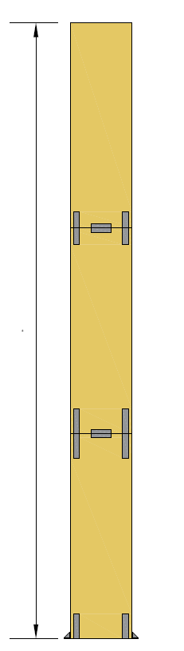
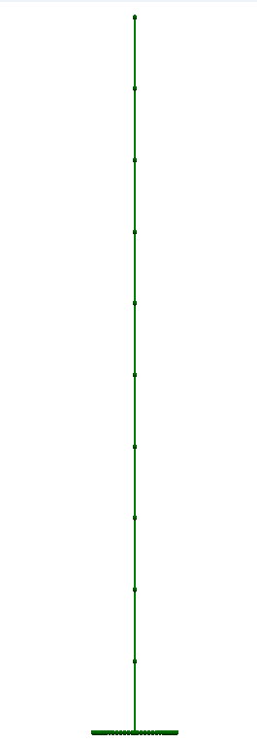
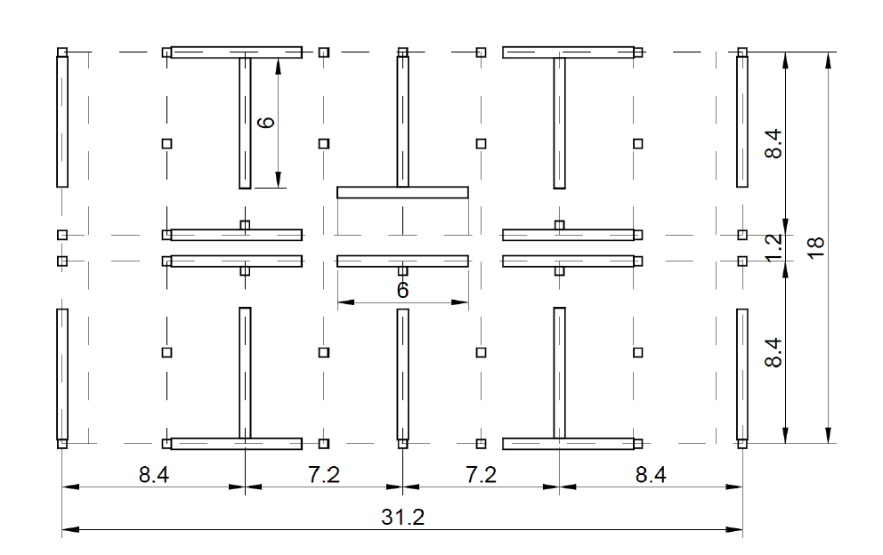
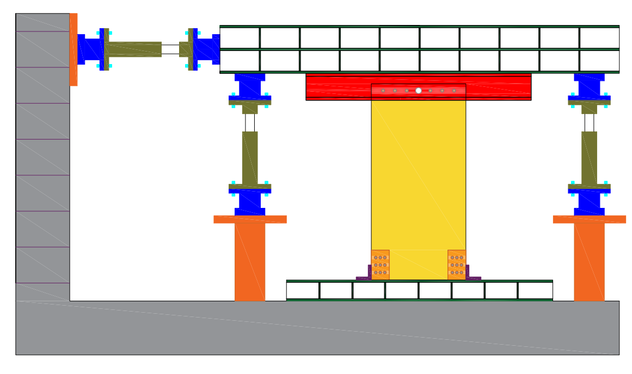
Phase 3: Develop full scale testing of balloon walls
Hybrid simulation
Notes:
Hybrid simulation is an experimental testing methodology that is beneficial to study behaviour of systems that cannot be fully tested due to cost and laboratory constraints.
Since the damage and energy dissipation of single balloon walls primarily occur at the base of the wall, the first story of the wall will be constructed in the laboratory. The remaining sub-assembly will be virtually modeled on the computer.
A specialized test setup will be designed and developed, as shown here, to simulate the boundary conditions of the wall where the experimental and numerical sub-assemblies intersect.
A control algorithm will be employed to control the horizontal and vertical actuators to impose the translational and rotational displacement at the intersection of two assemblies. The force feedback at each step of the test will be continuously transmitted to the computer to update the response of the numerical model and calculate the displacements for the subsequent step.

Slide 20
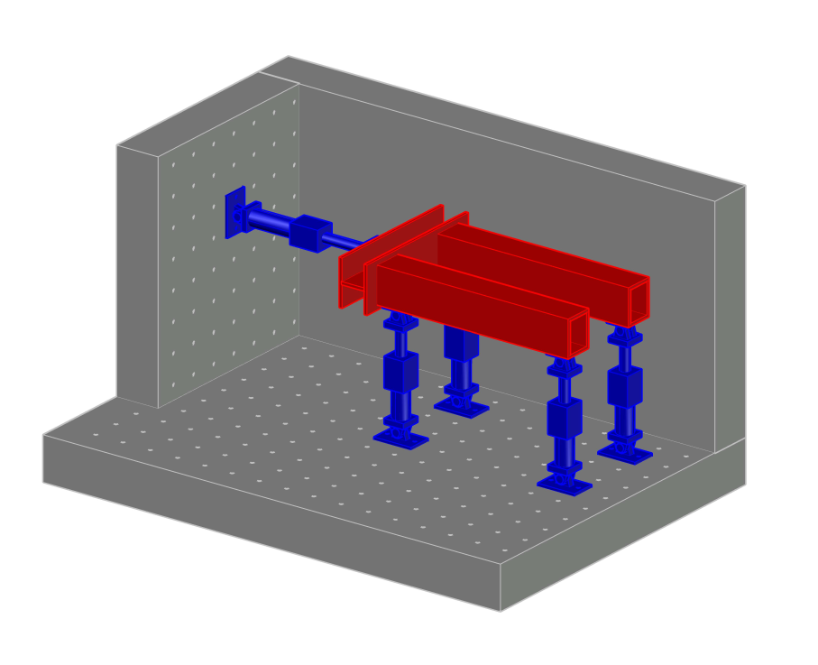
Phase 3: Develop full scale testing of balloon walls

Slide 21
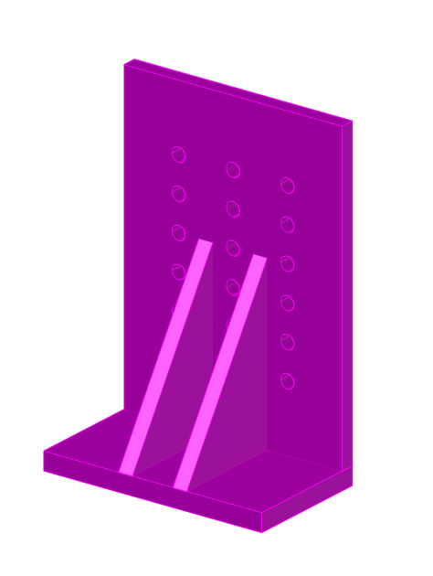
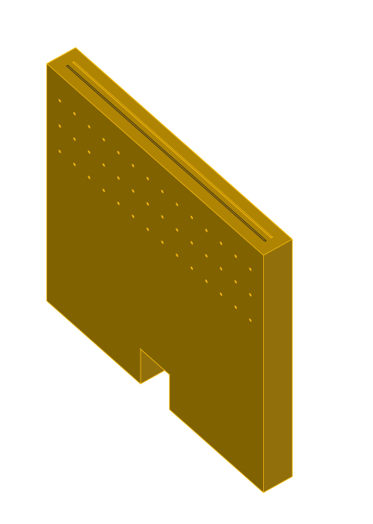
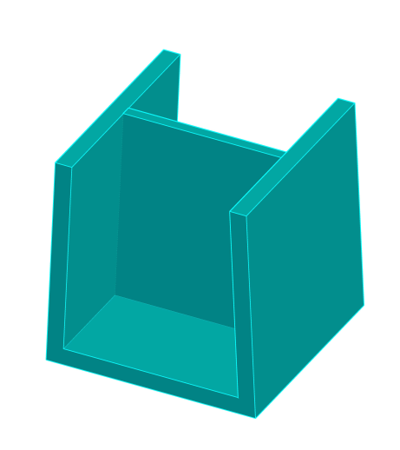
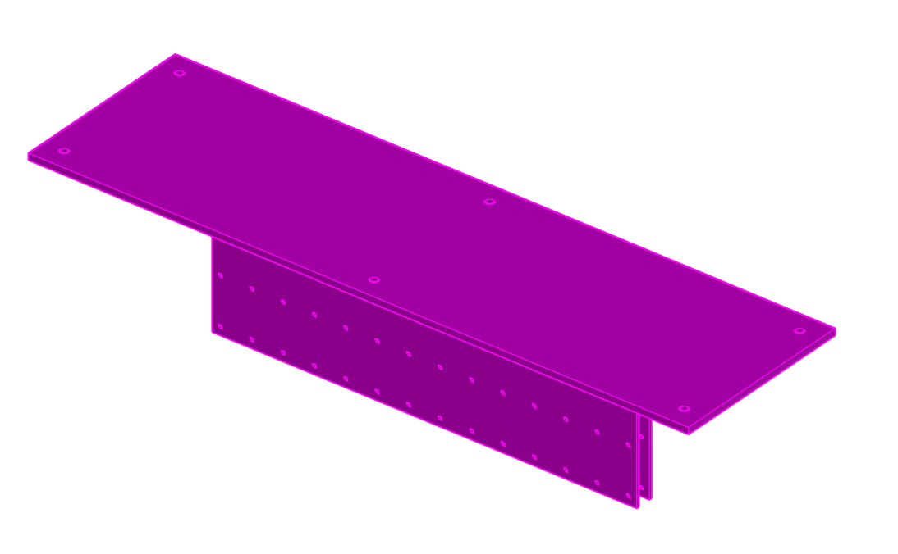
Phase 3: Develop full scale testing of balloon walls

Slide 22
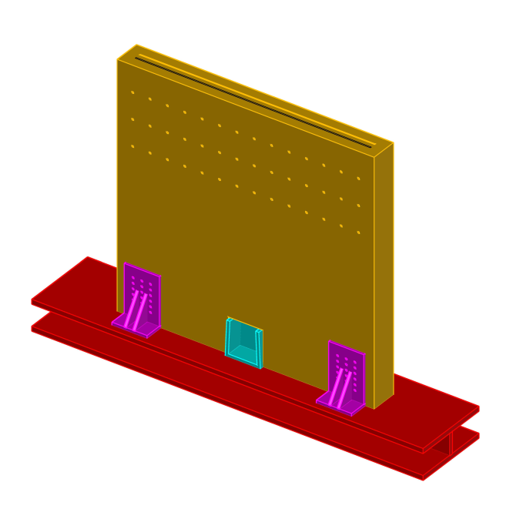
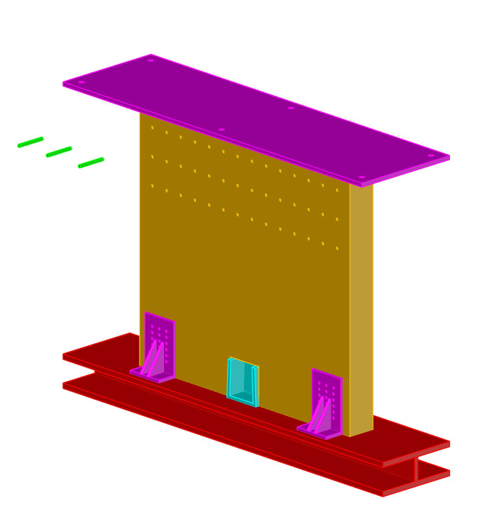
Phase 3: Develop full scale testing of balloon walls

Slide 23
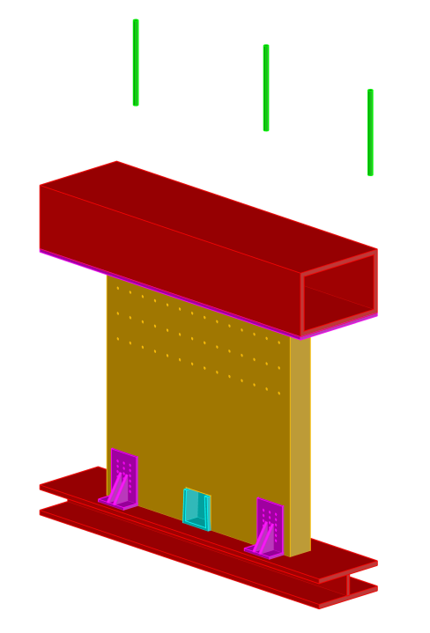
Phase 3: Develop full scale testing of balloon walls

Slide 24
Summary
A verified simplified modelling procedure for single CLT balloon-type wall is developed for the upcoming NLTHA
A proper base model is paramount for the accuracy of simplified models
Effects of various parameters on the global and local response of single CLT balloon-type walls is investigated
Aspect ratio and hold down strength have the most significant effects on the global and local responses

Slide 25
Thank you
Contact:
Amir Ghahremani Baghmisheh
amirghb@mail.ubc.ca
+1 (236) 869-2459

