Slide 1

BC Code Changes
Experience with Mass Timber
Andrew Harmsworth, M Eng, P Eng, PE, CP, FEC
Email: ah@ghl.ca
Web: www.ghl.ca

Slide 2

Andrew Harmsworth, M Eng, P Eng, PE, CP, FEC
Founding Principal, GHL Consultants Ltd Email: ah@ghl.ca
BASc, Queen’s University at Kingston, Civil Engineering
M Eng, UBC’s short lived Fire Science program
Standing Committee – Fire Protection of Codes Canada
GHL – over 30 years in Equivalencies and Alternative Solutions
2

Slide 3
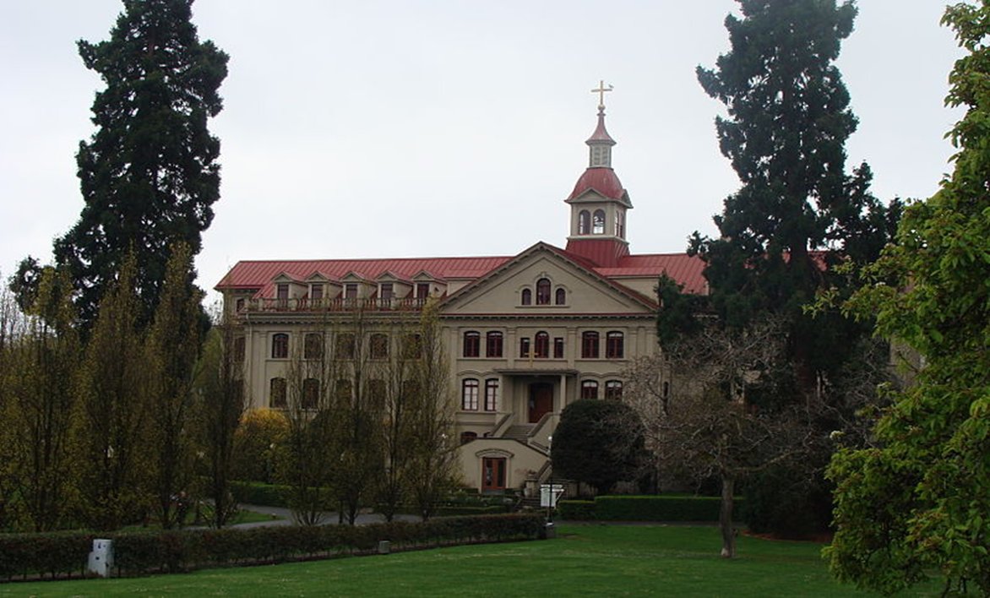
Construction Type - 1900
St Ann’s Academy
6 Storey Wood Frame
Convent
TB Treatment Facility and other health care uses
Notes:
During my late teens surveyed 6 storey St Ann’s Academy in Victoria, 6 storey from 1905, would shake under my footsteps on the 6th floor.

Slide 4
WOOD – My Journey
Early work renovating old light frame
Heavy timber buildings
British Columbia study 6 storey wood frame – Provincial Study and BC Code Change 2009

Slide 5
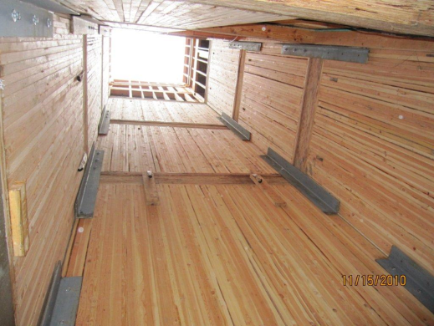
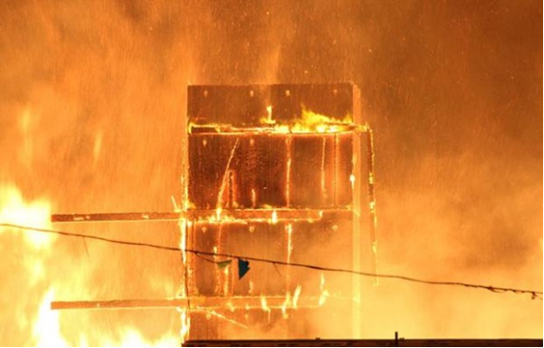
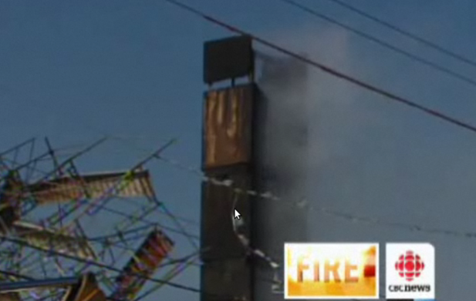
And then there was a fire
Evidence from Remy Fire – Richmond:
Mass timber (Nail Laminated 2x6) before, during and after the fire.
Unprotected steel connections.
Mass Timber can withstand construction fires
Notes:
First 6 storey building in BC – demonstrated the robustness of Mass Timber as NLT elevator shafts survived the full burnout, unprotected steel connectors.

Slide 6
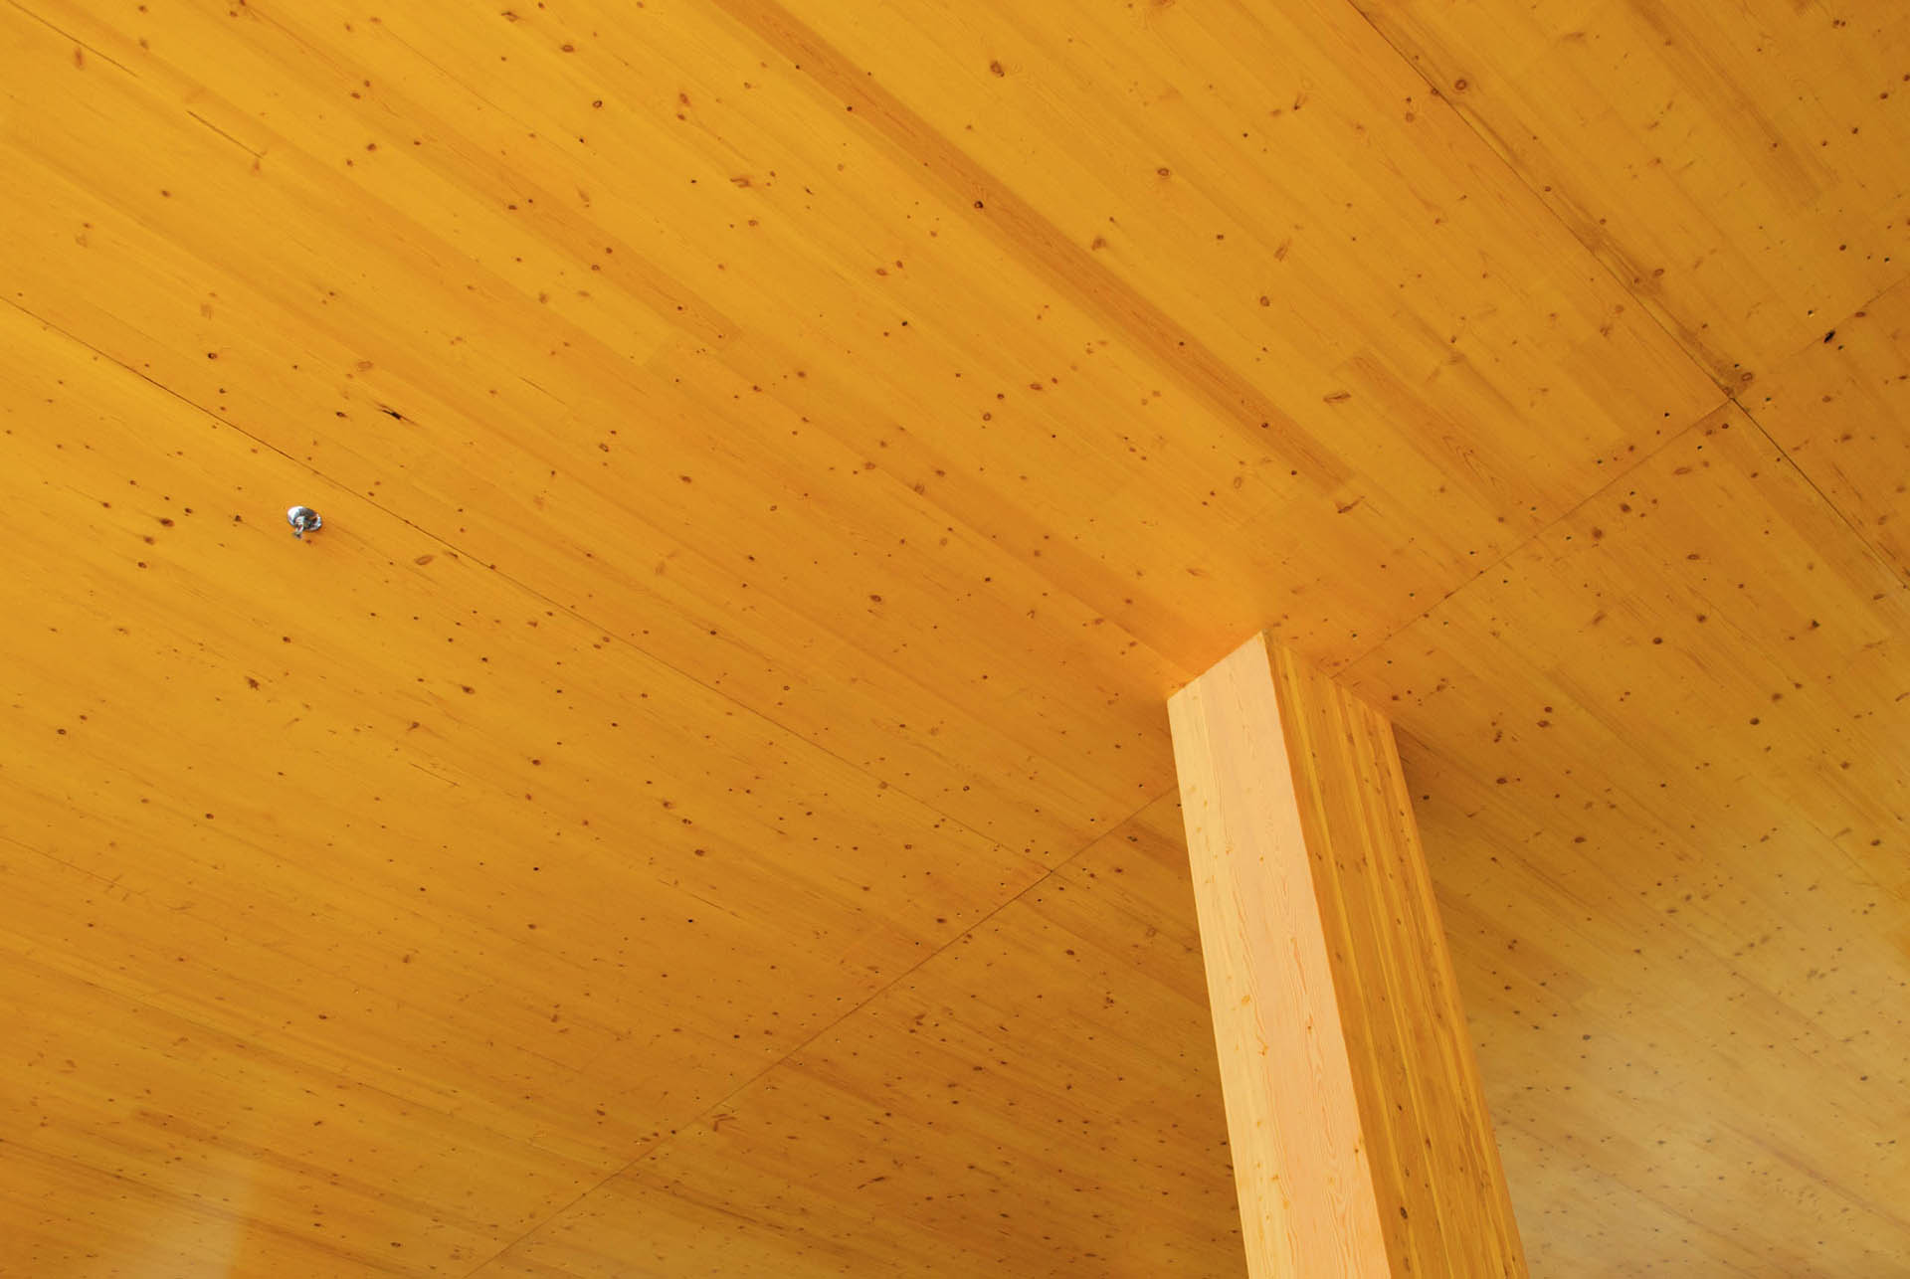
ITS HAPPENING
Notes:
Current GHL Mass Timber projects

Slide 7
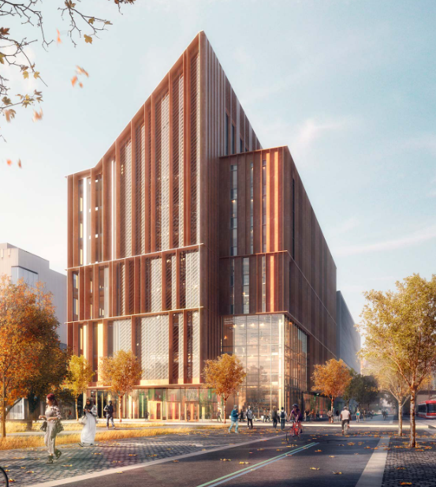
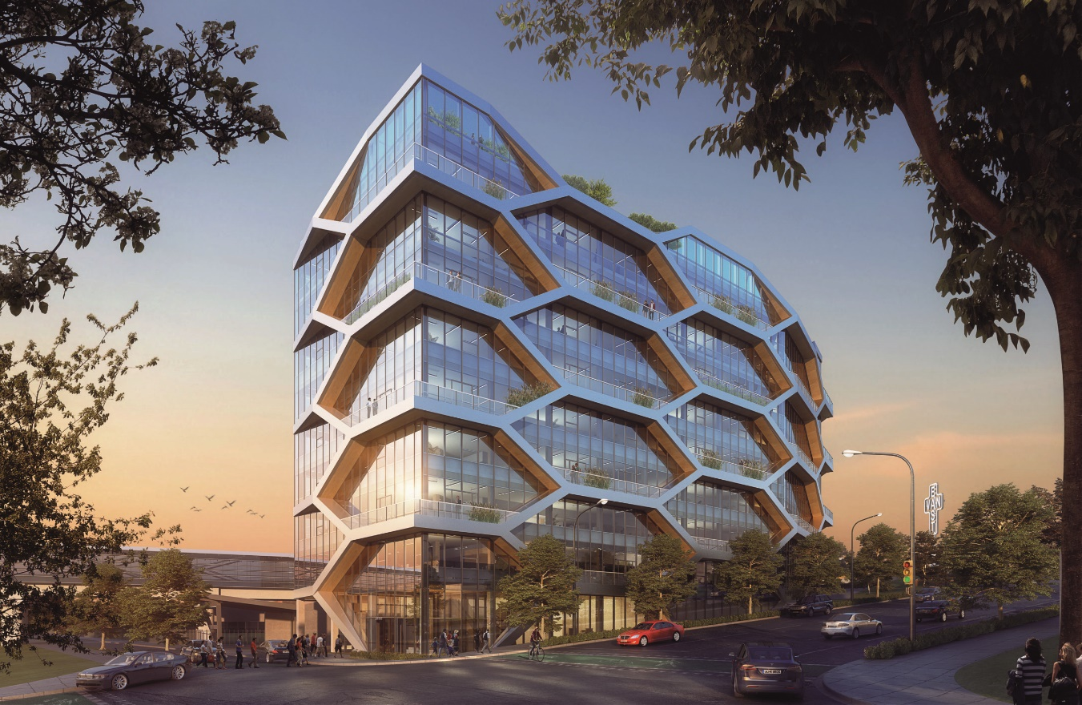
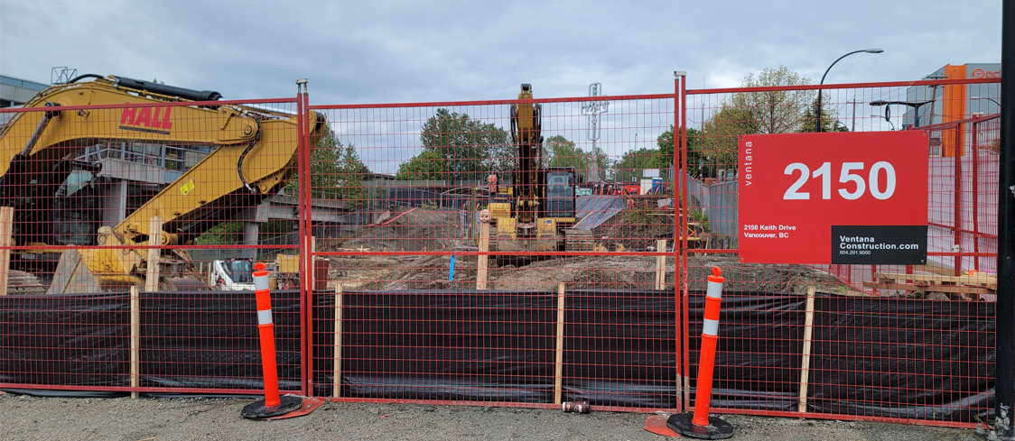
Approved and Under Construction
The Arbour, George Brown College, Toronto
Moriyama & Teshima Architects + Acton Ostry Architects
1250 Keith Drive, Vancouver
Dialog, Bentall Green, Under Construction

Slide 8
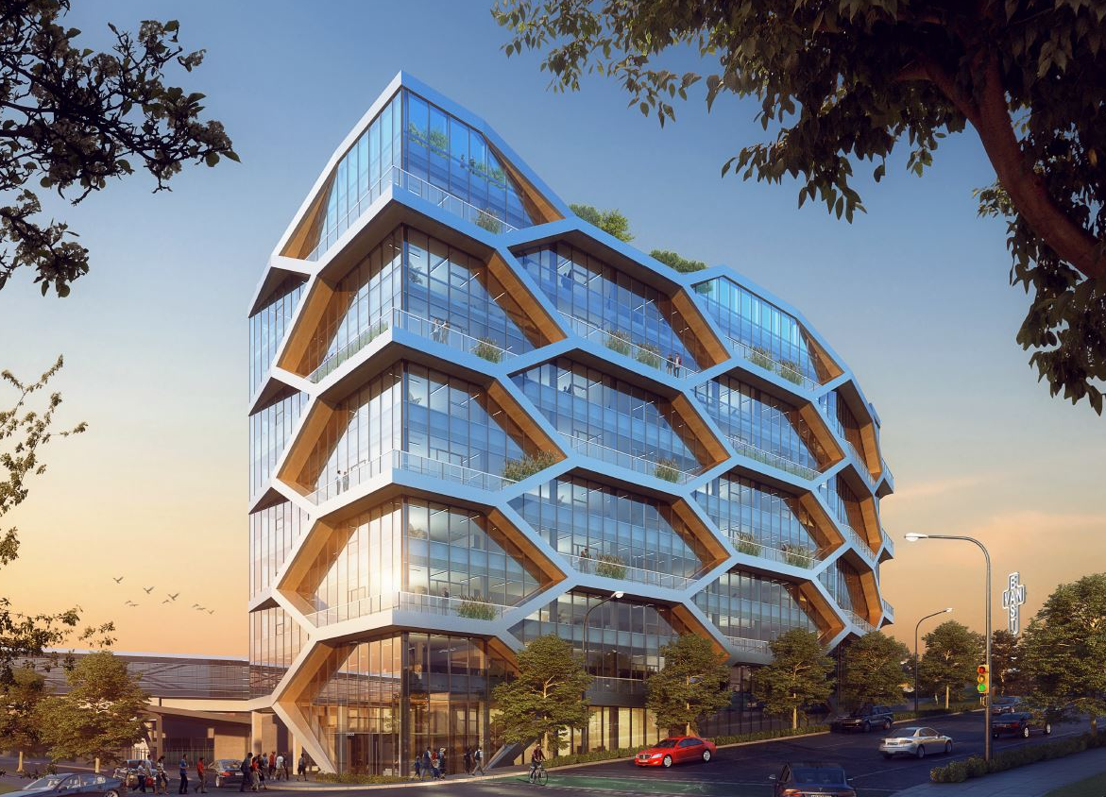
2150 Keith Drive
Dialog and Fast+Epp
Bentall Green Oak
Fully Exposed
10 storeys
Timber Lateral System
GC Wood Support

Slide 9
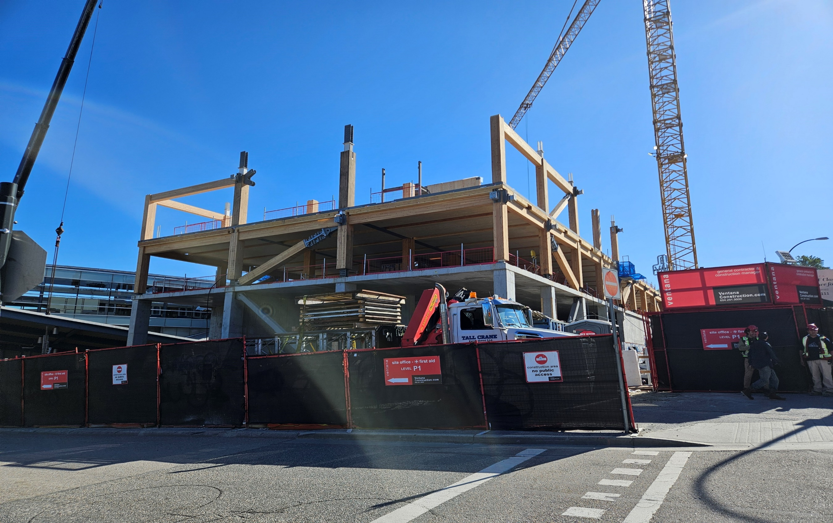
May 2024
Notes:
2150 Keith Drive, last week, timber on site after 3 year Covid delay.

Slide 10
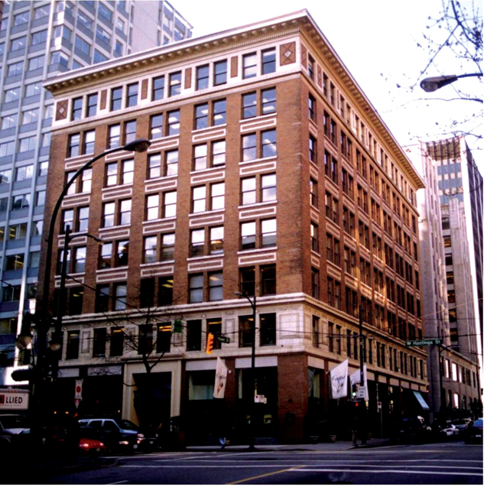
The Landing - Gastown
Constructed 1905
Upgraded ~ 1980
9 Storeys
2100m²
Keith Drive:
  10 Storeys
  1675m²
10
Notes:
Interestingly, 2150 Keith Drive is same size as The Landing, Gastown, known as home of Steamworks Pub.

Slide 11
BACKGROUND ON CODES-FIRE

Slide 12
Why Discuss Codes / Fire
Fire Concerns – Biggest Impediment to new materials and methods
Fire concerns, in my opinion, outdated
Alarms, Sprinklers, have reduced fire death rates to in my opinion ‘de-minimus’ levels
Statistics still bad due to old housing stock, SFD

Slide 13
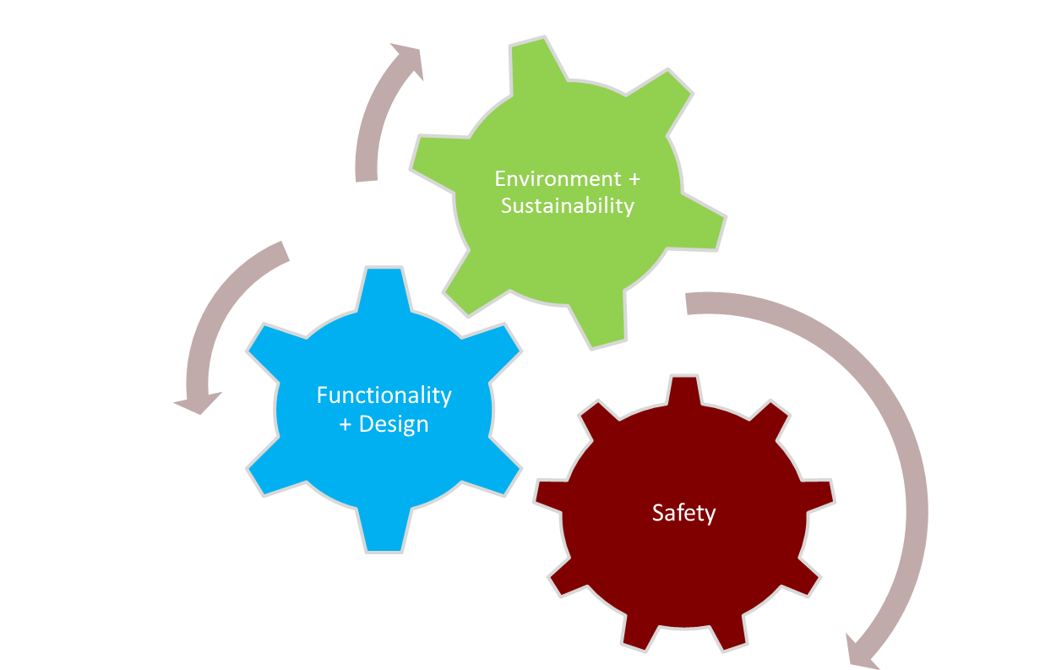
Why Codes?
To provide the public with consistent levels of safety acceptable to the public
So we do not have to do a safety check of every building we enter
Notes:
Important that Codes balance all concerns, fire safety, structural safety, affordability, carbon and liveability

Slide 14
Balance
Paul Fast raised this question yesterday
Do we need 1:2500 year probability for Seismic, or is 1:500 acceptable and better meet the needs of affordability and liveability
I believe it is time to ask the same question with Fire. Is the level of fire safety provided, appropriate, too low or higher than needed.

Slide 15
FIRE SAFETY
Improved safer buildings permit advanced construction methods

Slide 16
Brief History of Building Code
Hammurabi’s Code (1792 BC)
NBCC 1953
Recommended Building Code in US (1905)
A Building Code for Small Municipalities 1951
NBCC 1941
NBCC 2020
Great Chicago Fire (1871)
5 – Year Update Interval
Great London Fire (1666)
San Francisco Conflagration (1906)
Great Fire of Rome (64AD)
Great Baltimore Fire (1904)
National Building Code of Canada - NBCC
Notes:
Many Code provisions date back to early days, 2h designs, 2 exits, have they been re-considered.

Slide 17
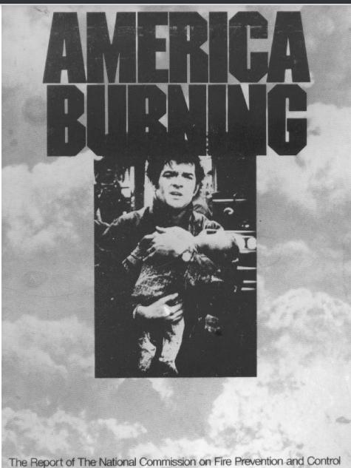
1970’s and before
Unacceptable level of fire deaths
1973 US Report
Maximum Allowable Residential Building Height – 3 storeys
No Mass Timber
Start of my awareness of the issue
Notes:
My life, 1970’s we clearly had an unacceptable fire death rate. Father (structural engineer) involved in several fatal fire investigations.

Slide 18
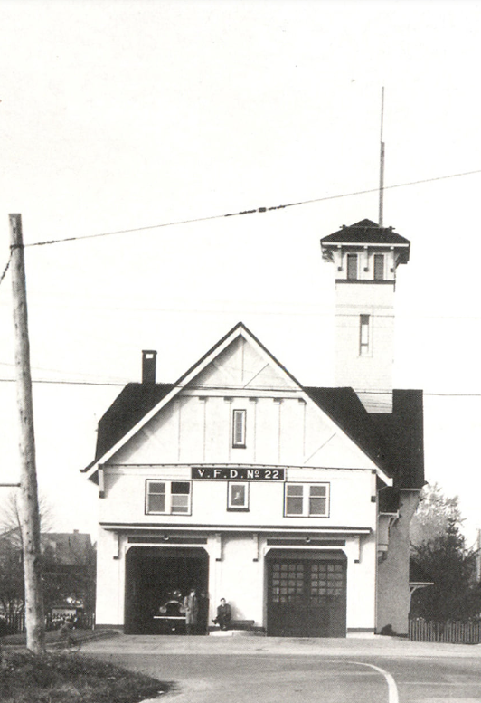
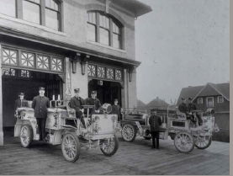
Response Times - 1920
1920 – Human detection could be delayed, not unreasonable to say 10 to 30 minutes if fire starts in an unoccupied room.
Fire often fully developed when Fire Department called.
Occupants notified by Fire Department.
Minimal sprinklers.(Coal furnace room)
Slow response, occupants may still be in building.

Slide 19
Fire Safety Measures Added since 1980
Fireblocking of cavities in frame construction
Smoke Alarms
Enhanced fire alarm systems
Sprinklers – to protect occupants outside the compartment of origins (slow response)
Better sprinklers – residential and fast response to protect occupants INSIDE the compartment of fire origin
Enhanced reliability via monitoring and supervision

Slide 20
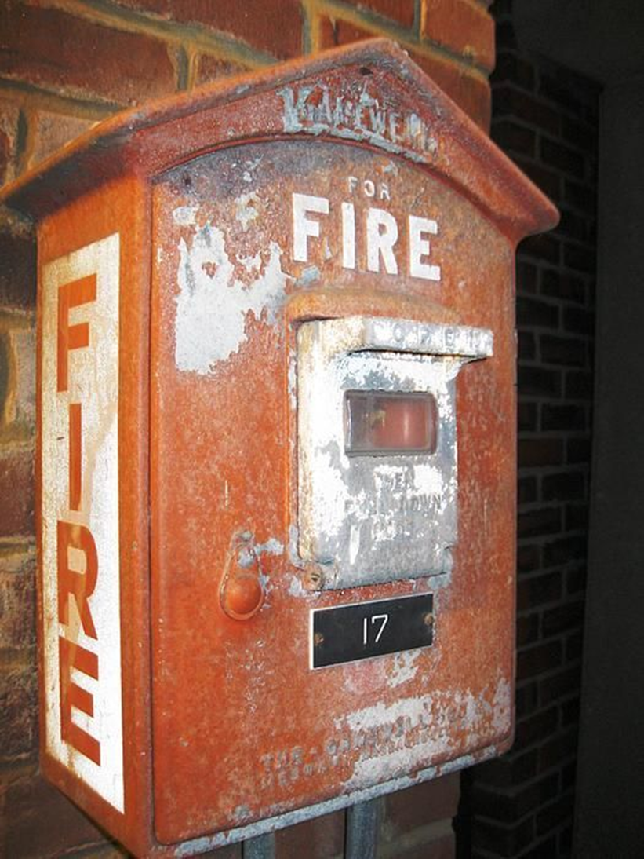
Perspective
Fire Detection 1920
Visual/Sensory Detection
Street Alarm Boxes
Occupant not in Room
of Fire Origin.
Wood aneling consumed
Sprinkler Detection and Call to Fire Department
Time (Min)
Notes:
1970’s fire could occur in the room below or beside you undetected, spread into the frame of the building leading to floors collapsing under occupants.
Today we have fire detectors – sprinklers – in every room, fire is detected before it threatens other rooms, if not controlled in room of origin.
Fire department is called within minutes of significant heat, sprinklers control fire until firefighters arrive.

Slide 21
Where are the fire deaths?
Majority of Fire Deaths in houses.
Majority of fire deaths in multifamily buildings – older buildings not updated
  Mostly 3 and 4 storey frame with no fire-blocking or fire alarms.
Modern sprinklered buildings have VERY low fire Death Rates.
Tendency of Codes to try to resolve problems with older buildings with new measures on NEW buildings.

Slide 22
My Opinion
1970’s we had a huge problem with fire
We compensated by piling on good ideas
  Fire blocking
  Fire Alarms
  Sprinklers
  Betters Sprinklers – residential and QR
  Supervised and Monitored Sprinkler Systems

Slide 23
We have increased the level of safety beyond that needed.
  Sprinkler reliability in conjunction with fire department response much higher than reported by NFPA.
  Near zero fire deaths beyond room of origin in sprinklered buildings
Consequently,
Some recent improvements have no measurable impact on life safety
  Smoke dampers in residential buildings ($200 000/building)
    In my opinion miniscule life safety value in sprinklered buildings
  Additional firestopping in sprinklered buildings
It is time to re-assess the decisions of the Early Codes (1905/1941)
  Consideration of what we need in modern buildings to achieve the required or de-minimus risk lev
  However, we also need to encourage upgrading of the Old housing stock pre-1980
Research Suggestion - Have we achieved De-Minimus Risk?
Notes:
We need professionally gathered and analysed statistics showing the Canadian experience with sprinklers. For modern sprinklered buildings adding more fire safety measures does not measurably increase safety. HOWEVER

Slide 24
Point Access Blocks
New concept being considered for both BC and National Codes
Forces questioning need for 1905 recommendations in US for minimum 2 exits.
However, with modern sprinklers, fire-blocking and smoke alarms, perhaps we have increased the level of safety sufficiently that we can make these work.

Slide 25
BC CODE CHANGES

Slide 26
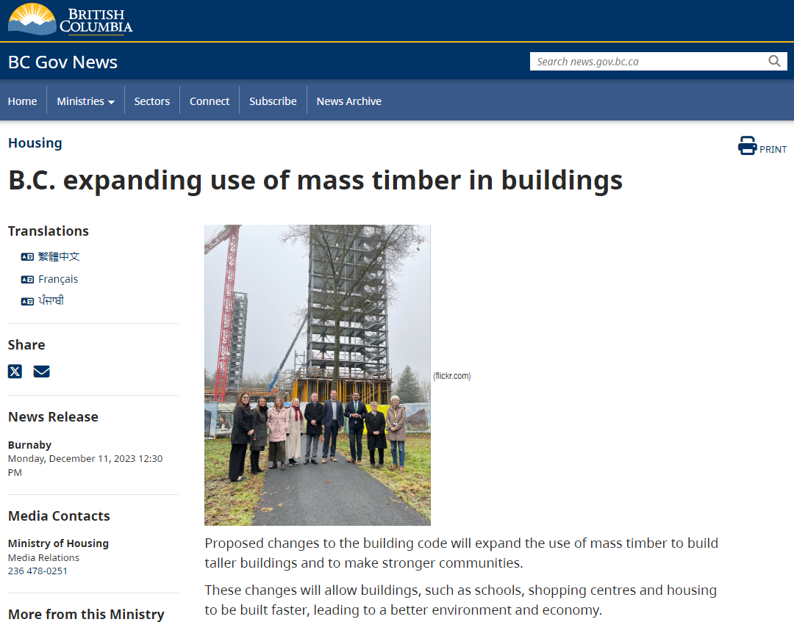
26
Notes:
BC Code Changes enacted March 2024 – being forwarded to Canadian Board for Harmonization of Building and Fire Codes for 2030 Code

Slide 27
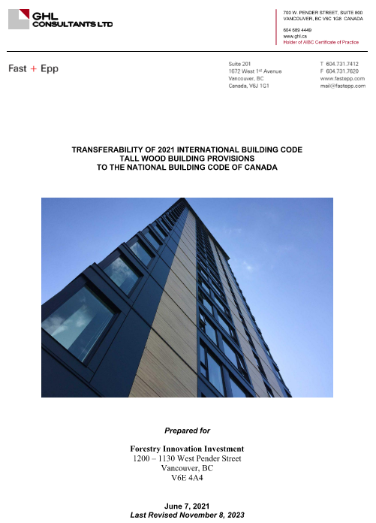
GHL & Fast+Epp Transferability Report 2021
GHL & Fast+Epp Transferability Report 2021
Compared US International Building Code provisions
for MT to Canadian
2023 – Peer Reviewed – Keith Calder, PEng
BC initiated and let the ‘Expert Technical Advisory
Group’ – ETAG to review
CBHCC – initiated public comment
Notes:
GHL retained two years ago to do study on bringing US mass timber building provisions into the NBC
OMTI – Office of Mass Timber Implementation
CBHCC – new name for ‘Codes Canada’ – administrated by NRC – National Research Council

Slide 28
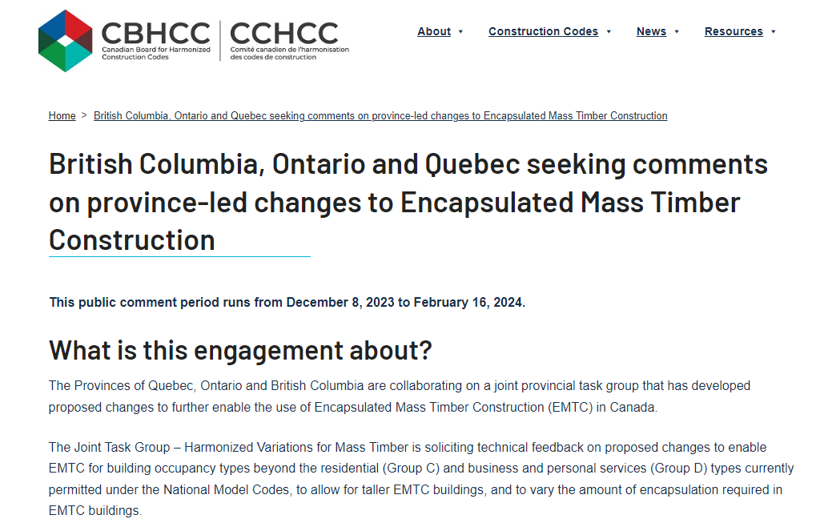
28
Notes:
BC led a committee with Ontario and Quebec involvement to review GHL’s proposal

Slide 29
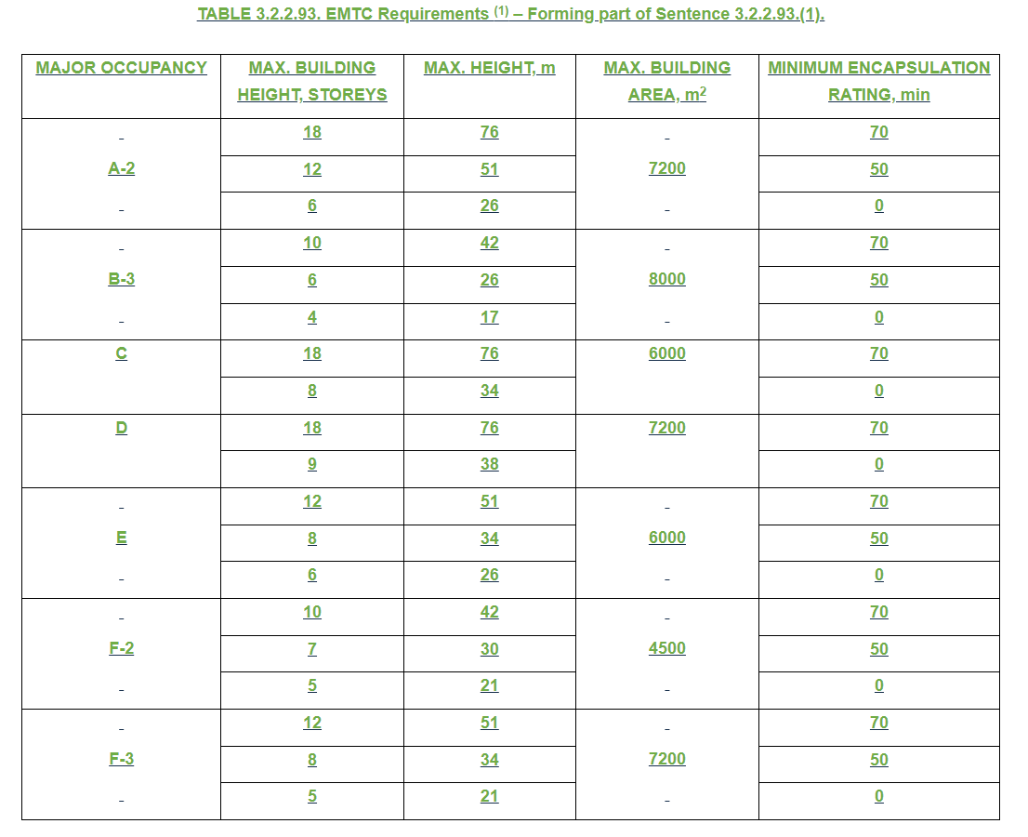
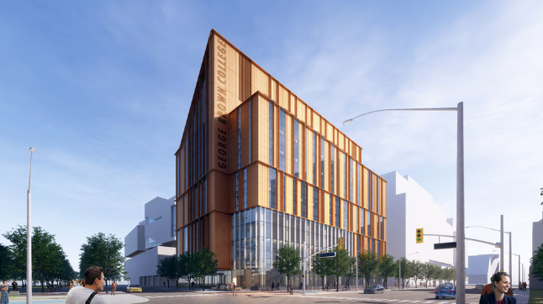
EMTC Proposed Change 01
New EMTC Major Occupancies
18-storey for A-2, C and D
10-storey for B-3 and F-2
12-storey for E and F-3
Limberlost Place, Toronto,
10 storey Assembly Group A-2
Image courtesy Moriyama & Teshima Arch. with Acton Ostry Arch.
Notes:
Added provisions for 18 storeys fully encapsulated, 12 storeys partially exposed and 9 storeys exposed for most occupancies, lesser limits for higher hazard buildings.

Slide 30
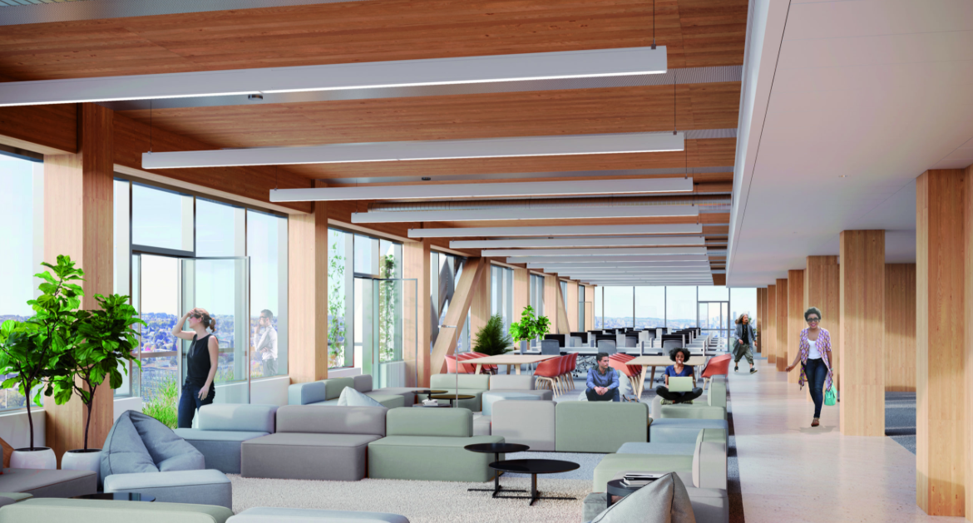
Change 2 – Encapsulation → Exposed Timber
100% Ceilings Exposed – MT surfaces must be FSR 75
Maximum 12 Storeys (same as US) but why?
Walls Exposed if 4.5m apart, or facing one direction
These are highlight only.

Slide 31
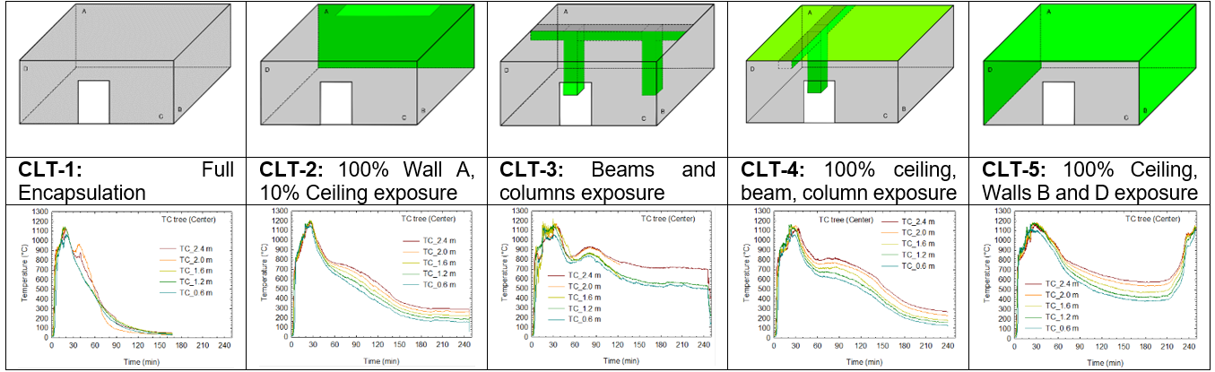
Based on NRC Fire Tests
NRC CLT Tests Green is ‘exposed timber’
Fire dies out | Fire dies out | Fire dies out | Fire dies out | Fire REGROWS
Notes:
Encapsulation provisions were based on tests of exposing different amounts of timber (green) and establishing where the fire had enough re-radiation and heat retention to regrow. Conditions where fire died out were considered acceptable.

Slide 32
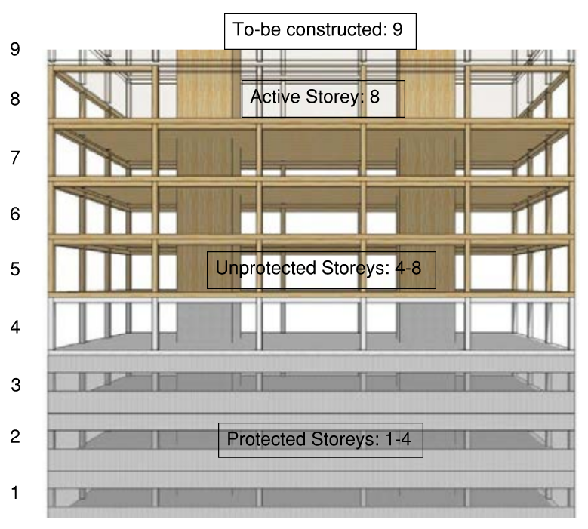


It must be buildable – Moisture Control
Options to ‘Encapsulate as you go
Block or firestop all openings to keep fire to one floor during construction
  Penetrations
  Slab edge
Protected exits during construction
Charged hoses on site
Notes:
Existing Code requires that you start encapsulating Mass Timber as soon as you reach 4 storeys
New Code provides options
Similar to GHL Alternative Solution
Addresses concerns with moisture control during construction as detailed in Graham Finch presentation.

Slide 33
Why 18 Storeys
UBC Tallwood House Design limited to 18 by aircraft and planning (view) considerations.
IBC (US) at 18 is based on UBC 18 storeys.
THEREFORE - All US Codes regarding FIRE SAFETY are limited by UBC Planning and Aircraft considerations?
Does this make sense?
Notes:
A piece of absurdity demonstrates lack of technical analysis.

Slide 34
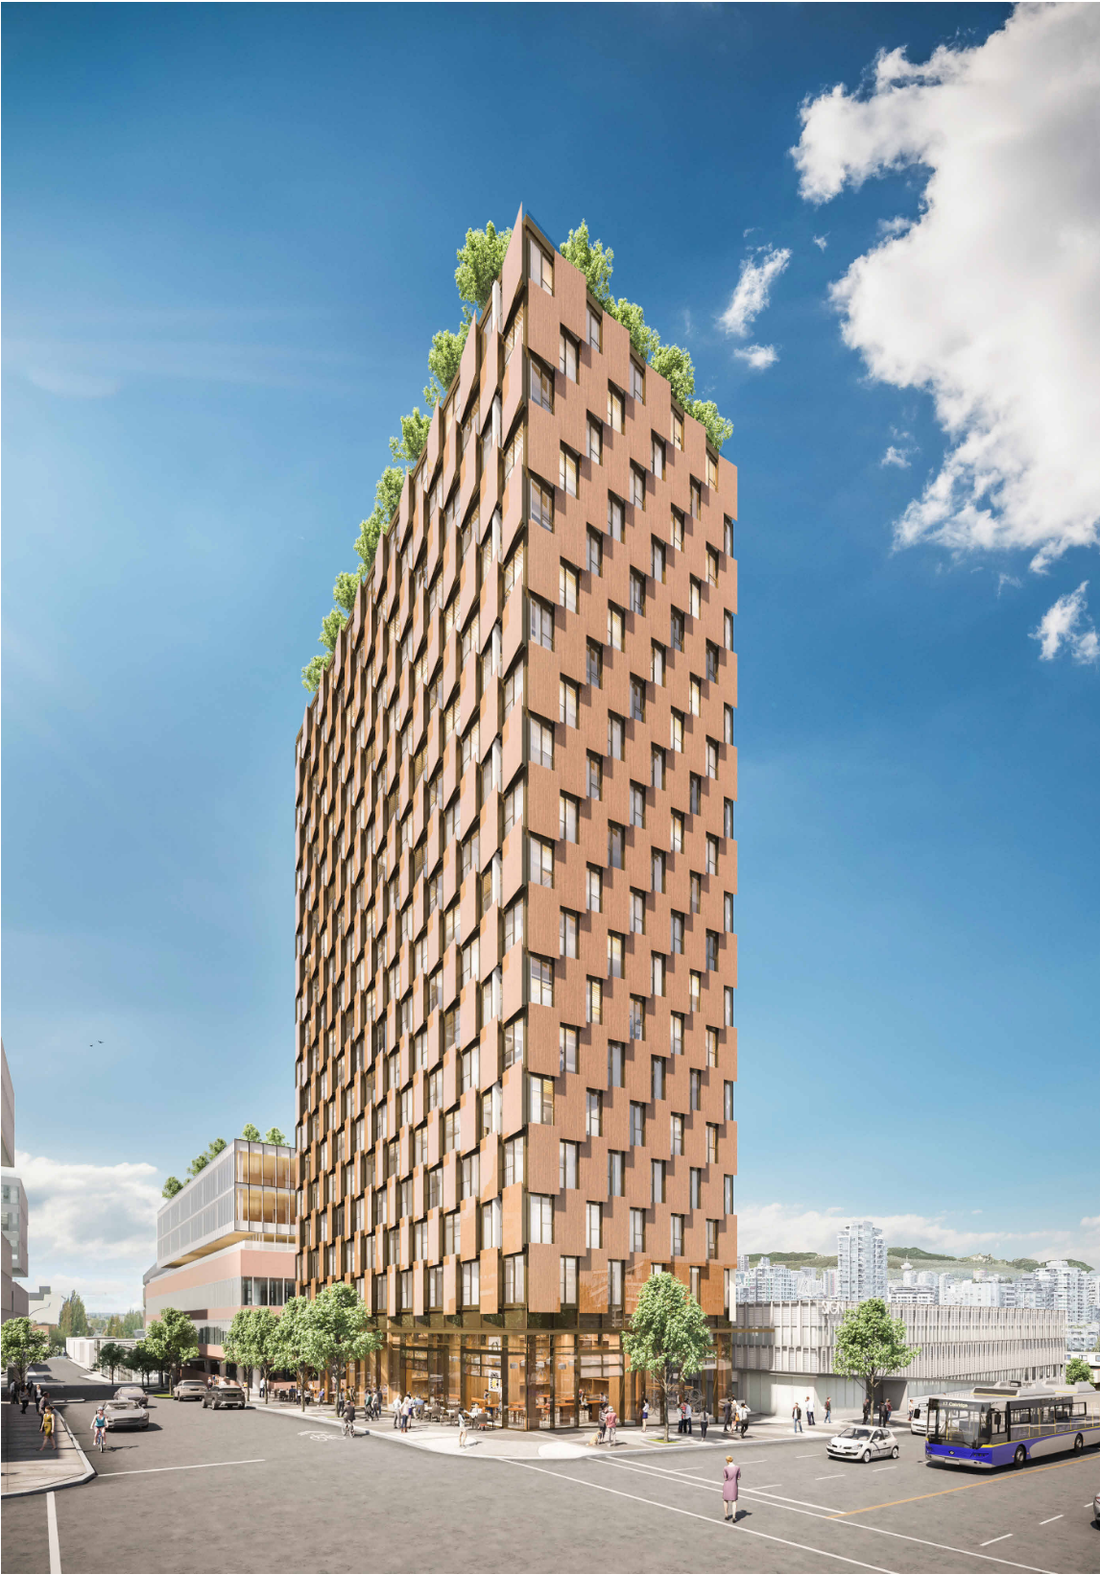
M5 Project Overview
First of several projected tall wood projects
26-storey, 579m²
2h FRR structure
Concrete core
Steel vertical structure, steel beams
Level 1 Retail
Levels 2-25 Residential
Maximum 72% exposed ceiling in
some suites
Maximum 31% exposed walls
Thanks to Westbank and Henriquez Architects
Image: Henriquez Partners Architects
Notes:
GHL has received conceptual agreement on a hybrid steel/mass timber/ concrete core 26 storey building in Vancouver

Slide 35
OPPORTUNITIES FOR SCALE

Slide 36
Smaller Buildings
We have dealt with the big stuff
We need to work on what can scale

Slide 37
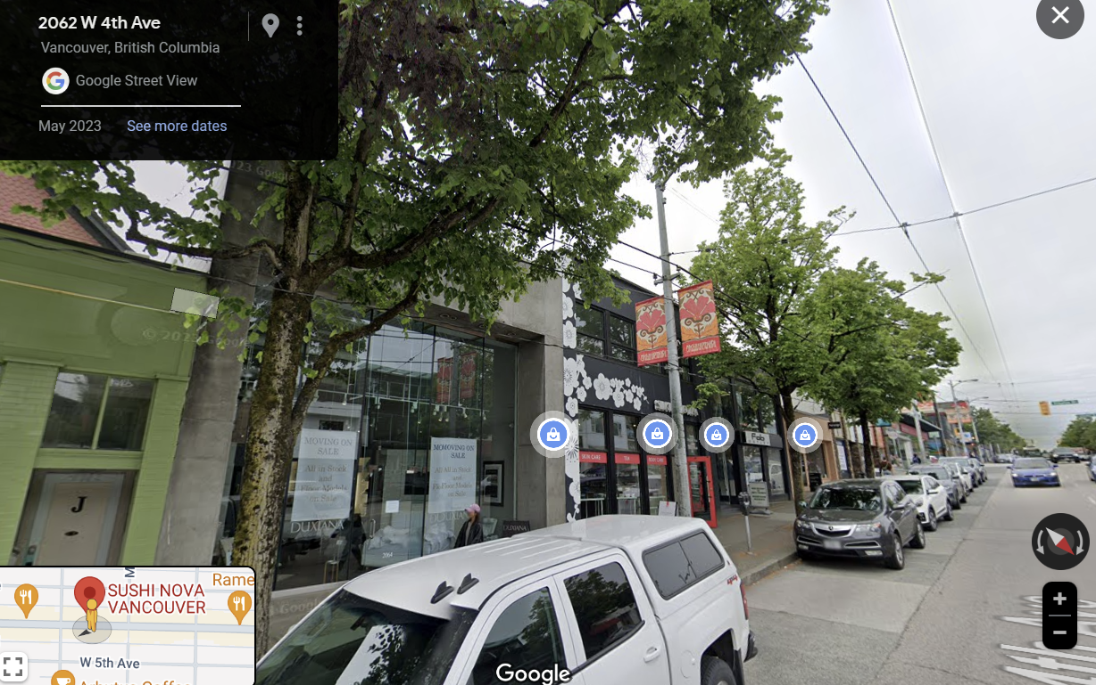
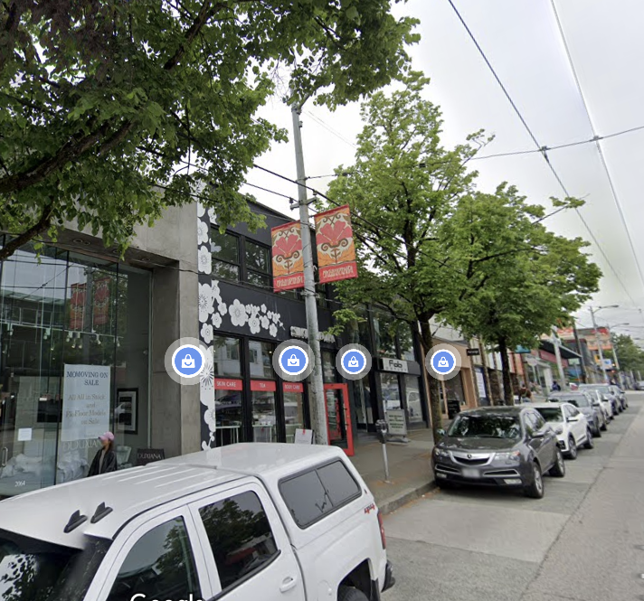
Strip Retail Developments
Concrete – WHY?
Notes:
Section of West 4th Avenue retail area in Vancouver showing a strip of concrete, concrete block and steel single storey buildings. These are concrete because it he 1950, the code prescribed brick exterior walls with a limiting distance (distance to the property line or center of street) less than 4 feet. This remains in the Code today. So a small building is required to have non-combustible exterior walls on 2, if not 3 walls, front in glass. Given that, is it not simpler to keep the whole building non-combustible and make the permitting easy. The Timber industry is losing huge numbers of buildings this way. GHL has mass timber exterior walls approved on multiple projects as alternative solutions, but that takes unnecessary time and money. This SHOULD be an easy code change.

Slide 38
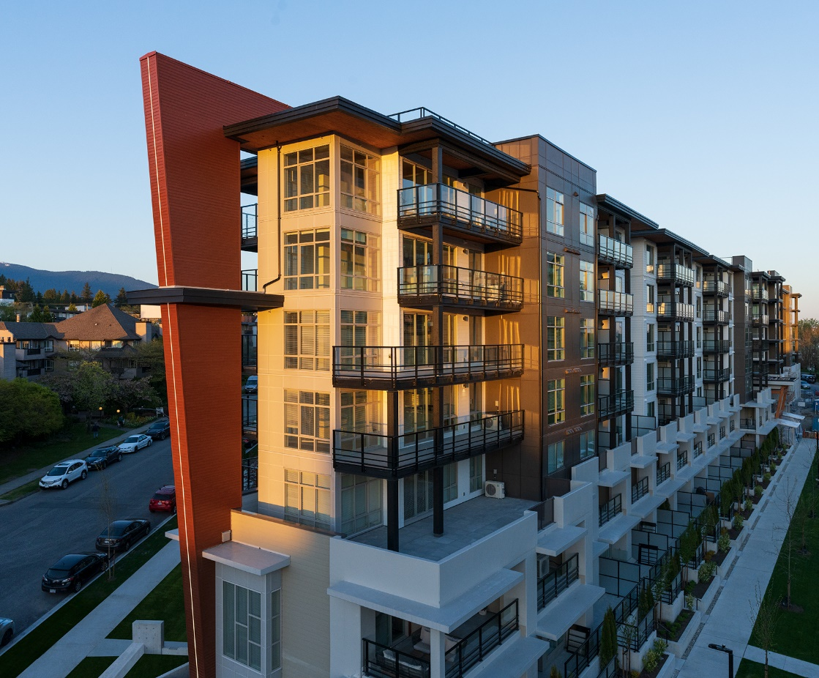
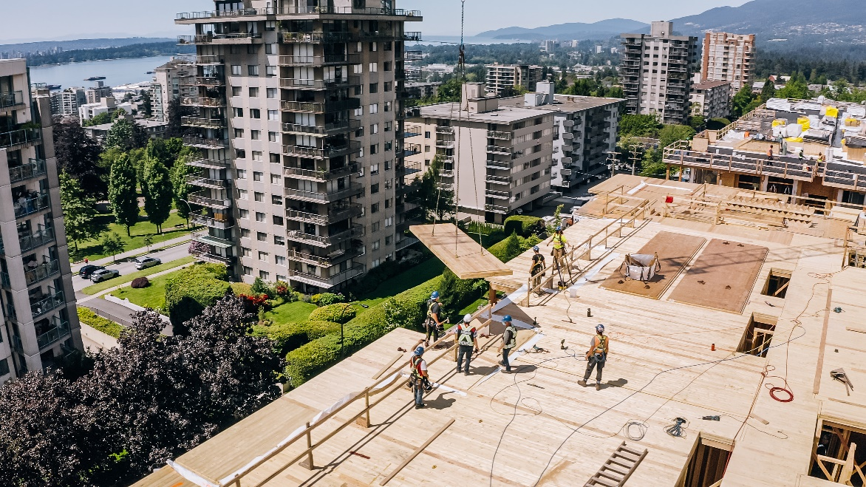
CLT Firewall+ 7 Storey
CREST – North Vancouver
7 storey building
with mass timber floors
Mass timber firewalls
Adera in North Vancouver
Notes:
Example in North Vancouver of a 7 storey building with CLT firewalls, on an alternative solution basis based on the inherent safety of CLT and wood frame wall construction as demonstrated below.

Slide 39
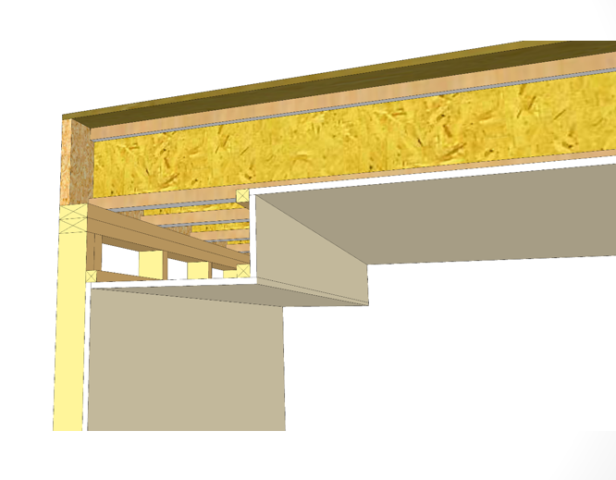
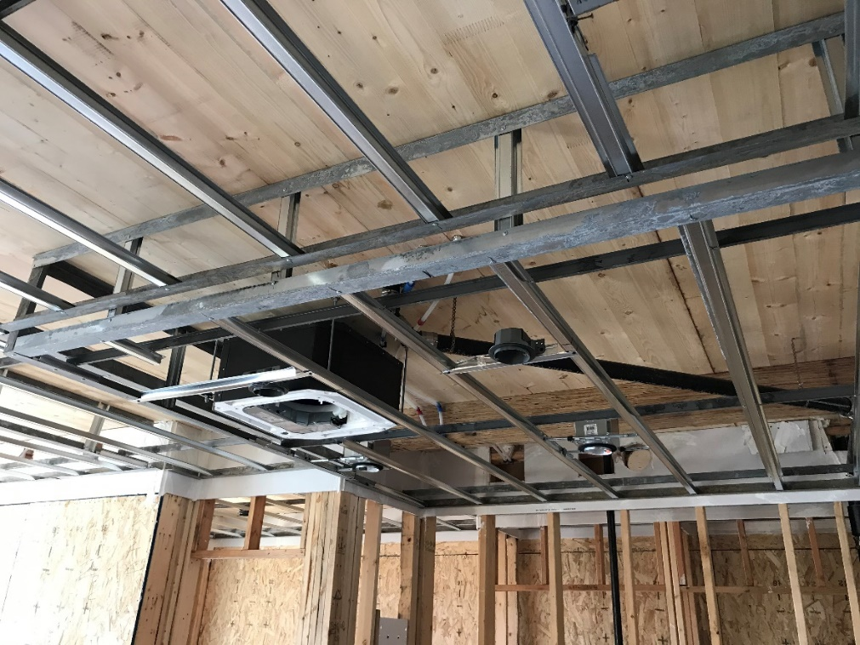

MT Floors → Safer Construction
$$×$$
Notes:
Mass Timber floors and wood walls provide a robust, fast and Much safer means of construction. A small number of developers are adopting this but most consider this too expensive.

Slide 40
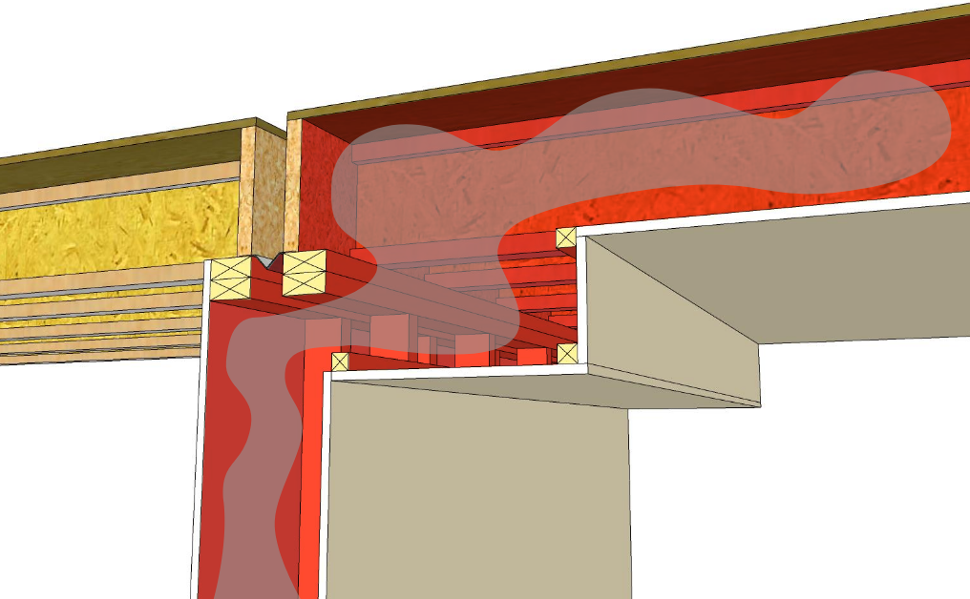
Fire spread through poor or missing fireblocking
Notes:
With Wood I Joists, and poor or missing fire blocking, fire spreads from walls t floor assemblies and into upper walls, creating a major a hazard.

Slide 41
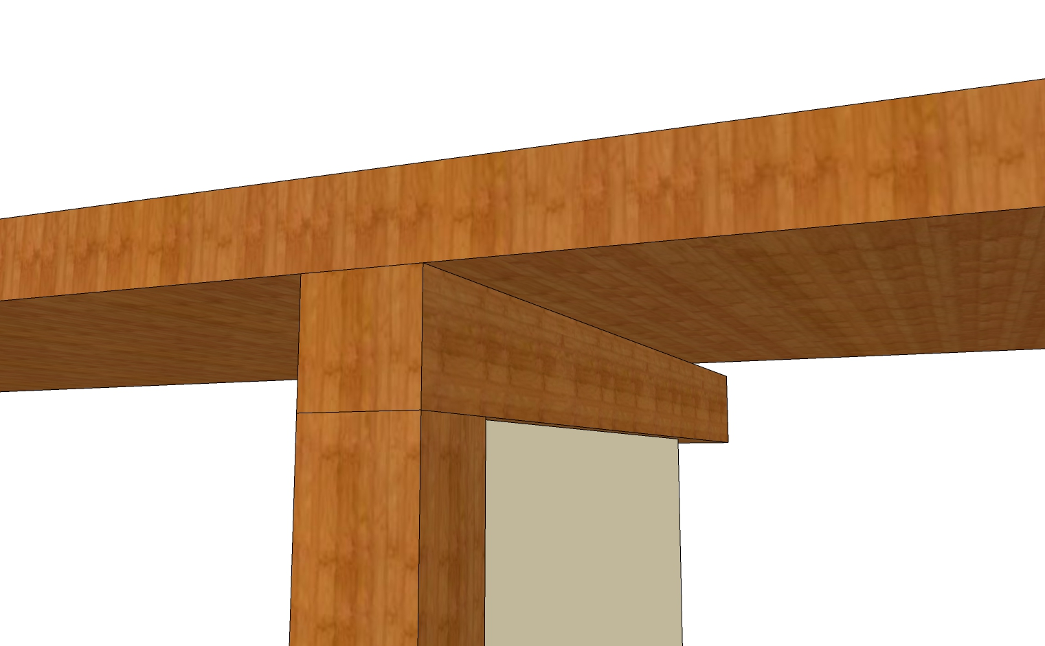
No continuous void spaces eliminates fire spread in walls and floors
Notes:
With no voids in the mass timber floors, fire cannot spread.

Slide 42
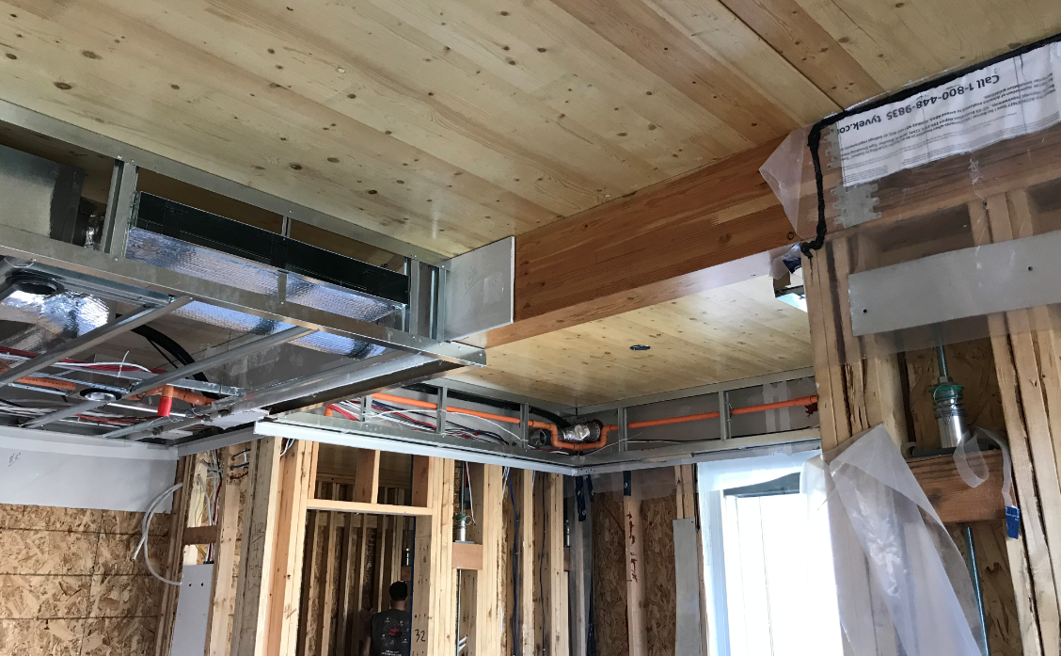
MT Floors → Safer Construction (Cont’d)
42
Notes:
Example of this construction

Slide 43
Fire spread through poor or missing fireblocking
Notes:
With Wood I Joists, and poor or missing fire blocking, fire spreads from walls t floor assemblies and into upper walls, creating a major a hazard.

Slide 44
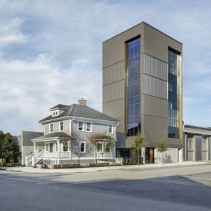
6 Storey Jewelry Manufacturing
Pyrrha Jewlery
6 Storey Mass Timber Factory
F-3
Zero Lot Line MT walls
Notes:
Example of MT F3 industrial building with two mass timbe exterior walls at the property line.

Slide 45
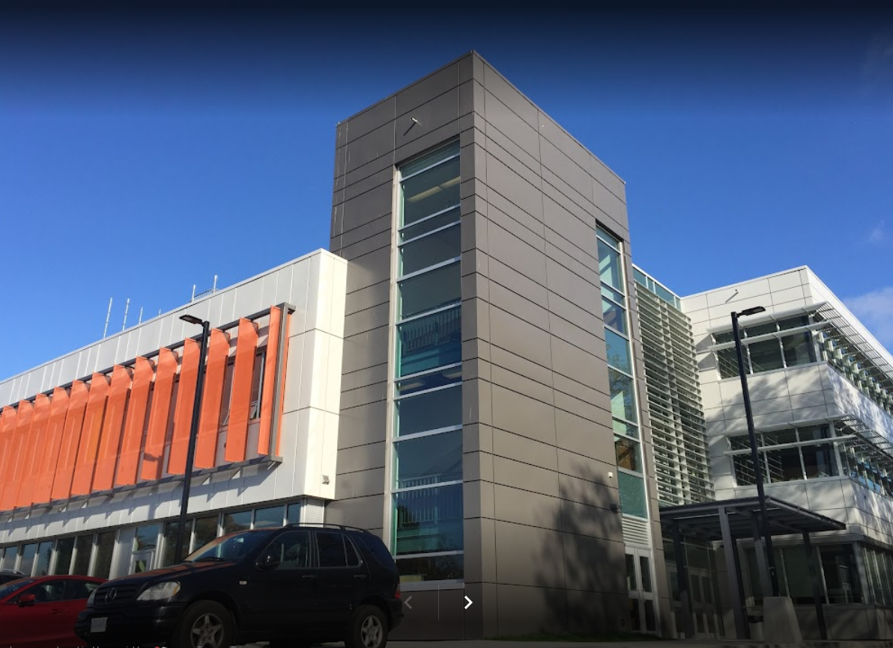
Bigger – Typical High-School
3 storeys
10,000m² building area
Why did it go Steel?
Kitsilano Secondary
Notes:
We have increased the height of residential buildings from 3 storeys of timber to 6 storeys, but we have not changed the limit for schools (assembly) which is still 2 storeys of timber, frame, Heavy Timber or Mass timber. BC changes bring in 2h mass timber, but still too expensive for 3 storeys.

Slide 46
Opportunities for 1h Mass Timber Buildings
CLT floors and Frame Walls
Larger building areas?
Over 18m?
Assembly buildings up to 6 storey
Notes:
A call for simple code changes to allow CLT floors and wood frame walls.

Slide 47
PENALIZING TIMBER

Slide 48
Why is fire design 1h and 2h
Simplified system – 1h is 1 layer of 5/8th X, 2h is 2 layers 5/8 X
Most 2h ratings in the Code are there to be ‘conservative’ rather than a demonstrated need for more than 1 hour.
Potential significant cost savings if we can break this down.
48

Slide 49
Construction Requirements
Should be a sliding scale of construction requirements based on height and area
There are significant gaps that are costly
3.2.2.56
2h FRR, NC
Unlimited Height and Area
Increasing Safety Measures
3.2.2.57
2h FRR, EMTC
9-storey, 8000m2
Boundary of Acceptable Risk
3.2.2.60
1h FRR, Light Frame
6-storey, 18m
3.2.2.62
45min, unsprinklered
3-storey, 1600m2
Solutions considered not acceptable
Increasing Height, Area, Occupancy Risk
49
Notes:
Graphical representation of Fire Protection construction provisions showing gaps in the solution.

Slide 50
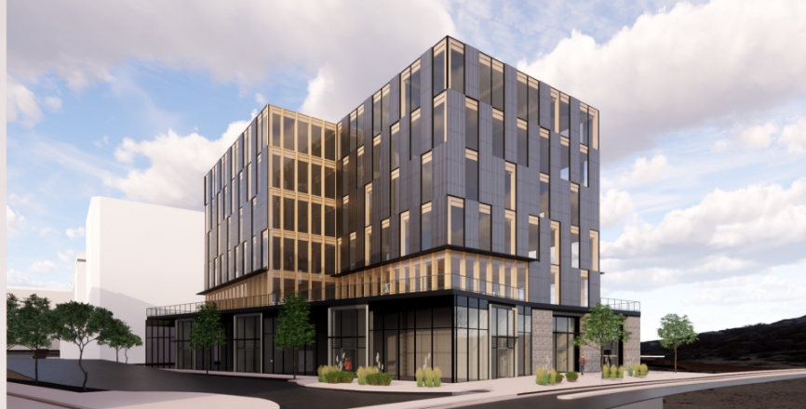
6-Storey Exposed Mass Timber
22m in Height
50

Slide 51
Project Description
6 storeys in Building Height
1658m² in Building Area
2 levels of below-grade parking
Mass Timber construction (2nd to 6th storeys)
Noncombustible construction (basement to 1st storey)
22.6m height between grade to 6th storey vs 18m (4.6m difference)
26.7m height between grade to roof vs 25m (1.7m difference)
51

Slide 52
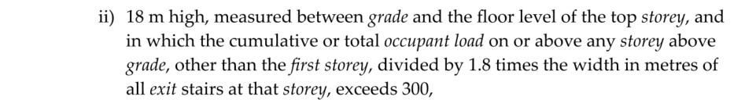
High Building Measures (For Discussion)
Top floor is 4.6m over 18m for high building definition.
As a noncombustible building per formula, not a high building
(no FF elevator).
Rapid evacuation at 6 storeys.
Generator cost approx. $200K.
52

Slide 53
Material Cost Comparison
 |  | 0min | 60min | 75min | 90min | 100min | 110min | 120min
Glulam | Material (CAD) | $ 382,208.00 | $ 443,931.00 | $ 497,324.00 | $ 517,098.00 | $ 537,090.00 | $ 547,141.00 | $ 645,495.00
 | Hardware (CAD) | $ 60,000.00 | $ 66,000.00 | $ 73,000.00 | $ 80,000.00 | $ 88,000.00 | $ 97,000.00 | $ 275,000.00
CLT | Material (CAD) | $ 1,257,691.00 | $ 1,257,691.00 | $ 1,257,691.00 | $ 1,257,691.00 | $ 1,257,691.00 | $ 1,257,691.00 | $ 1,722,127.00
 | Total | $ 1,699,899.00 | $ 1,767,622.00 | $ 1,828,015.00 | $ 1,854,789.00 | $ 1,882,781.00 | $ 1,901,832.00 | $ 2,642,622.00
53

Slide 54
Cost Comparison
Baseline is 18m stick frame 1h.
Increment to 2h construction $875,000.00.
Increment to 110minute – only $134,000.00.
Arbitrary 10min increase in fire rating is VERY expensive.
We are trying to get recognition of inherent safety of MT construction and remain at 1h construction.
54

Slide 55
Comparison: Project vs Wood Frame
Project
Division B Article 3.2.2.60
More robust/durable
Superior fire separation performance
Limited combustible concealed space
Negligible risk of multi-floor concealed space
Less robust/durable
Significant combustible concealed space
Standard drywall finish
High risk of multi-floor concealed space
55

Slide 56
Fire spread through poor or missing fireblocking in light frame construction
56

Slide 57
No continuous void spaces eliminates fire spread in walls and floors
57

Slide 58
Our Client wants to pay the premium to construct a better Mass Timber office building
Essentially penalized and being pushed into a lesser performing building.
58

Slide 59
RESEARCH NEEDS

Slide 60
Education
Desperately need more education in Fire Safety
Significant in need to reduce costs of construction
Address Housing need.
60

Slide 61
Research Needs
We have done the big buildings
Now that they are getting built, public, legislators, fire officials, will start to accept and understand the inherent safety.
Need to facilitate exposed timber in taller and hybrid buildings 12 to 18
But the ‘big building hurdle is overcome
61

Slide 62
Cost and Scale
Research needs to concentrate on costs
Scalability of buildings 6 and more storeys
Understand the safety of Mass Timber
62

Slide 63
Predictions
We are early in the game,
Prefab is the future, mass wood facilitates prefab
Hybrid – best material for the job
New products will reduce costs
  New CLT layups to reduce ‘wasted wood’
  Nail Laminated Timber – Factory Produced
  Dowel Laminated Timber
  Prefab, enclosed, nonstructural components such as walls, floors
63

Slide 64
Speed of Construction
Speed of Erection not factored into costs properly
  3+ floors per week, multiple small teams
Speed of construction hampered by other team members expectations
We will see many refinements reducing costs
  Integrated electrical systems (pre-installed conduit)
  Integrated plumbing systems
  Prefab wall and floor modules
  Simple ‘Lego-like systems’ expanded to more complex layouts
64

Slide 65
Cost Curves
Great potential for reducing construction duration
Great potential for reducing construction costs
Prefab - realized
65

Slide 66
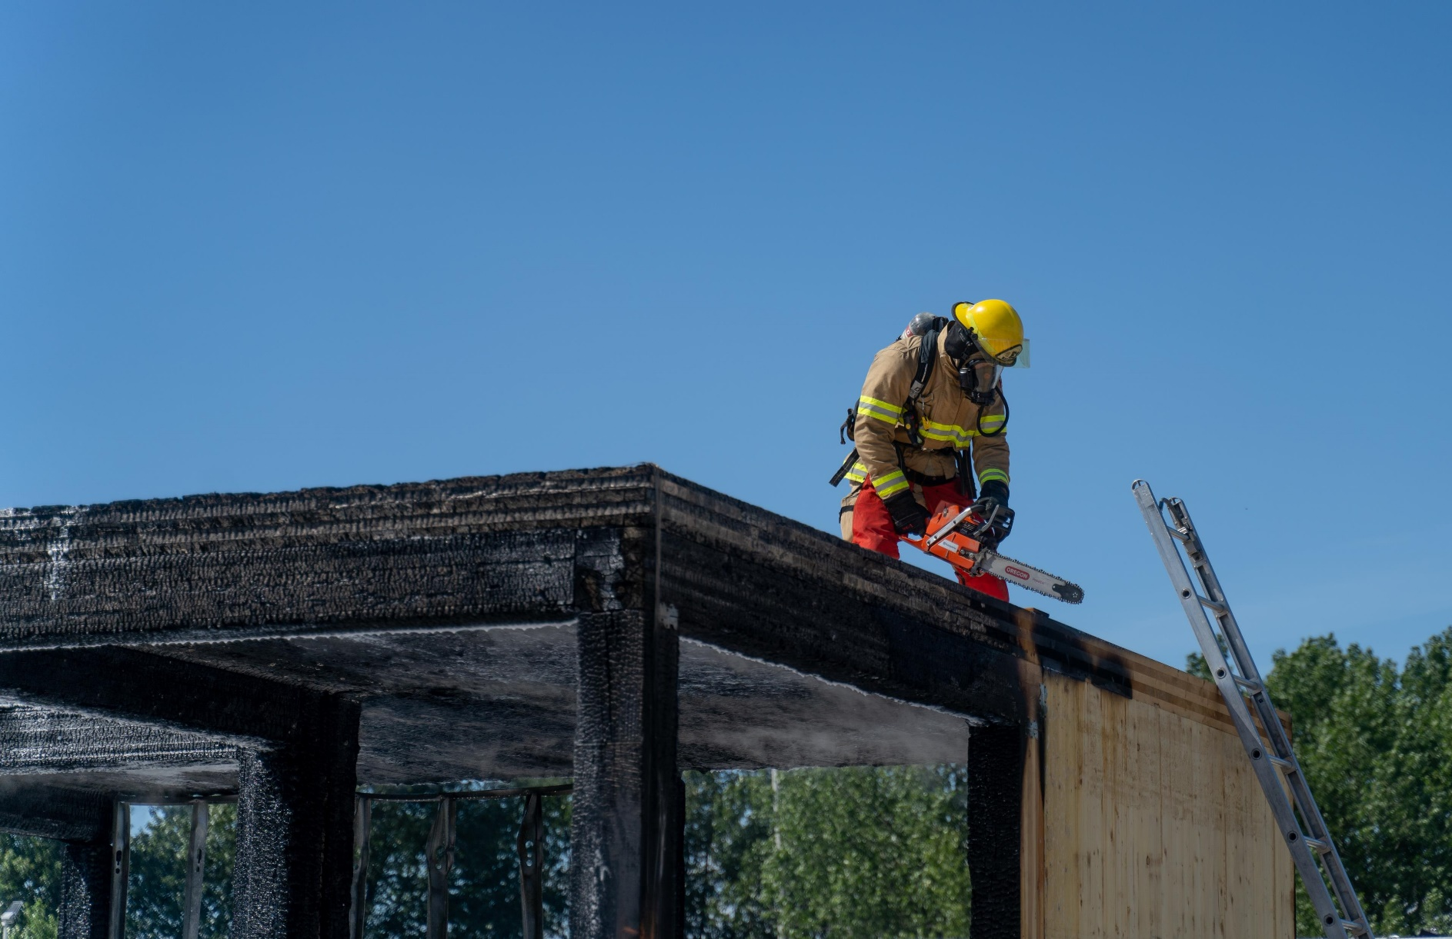
Questions and Comments?
66

Slide 67
Thank you
GHL Consultants Ltd
Suite 800 – 700 West Pender Street
Vancouver, BC
Phone: (604) 689-4449
Email: ah@ghl.ca Web: www.ghl.ca

