Slide 1

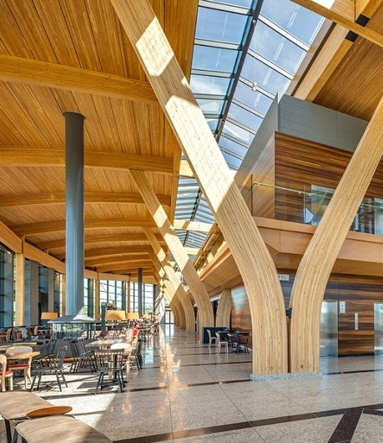



NSERC Alliance Grant Project
‘NEXT-GENERATION WOOD CONSTRUCTION’
A CWCRN Initiative
PROJECT NUMBER M5- T3: Improved Resiliency against damage caused by indoor water leakage
Bisrat H. Tariku ^{1, 2}, Phalguni Mukhopadhyaya¹
¹ Department of Civil Engineering, University of Victoria, Canada
² bisrathmariam@uvic.ca
Picture Credit: Alberta WoodWORKS

Slide 2
Presentation Title
ASSESSING THE IMPACT OF INCIDENTAL INDOOR WATER LEAKAGE ON THE PERFORMANCE OF CLT FLOOR PANELS

Slide 3
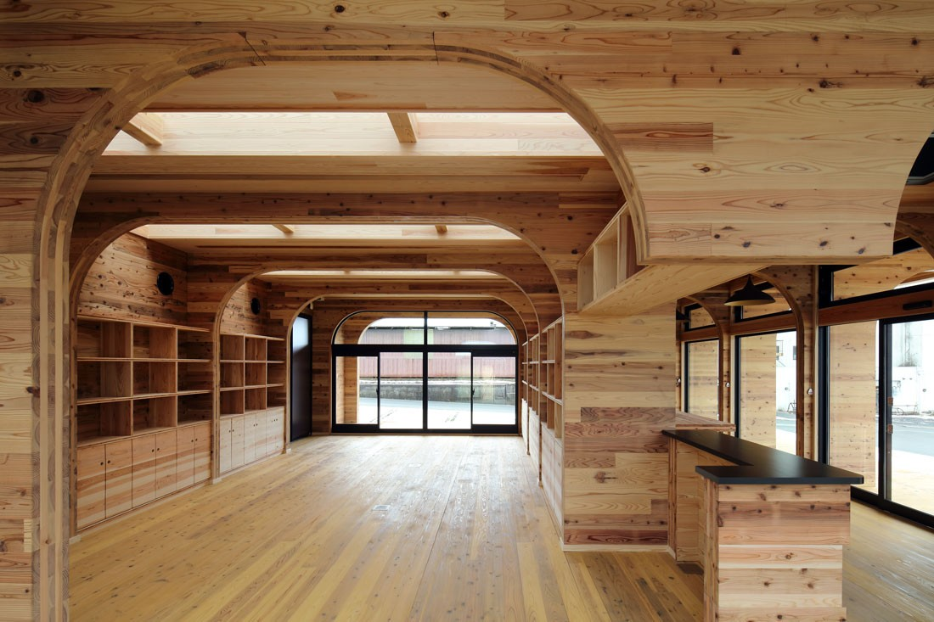
Background
Low Carbon footprint
Speed of Construction
High strength-to-weight ratio
Natural fire resistance
Aesthetic Value
(Source: www.indesignlive.com)
Notes:
Interest in mass timber construction has been on the rise over the past few decades. Mass timber is now being considered as an alternative to traditional concrete and steel construction.

Slide 4
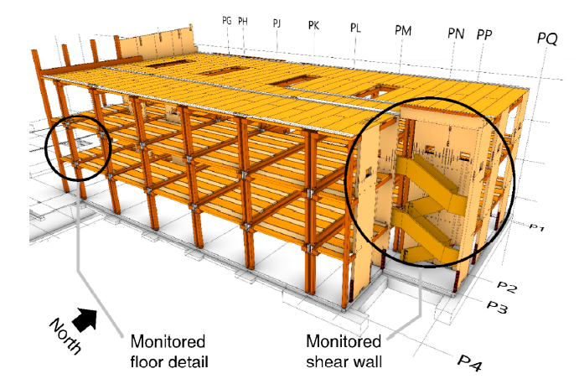
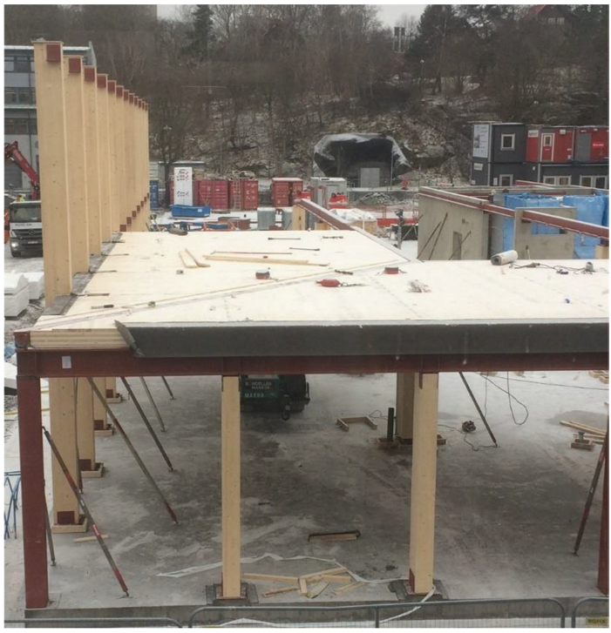
Background
Research have been conducted to investigate the Moisture Management of CLT components during construction.
(Schmidt & Riggio, 2019)
(Olsson, 2021)
Objective: Monitoring hygrothermal performance of CLT during construction.
Method: Field investigation using sensors
Findings: Wetting/drying rates varied significantly based on location-specific conditions and the implementation of moisture protection measures.
Objective: To examines how CLT constructions are affected by precipitation during construction.
Method: Field investigation and microbiological analysis.
Findings: It is difficult, or impossible, to
avoid the appearance of microbial growth during CLT construction without weather protection.
Notes:
The first one is a field experiment conducted in Oregon, USA. Around 19 moisture sensors installed and monitored during a six-month period.
Findings: Areas lacking coating and shaded spots exhibited high moisture levels.
Olsson underscored the importance of weather protection in CLT construction.

Slide 5
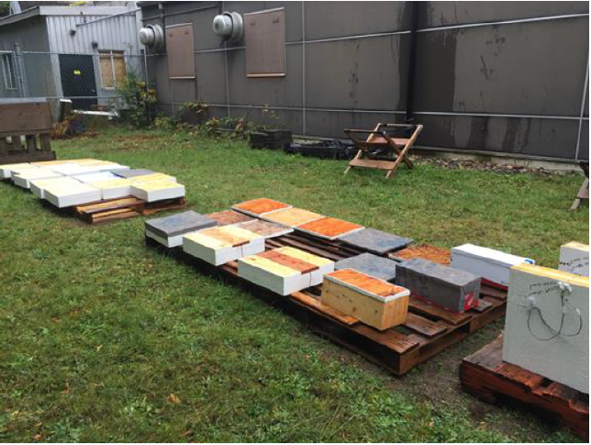
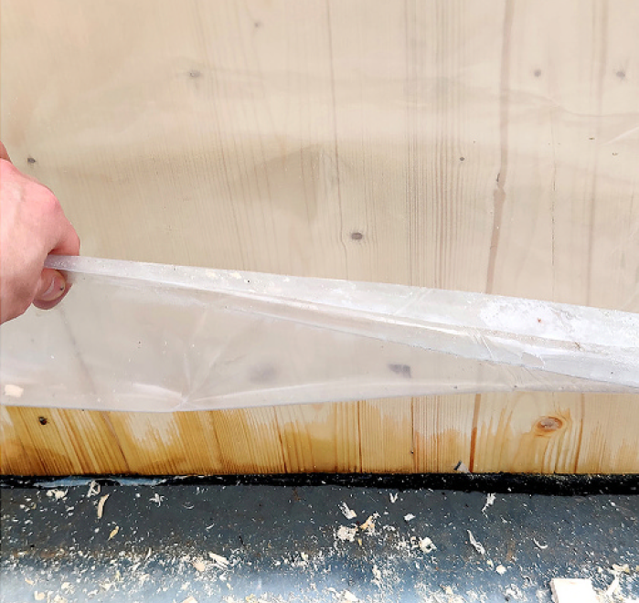
Background
The vulnerability of CLT end-grain surfaces during construction has been examined by Field and Lab experiments.
(Wang, 2018)
(Kalbe et al., 2022)
Objective: Examine wetting and drying behavior of face and edge CLT surface and effectiveness of water repellent coatings and membranes
Method: Survey and lab experiment
Findings: CLT exposed end grain edges are much more susceptible to moisture absorption than face surfaces. And self-adhered vapor permeable membrane is found to be the most effective.
Objective: Moisture content, and drying performance of CLT end-grain edges based on field measurements and laboratory analysis
Method: Field measurement and lab experiment
Findings: moisture penetration into the edges of CLT panels poses a high risk and has a lower probability of drying without mechanical drying methods.
Notes:
In 2018, FP Innovations has published research on wetting and drying performance related to on-site moisture protection of CLT following the construction of UBC tall wood house project. Lab experiment By exposing the CLT samples to the rainy wintertime weather in Vancouver for three months.
Similar suggestions have been made in the research conducted in the Swedish climate which incorporated field and laboratory experiment. They have tried to replicate the field observation in the lab

Slide 6
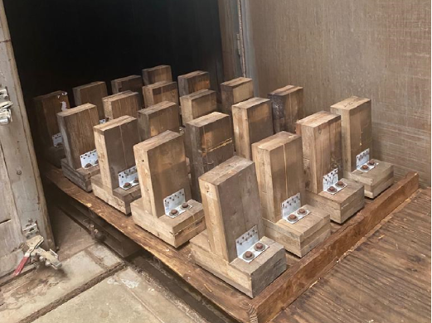
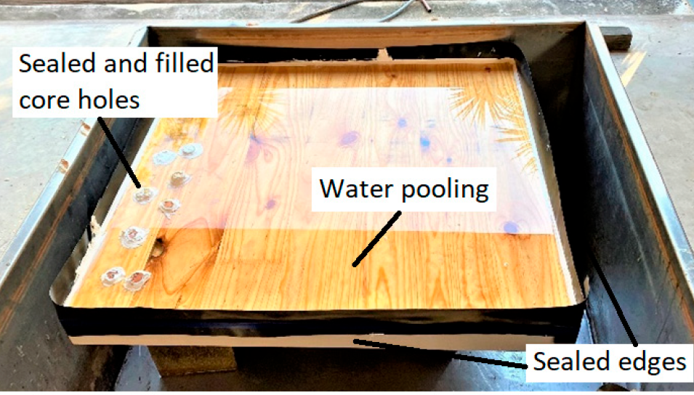
Background
CLT drying performance has been examined in lab experiments.
(Udele et al., 2023)
(Shirmohammadi & Faircloth, 2023)
Objective: The effects of various drying schedules on the performance of wet wall to floor CLT connection assemblies.
Method: Lab Experiment; CLT soaked in tap water and then dried using different schedules.
Sample: 330x203 mm, 3-ply CLT
Findings: Increased rate of drying increases the chances connection brittleness, which is detrimental to connection performance.
Objective: Investigate the effect of alternate drying techniques on CLT after exposure to free-water wetting.
Method: Lab Experiment; CLT water pooling and then subjected to different drying techniques.
Sample: 800x850 mm, 3-ply CLT
Findings: Fan drying reduced moisture content from 40% to under 20%, more effective than natural drying.
Notes:
After exposing to water pooling for 6 weeks, they have used bath fan and ambient drying.
They have soaked the CLT wall to floor connection for four weeks.

Slide 7

Research Question
What happens if there is an Incidental indoor water leakage in a Mass Timber building?

Slide 8
Objectives
General Objective
Assessing the Impact of Indoor water leakage in mass timber buildings.
Sub-objective
Evaluate the impact of incidental indoor water leakage on the performance of CLT floor panels using lab experiment and hygrothermal simulation.

Slide 9
Methodology
Research
Question
Literature
Review
Draw
Conclusion
Research
Objectives
Experimental Design
Revise and
Refine
No
Test
Feasible ?
Whole Building
simulation
Pilot Test
Yes
Lab
Experiment
Data
Analysis
Compare
Both Data
Initial data
Collection
Hygrothermal
Simulation
Simulation data analysis

Slide 10
Experimental Design
Sample Description
Test Specimens (5-Ply CLT)
Type 1: Top surface exposed
Type 2: Top surface exposed with half-lap joint
Type 3: One end grain surface exposed
Type 4: Top surface exposed with checks and cracks
Type 5: With concrete topping with out membrane
Type 6: With concrete topping and water resistive membrane under slab
Description
Size: 300 x 300 x 140mm
Dry Weight: 6.3 kg
Size (Concrete): 300 x 300 x 40mm
Density of Concrete: 1920 kg/m3
Mass of concrete: 6.912 kg
Total Mass (CLT + Concrete) : 13.2 kg

Slide 11
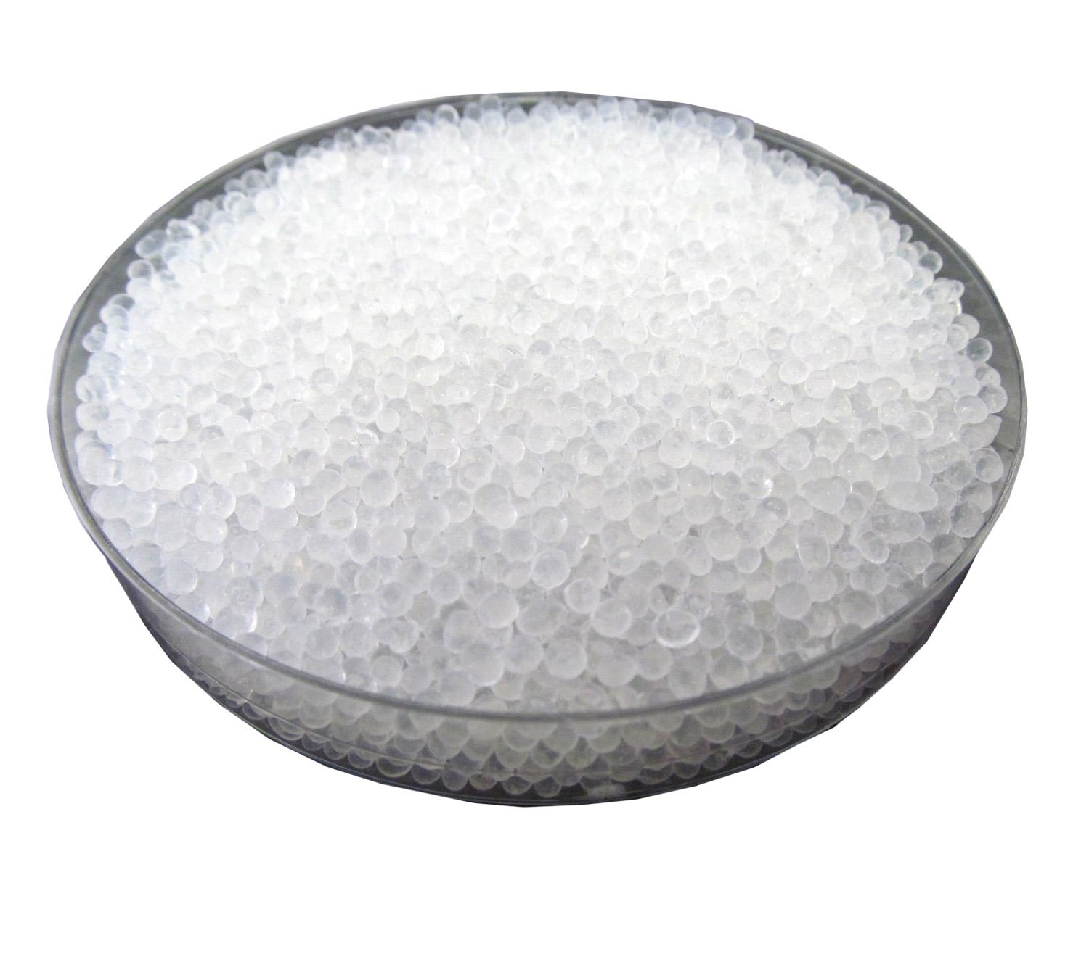
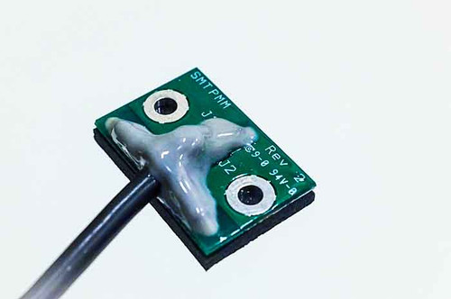
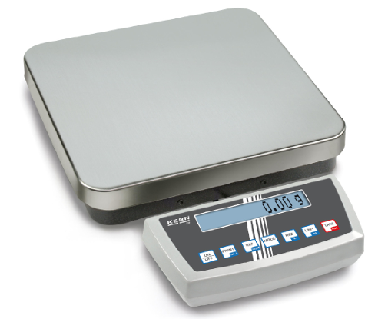
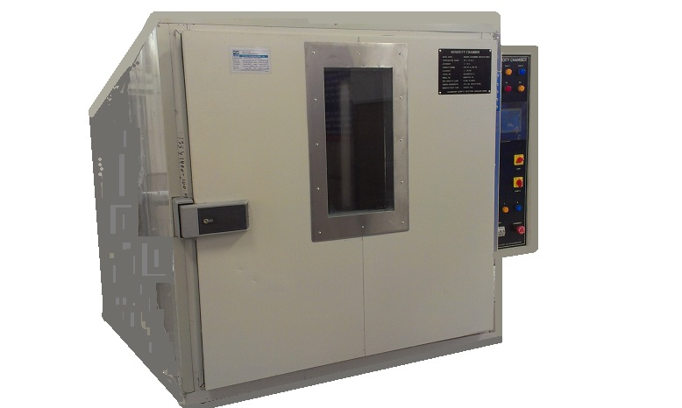
Apparatus
Drying Desiccant
Type: Silica Gel
Model No: S-3902
Gram size: 1 g/bag
Container: 5000 bags
Moisture absorption: 15% of its weight
Moisture Sensor
Operating Voltage: 2V to 12VDC
Model: SMT PMM-03
Thermistor range: -40°C to 125°C
Operating Temp: -40° to 50°C
Weight Scale
Model: KERN DS30K0.1L
Max weight: 30 kg
Min weight: 0.5 kg
Readability: 0.1 g
Repeatability: 0.2 g
Environmental chamber
Area: 6 m²
Operating RH : 40 to 60 %
Operating Temp: 21-25 °C

Slide 12
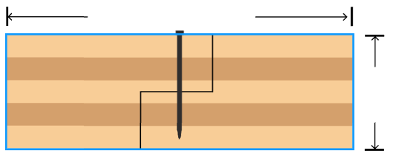
Sample Preparation
Cutting and polishing CLT samples according to the dimensions mentioned above.
300 mm
140 mm
Type 2
Make 3 samples for each test type, making the total number of samples 18.
Keep all samples in indoor condition (RH: 40 – 60 %, Temp: 21-25 C) until 10 – 12 % MC is maintained for all the samples.
Moisture sensor installation.

Slide 13
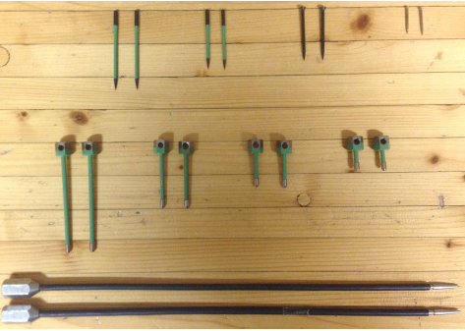
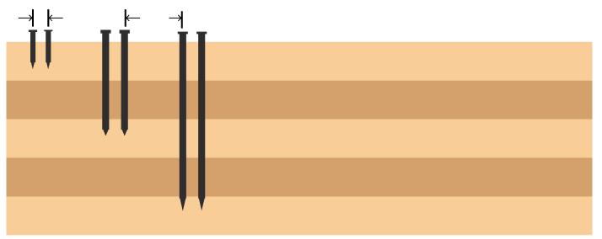

Point Moisture Sensor Installation
Point sensors will be installed positioning the tip of the sensors at the top, mid, and bottom layers.
Sensors will be oriented 90 degree from top surface.
Positive and the negative electrodes will be placed 30 mm from each other.
Each pair of electrodes should feature a sufficient distance to neighboring electrodes (min. 150 mm).
Each installation will be sealed using silicone (Sikaflex silicone sealant).
Philipp et al., 2014
30 mm
150 mm
Type 1
Type 2

Slide 14

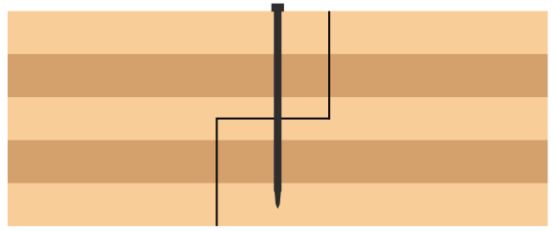

Sample Sealing
Take Type 1 and 2 and seal all the surfaces with water resistant vapor permeable membrane exposing the top surface.
Exposed
Prepare Type 3 by exposing end grain surface only.
Exposed

Slide 15
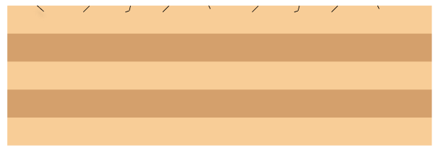
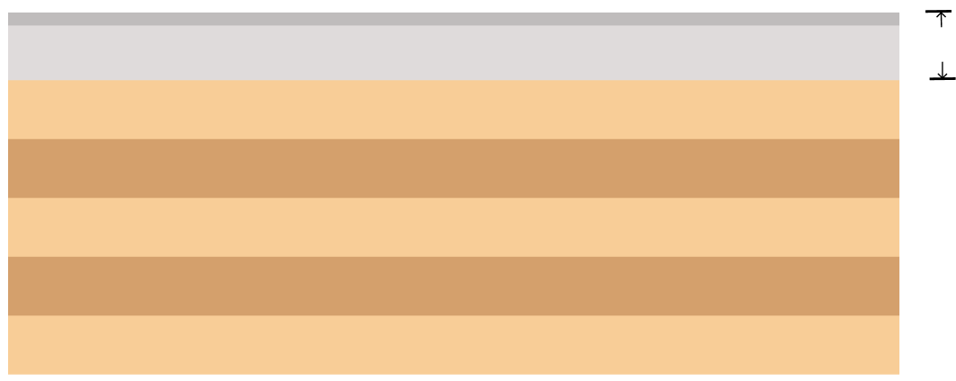
Sample Sealing
Type 4 sample will be prepared in a sealed and controlled environment with the desiccant to facilitate further drying of the CLT sample.
Exposed
Checks
Type 5 sample will have 40 mm light weight concrete topping, which is commonly used for wood-based floors for sound improvement and fire safety with epoxy flooring with out membrane .
Concrete topping
50 mm
Exposed

Slide 16
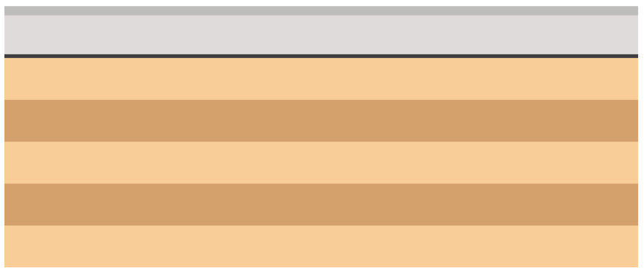
Sample Sealing
Type 6 sample will have 40 mm concrete topping with epoxy flooring and vapor permeable membrane.
Vapor permeable membrane
Exposed

Slide 17
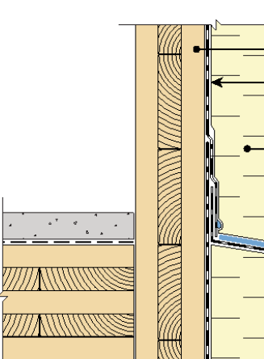

But why expose end-grain surface?
Changes in RH can contribute to the development of cracks at the intersection.
Shrinkage
Crack
CLT Handbook, 2019

Slide 18
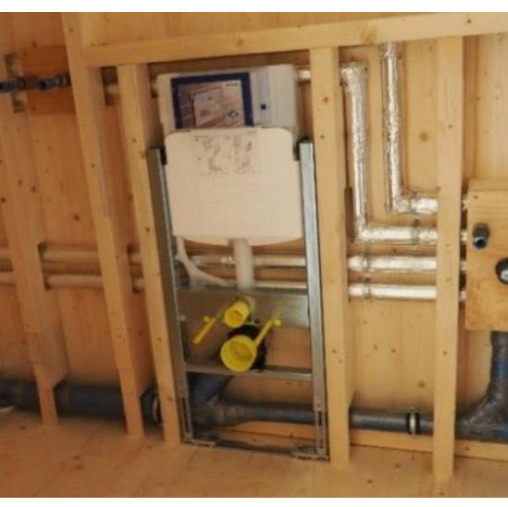
What kind of leakage are we trying to simulate?
Pipe leakages will stay undetected for a longer time.
Possible leakage area
Exposed CLT Floor
(Source: Mansberger et al., 2019)

Slide 19
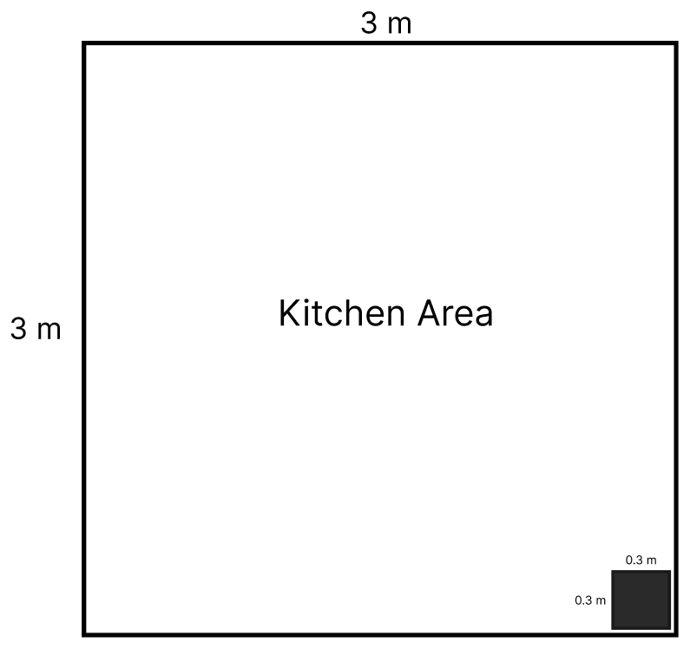
Exposure
Leakage amount
Recorded leakage amount from pipe leakage in a residential house is 3 - 30 liters / day (Britton et al., 2011).
30 liters/day in a room is taken for the experiment.
Assuming the room to be a small kitchen with area 9 m².
Sample
Our sample would encounter an exposure of 0.3 liters/day.

Slide 20



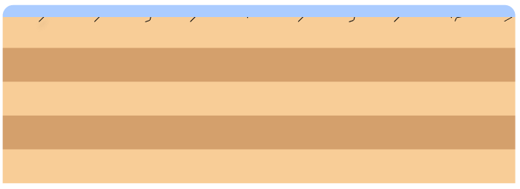
Exposure
Water Pooling
Water with room temperature will be applied on CLT samples
7.1 mm
Water
Type 1
Type 3
Type 2
Type 4

Slide 21


Exposure
Water Pooling
Water contained in a WRB exposing the end grain surface.
5.6 mm
Water
Type 5
Type 6

Slide 22
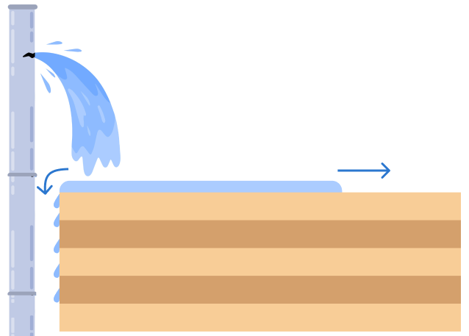
Exposure time
Literature shows a record of undetected pipe leakage for 6 weeks.
Leave the exposed samples in conditioned indoor environment, which is the environmental chamber, for 4 weeks.
Subtract the time it takes to cover the area and the distribution of the water to neighboring surfaces.
Why four weeks?
Remove the water and leave sample for 6 month.
Localized MC, every 24 hrs. Bulk MC; once a week.

Slide 23

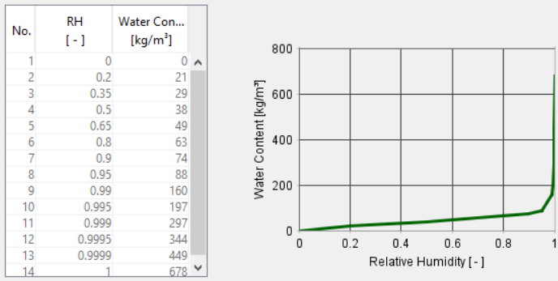
Hygrothermal Modeling
Hygrothermal simulation will be done using WUFI Pro 1D.
Recorded moisture content at the top layer will be converted to its corresponding RH.
Run simulation for 6 month, to compare result with lab experiment.

Slide 24
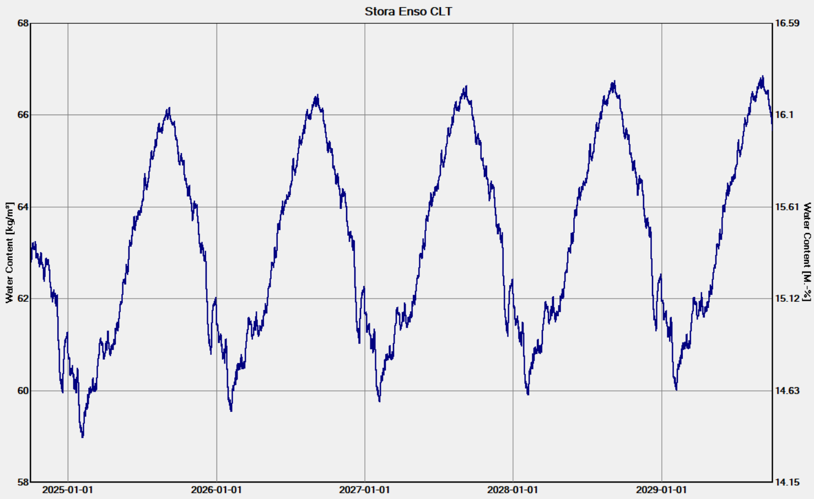
Hygrothermal Modeling
Long term hygrothermal simulation.
Measuring MC and possible mold growth, and its impact on the durability of the structure.

Slide 25
Possible Challenges
Stability of environmental chamber
Proper sealing of the samples surface

Slide 26

Thank you
Questions and Suggestions?
Email: bisrathmariam@uvic.ca

Slide 27
References
Shirmohammadi M, Faircloth A. Effect of Alternate Drying Techniques on Cross-Laminated Timber after Exposure to Free-Water Wetting. Forests. 2023 May 12;14(5):1007.
Udele KE, Sinha A, Morrell JJ. Effects of Re-drying on properties of cross laminated timber (CLT) connections. Journal of Building Engineering. 2023 Oct 1;76:107298.
Kalbe K, Kalamees T, Kukk V, Ruus A, Annuk A. Wetting circumstances, expected moisture content, and drying performance of CLT end-grain edges based on field measurements and laboratory analysis. Building and Environment. 2022 Aug 1;221:109245.
Wang J. Wetting and drying performance related to on-site moisture protection of cross-laminated timber. technical report of FPInnovations; 2018.
Olsson L. CLT construction without weather protection requires extensive moisture control. Journal of Building Physics. 2021 Jul;45(1):5-35.
Schmidt EL, Riggio M, Barbosa AR, Mugabo I. Environmental response of a CLT floor panel: Lessons for moisture management and monitoring of mass timber buildings. Building and Environment. 2019 Jan 15;148:609-22.

