Slide 1





NSERC Alliance Grant Project ‘NEXT-GENERATION WOOD CONSTRUCTION’
A CWCRN Initiative
Experimental investigation of vibration serviceability performance of a full-scale glulam deck floor supported with glulam beams
Presenter: Chenyue Guo, PhD Student, University of Alberta
Supervisor: Dr. Yinghei Chui, University of Alberta
Dr. Jianhui Zhou, University of Northern British Columbia
Picture Credit: Alberta WoodWORKS

Slide 2


Contents
Background
Experimental test
Materials
Methods
Test phases
​Results
Conclusion and future work
Picture Credit: Alberta WoodWORKS

Slide 3
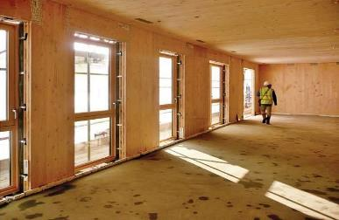
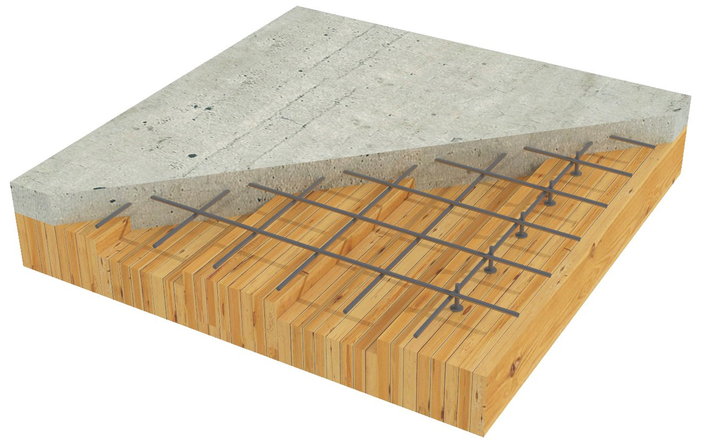
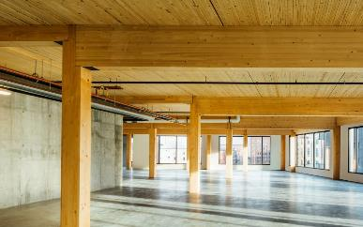
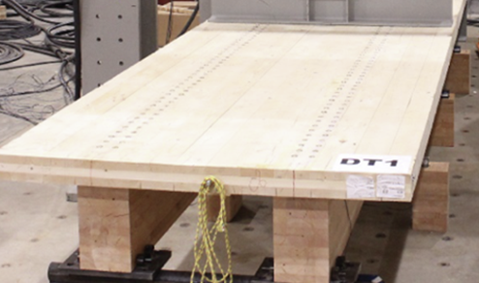
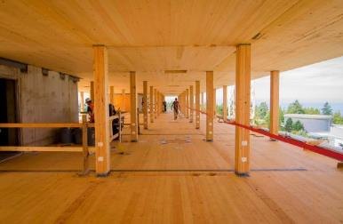
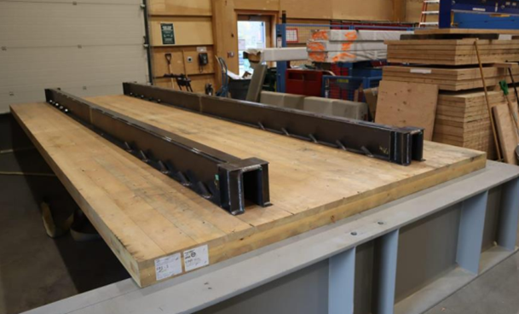
Mass Timber Floor Systems
Wall-supported
Timber-concrete composite floor
(US Framing)
(Archdaily)
Beam-supported
Timber-timber composite floor
(Structurecraft)
(Shahnewaz et al.,2022)
Point-supported
Timber-steel composite floor
(Fast+Epp)
(Owolabi et al.,2022)
Notes:
From the great presentations this morning and our previous experience, I believe that we should have a good understanding of mass timber buildings. Here I want to specifically talk about mass timber floor systems. They have various types and are used widely in the current construction. For example, they can have different support conditions, like.. They can be combined with other building materials, like.

Slide 4
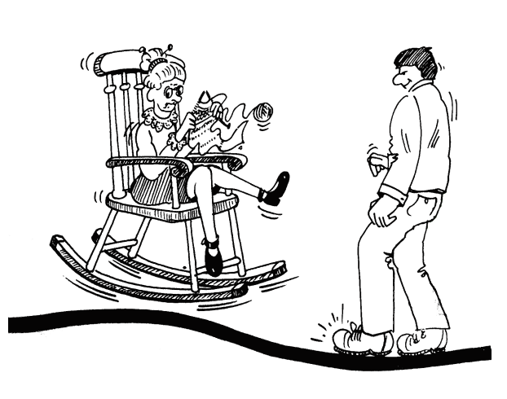

Floor Vibration
Prediction of structural response/ dynamic properties
Physical and mechanical properties of floor systems
Dimensions
Boundary conditions
Mechanical properties (stiffness, damping, connections)
Construction details (topping)
Vibration serviceability issue
Performance criterion
Notes:
But compared to other common construction materials like concrete or steel, floors made by mass timber panels are more lightweight, which means they are prone to human-induced vibration. This vibration could lead to the discomfort of occupants, that is the vibration serviceability issue I am talking about here.
For the design of floor systems, we consider their physical and mechanical properties. Like …. Those properties would have effects on the floor’s vibration serviceability performance.
To design the floor with a good vibration performance, the current design methods they often have these two parts, …

Slide 5
Mass Timber Floor Vibration Design Standard
Canadian Standard CSA O86-19
Performance Criterion (Hu,2000) (Light-framed timber floors):
Field test data（example)
Measured fundamental natural frequency
Measured deflection under 1 kN point load
Subjective ratings
Notes:
Then I want to show you some current-used timber floor vibration design standard, to give you some ideas how to design for the floor’s vibration performance. Firstly of course is the Canadian method, this method was first proposed by FPInnovations more than 20 years ago, they collected the field test data from light-framed timber floors for their fundamental natural frequency, deflection and ratings from occupants. The data can be plotted like this with the rating,

Slide 6
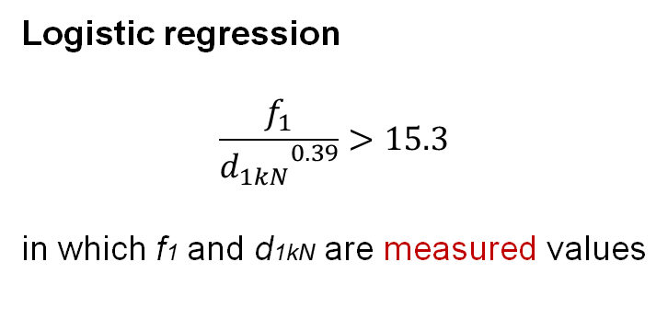
Mass Timber Floor Vibration Design Standard
Canadian Standard CSA O86-19
Performance Criterion (Hu,2000) (Light-framed timber floors):
Develop criterion
Measured fundamental natural frequency
Measured deflection under 1 kN point load
Subjective ratings
Logistic regression
$$\frac{f_{1}}{{d_{1kN}}^{0.39}}>15.3$$
in which f1 and d1kN are measured values
Notes:
What they did is to perform a logistic regression using those data, and the result is shown here as this curve. So this equation or curve, could divide most of the acceptable and unacceptable floor by their measured properties.

Slide 7
Mass Timber Floor Vibration Design Standard
Canadian Standard CSA O86-19
Performance Criterion (Hu,2000) (Light-framed timber floors):
New field test data to verify
Measured fundamental natural frequency
Measured deflection under 1 kN point load
Subjective ratings
Logistic regression
$$\frac{f_{1}}{{d_{1kN}}^{0.39}}>15.3$$
in which f1 and d1kN are measured values
Notes:
To further verify this criterion, they used other field test data to compare with this equation, it turns out that this curve could distinguish the light-framed timber floors’ vibration performance perfectly by just the measured values. And this equation was used for the evaluation of light-framed floor’s vibration performance.

Slide 8
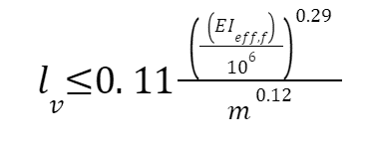

Mass Timber Floor Vibration Design Standard
Canadian Standard CSA O86-19
CLT Vibration-controlled Span Equation
Same approach adopted:
Correspond
Design criterion
Measured f₁
Calculated f₁
$$\frac{f_{1}}{d^{ 0.7}}≥13.0$$
Subjective Rating
Transform
Test data from CLT panel
Only for :
1.Bare CLT floor
2.With rigid support
Measured d₁
Calculated d₁
Correspond
Notes:
For the mass timber floors, the same approach was adopted. Rather than using the measured value, they correspond the measured value to the calculated value, but with the same subjective rating. So in a same way, they got this design criterion for CLT floors, by transforming, the equation becomes the CLT … equation which is written in the current CSA O86. However, this equation is only suggested …

Slide 9
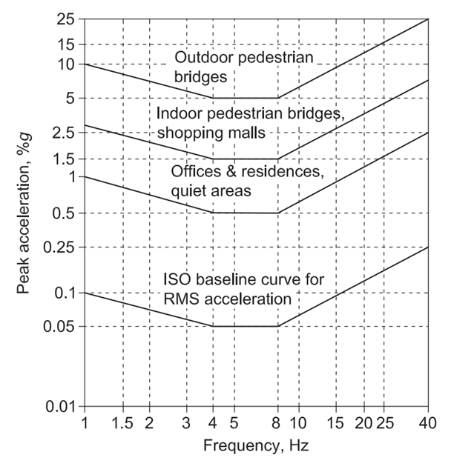
Mass Timber Floor Vibration Design Standard
Response-based Design Method (Eurocode5, AISC DG11, US Mass Timber Floor Vibration Design Guide )
1. AISC DG11 (steel-framed structure) (2016)
Peak acceleration calculation
Different tolerance limit for different occupancies
Notes:
Other than the Canadian method, the current engineers prefer to use the response-based method. Such as in those design standards. For example, in AISC DG11, the method specifies the calculation for floor’s peak acceleration depending on different fundamental natural frequencies. And then the calculated value should be compared with the given tolerance limit, like here, for offices or residences, the floor’s calculated peak acceleration should be not more than 0.05.

Slide 10
Mass Timber Floor Vibration Design Standard
Response-based Design Method (Eurocode5, AISC DG11, US Mass Timber Design Guide )
2. New Eurocode 5 Method (2024)
Choose the desired response factors based on floor usages and different expectations
Deflection under point load
Fundamental natural frequency
Response (RMS acceleration or velocity)
Notes:
In Europe, the new floor vibration design method is coming this year. It combined the deflection, fundamental natural frequency and floor response check together. By following this chart, we should check the calculated values, and choosing the response factor depending on our expectation of our design. But this method haven’t be verified by experimental data from mass timber floors yet.

Slide 11


Floor Vibration
1. Dynamic properties and Static response
(fundamental natural frequency, deflection under 1 kN point load)
Analytical equations
New indicators?
2. Vibration response
(acceleration or velocity)
Transient or resonant
Walking parameters
3. Occupants’ acceptability
Perception of vibration
Occupancy type
Prediction of structural response/ dynamic properties
Vibration serviceability issue
Performance criterion
Notes:
Coming back to the Vibration design, I think now you should have more understandings to the current design methods. However, the research of timber floor vibration still has a long way to go. For example, for the prediction of those parameters, how to calculate the fundamental natural frequency and deflection if the system have different support conditions? And since the mass timber floor has a much higher stiffness than the light-framed timber floor, is the deflection under 1 kN still be a good parameter?
For the vibration response, we also should consider both transient and resonant responses for mass timber floors, and due to the individual difference, the walking parameters like walking speed, step length and width, walking force, they are very different values. The walking paths are also random behaviours. So how to correctly quantify the responses still be a critical problem for us.
On the other hand, for the performance criterion for design, the acceptability of occupants is a subjective thing, we would have different acceptability depending on our living environment, age, gender and so on. And our perception to the same level of vibration is also different. For the different floor occupancy typle, like office area, public space and our residence, we would have different expectations. All those should be considered in the future and need more research on it.

Slide 12
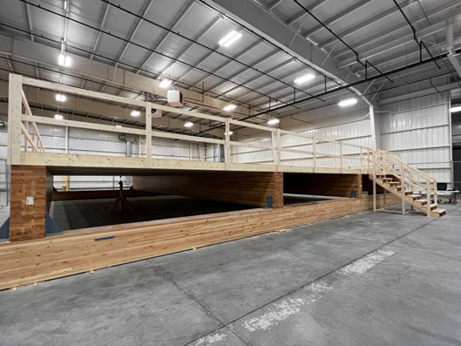
Objectives
Beam-supported glulam deck floor
To obtain the dynamic properties and responses of the floor under different construction phases in laboratory
To investigate the vibration performance of the beam-supported glulam deck floor
To assess the applicability of several current-used mass timber floor vibration design criteria to such floor system
(Test conducted in Western Archrib Factory, Edmonton)
Notes:
In this research, experimental tests were conducted in labotoray for a beam-supported glulam deck floor. The test was conducted with cooperation of western archirb. And the objectives for this test is to

Slide 13
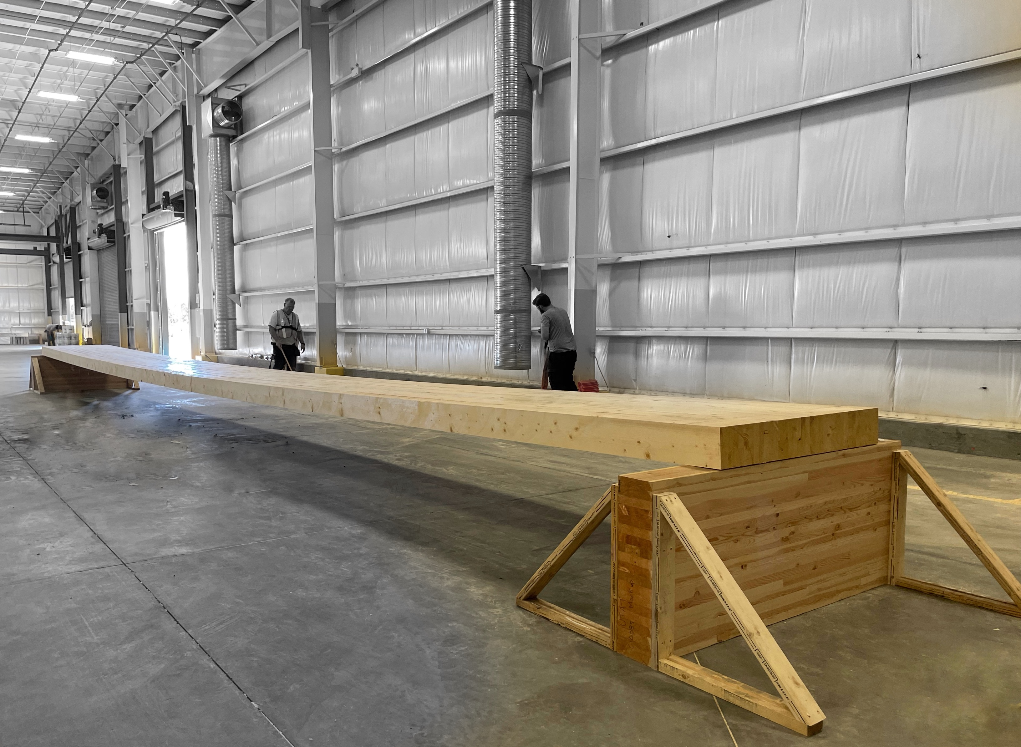
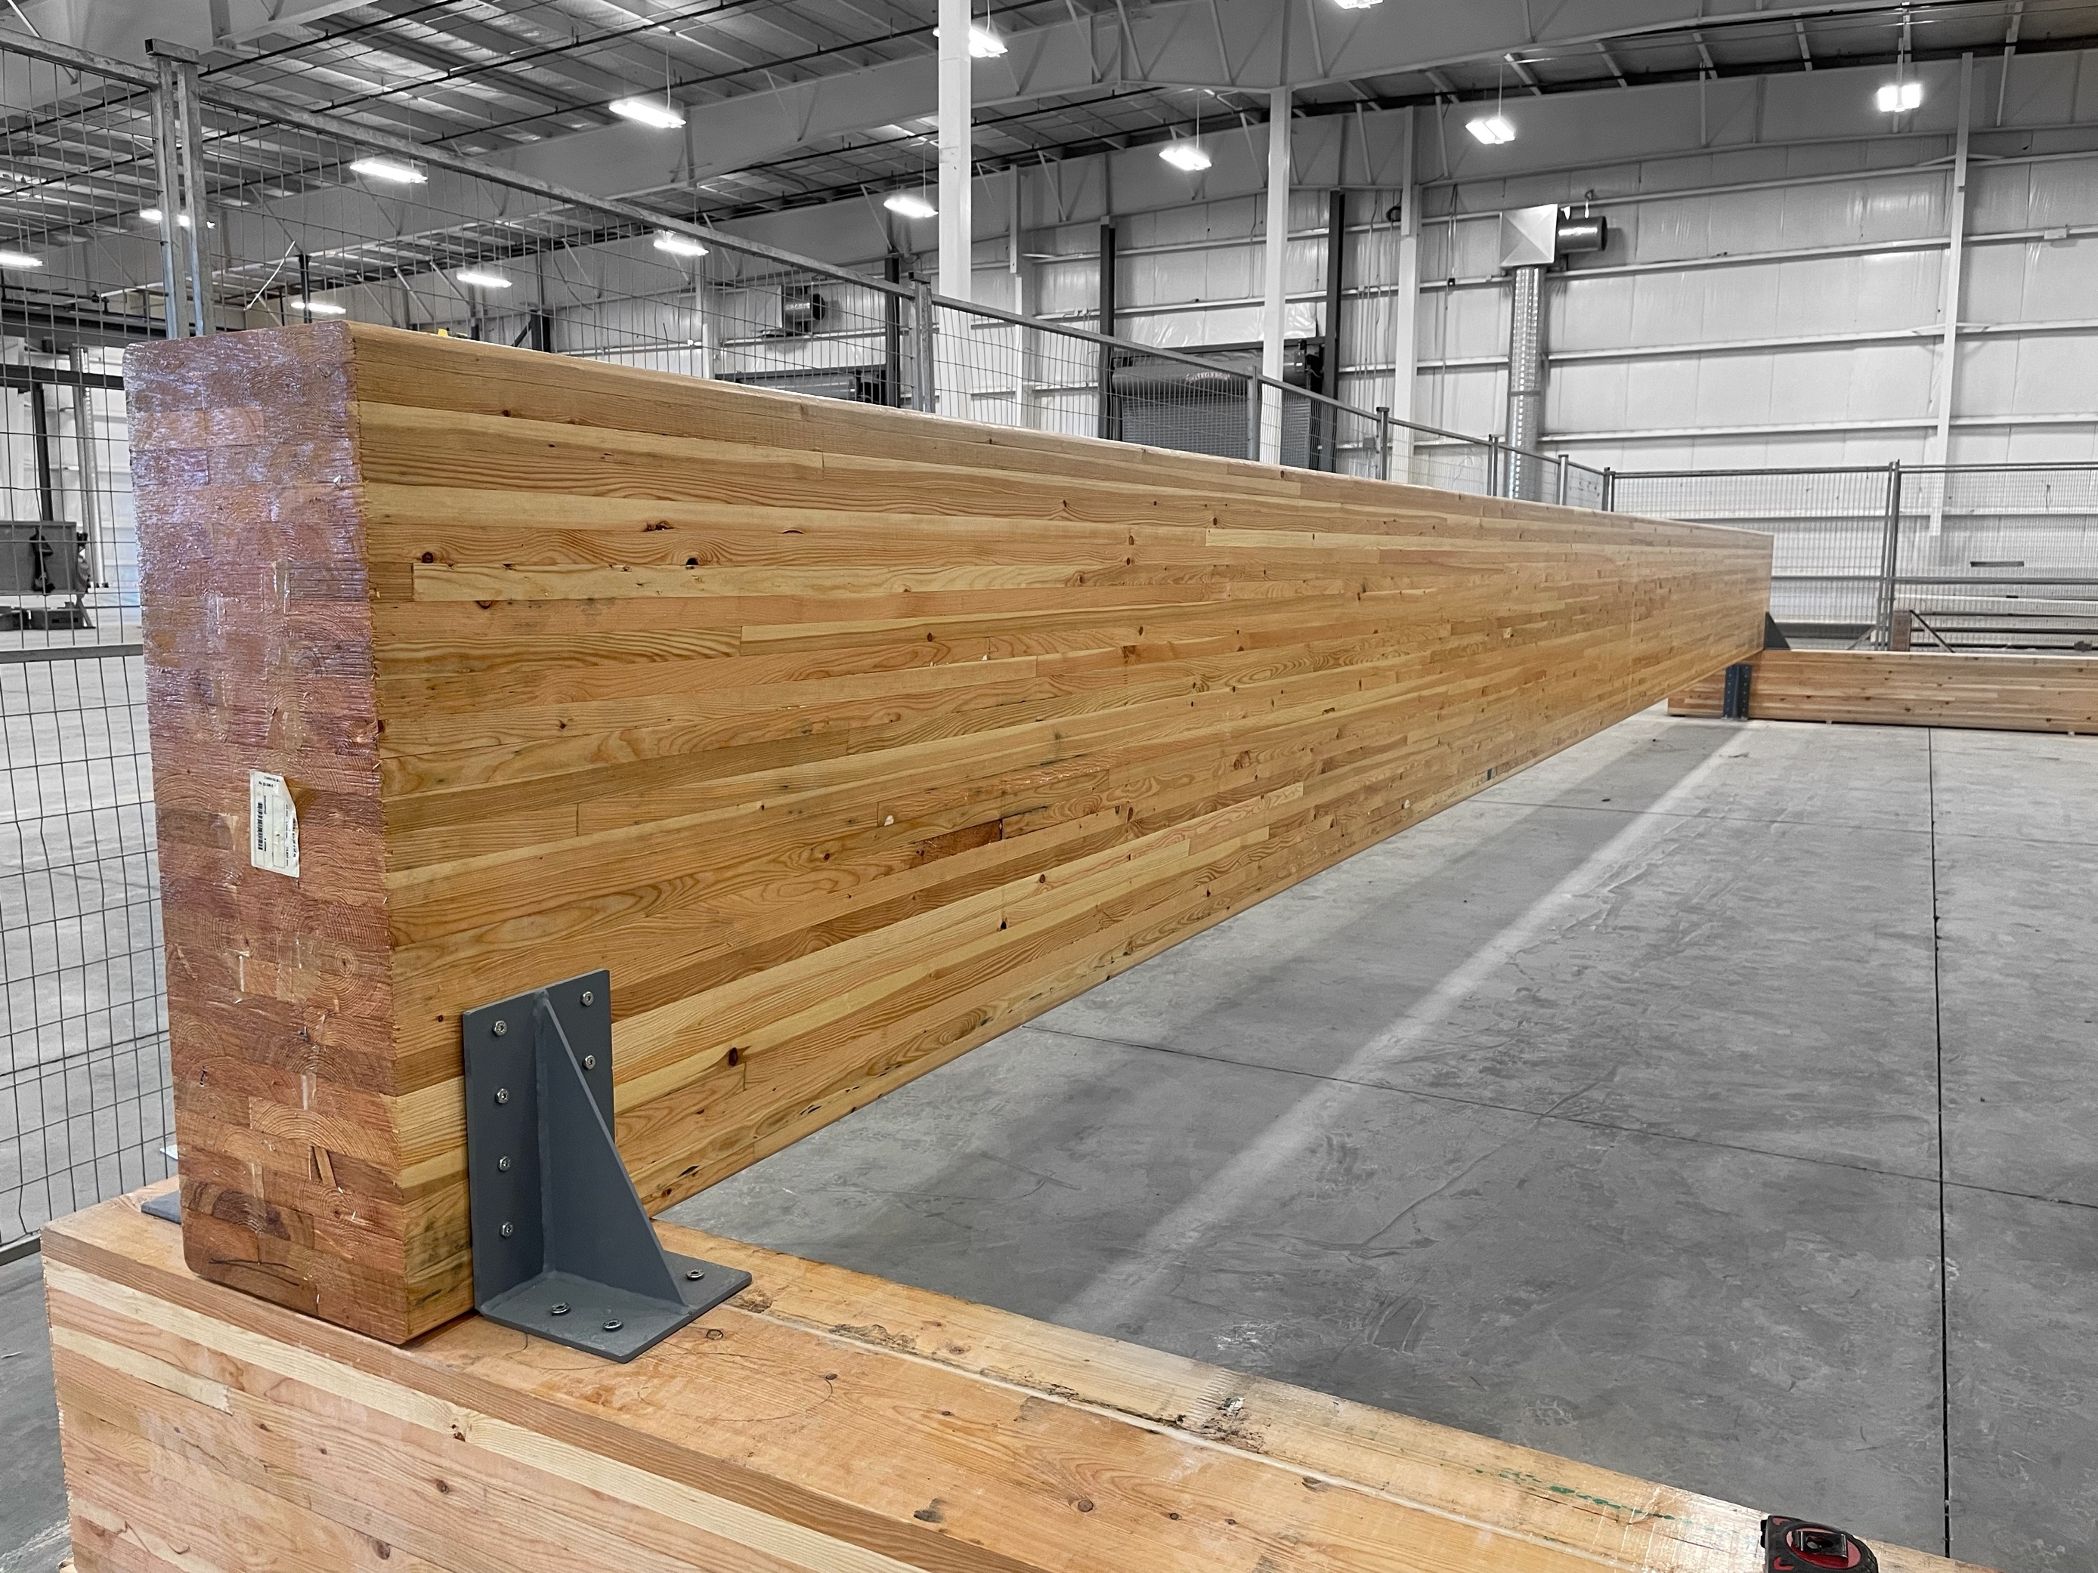
Materials
Components:
Thickness: 0.175 m
Width:1.2 m
Length: 15.9 m
Glulam deck panel
(Spruce-Pine)
Dimension: 0.365 m x 1.026 m
Length: 14.5 m
Glulam supporting beam
(D.Fir 24f-E - 120min fire rated)
Notes:
The components used in this test including the glulam deck panel spanning 16 meters total, and thickness of 175 mm. The glulam beam used for supports spanning 14.5 m, and has a dimension of 365 mm* 1026 mm.

Slide 14
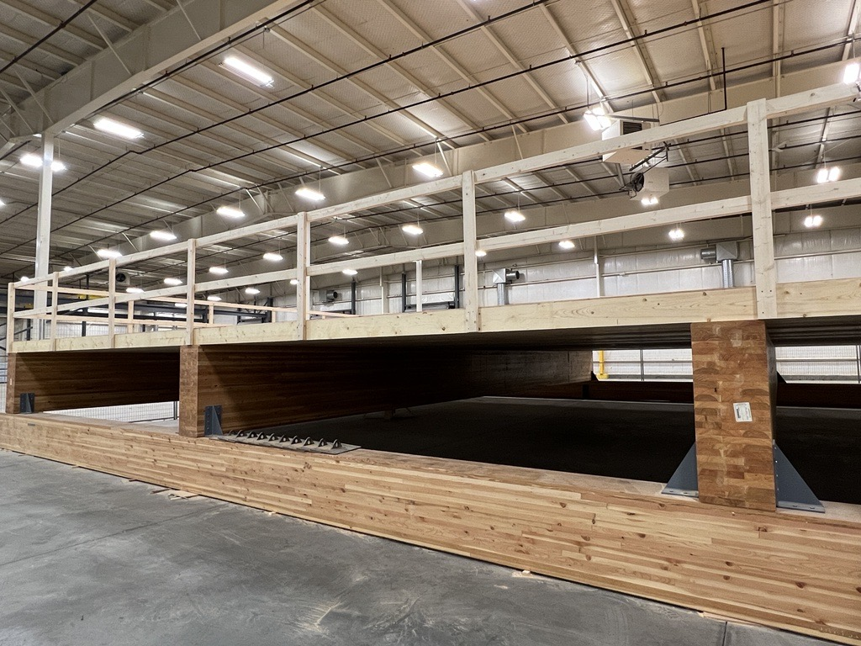
Floor Assembly and Test Phases
Primary step:
Component test (beam and floor panel)
Phase 1:
Bare floor
Phase 2:
Add one layer of 12.7mm plywood sheathing
Phase 3:
Add acoustic mat and one layer of 38 mm concrete topping (blocks)
5.3 m
4 beams
12 deck panels (three equal span, each 5.3 m)
Notes:
In total , four supporting beams and twelve glulam deck panels were used to assemble the floor. The floor has three equal span of 5.3 m.
The components was tested before assembled, and constructed and tested through three phases namely, phase 1 bare floor, phase 2 the floor with one layer of plywood and then phase 3 is the floor with 38 mm concrete toppings.

Slide 15
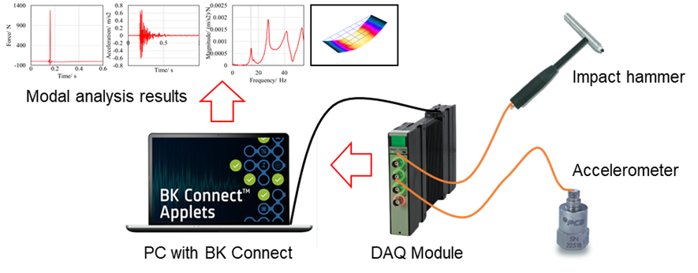
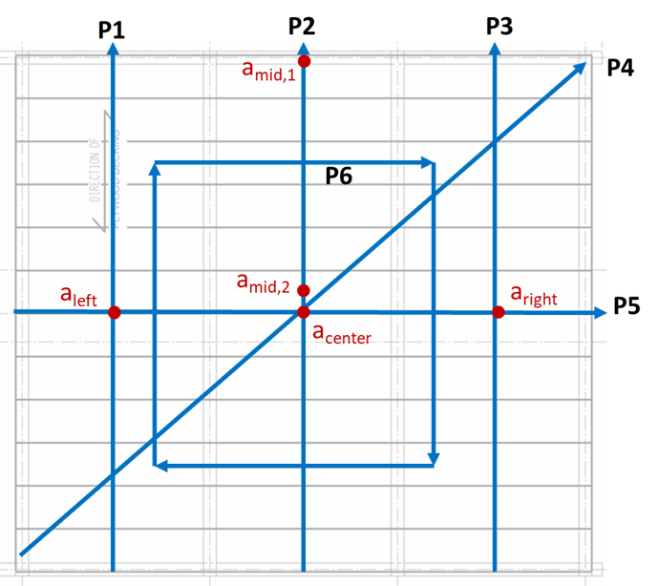
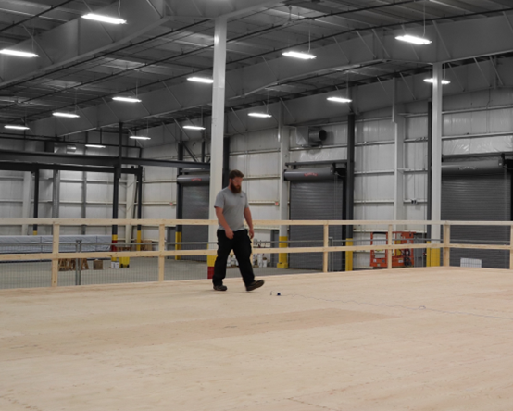
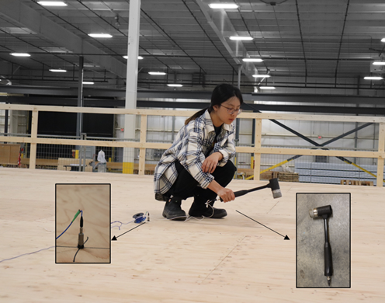
Test methods
Modal test and analysis
To obtain the dynamic properties
2. Acceleration measurement
To collect the acceleration under normal human walking
Different walking paths and sensor setup
A 100 kg evaluator walking following different walking frequency
Impact hammer test

Slide 16
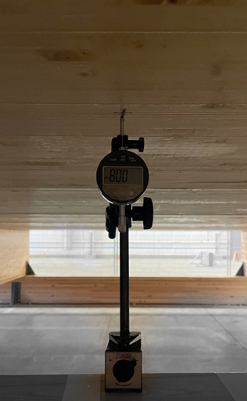
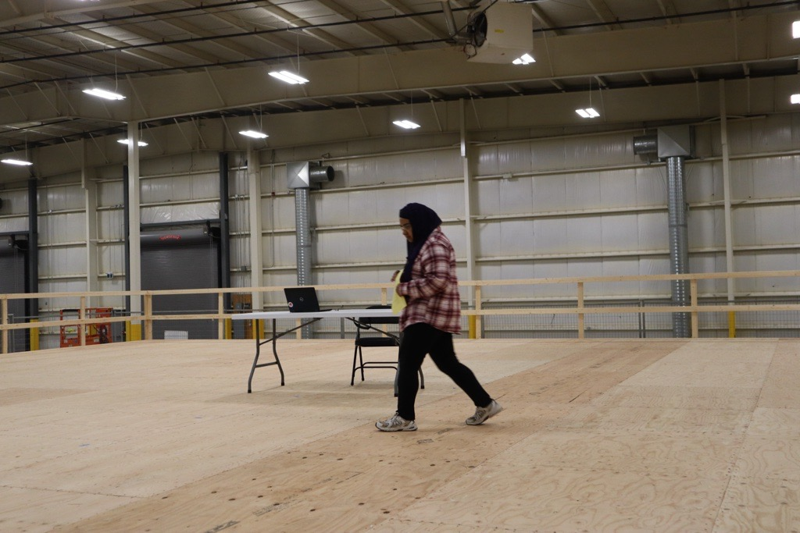
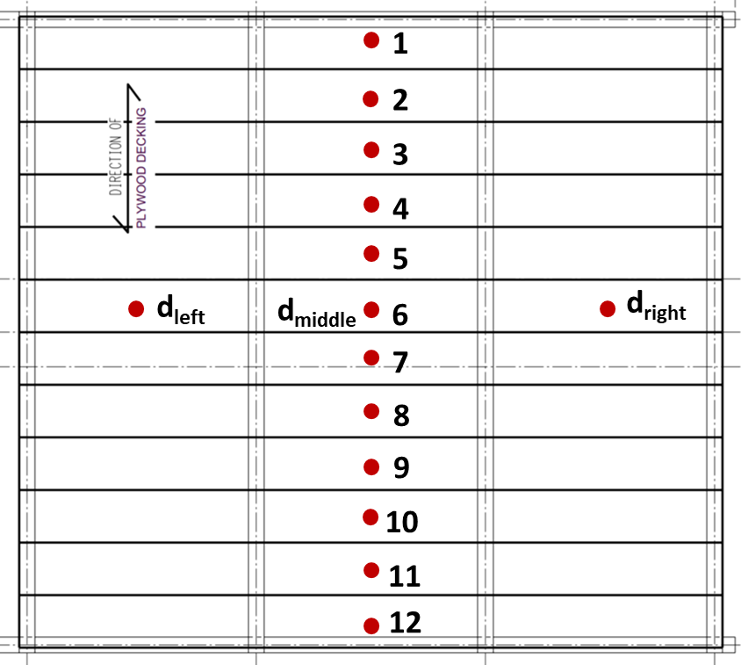
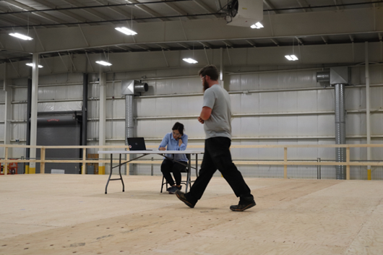
Test methods
3. Deflection measurement
To measure the deflection under 1 kN point load
4. Subjective evaluation
To obtain the floor’s vibration performance from occupants
10-20 evaluators
Rating the performance from 1-5 (ISO/TR 21136)
1- Definitely unacceptable
2- Unacceptable
3- Marginal
4- Acceptable
5- Definitely acceptable
Walking on the floor
Dial-gauge under the floor
Different measuring locations
Sitting on the floor, others walking

Slide 17
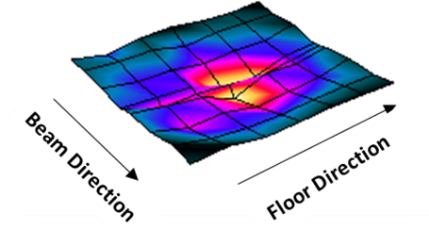
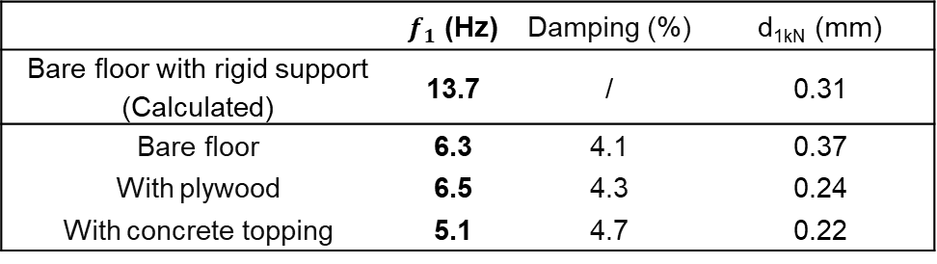
Results
1. Dynamic properties
f₁: fundamental natural frequency
decreased 55 % due to the change of support conditions
decreased 20 % due to the addition of concrete topping
 | $f_{1}$ (Hz) | Damping (%) | d_{1kN} (mm)
Bare floor with rigid support (Calculated) | 13.7 | / | 0.31
Bare floor | 6.3 | 4.1 | 0.37
With plywood | 6.5 | 4.3 | 0.24
With concrete topping | 5.1 | 4.7 | 0.22
First mode shape
Notes:
Then we come to the results from the test, from the modal test, the fundamental natural frequency of the floor under the three phases are shown here, comparing with the bare floor with rigid support, which we could easily calculate the fundamental natural frequency, the bare floor with beam supports has a much lower frequency, decreased by more than 50 %. And due to the addition of concrete topping, the floor’s frequency also decreased another 20 %, since the concrete toppings were added using blocks, they only brought some weight to the system but not the stiffness.
we can see that the floor performed a bending in both floor and beam direction,

Slide 18
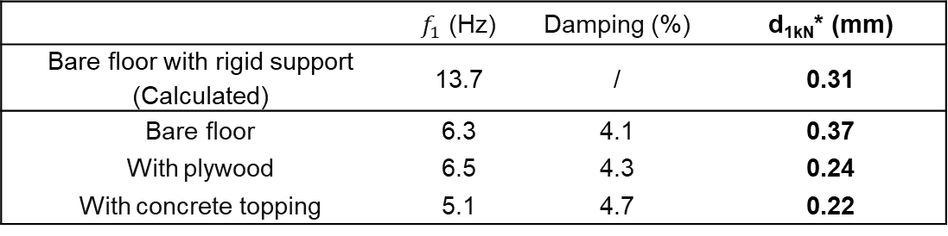
Results
2. Deflection
d_{1kN} :Deflection under 1 kN point load
 | $f_{1}$ (Hz) | Damping (%) | d_{1kN}* (mm)
Bare floor with rigid support (Calculated) | 13.7 | / | 0.31
Bare floor | 6.3 | 4.1 | 0.37
With plywood | 6.5 | 4.3 | 0.24
With concrete topping | 5.1 | 4.7 | 0.22
Increased due to the flexibility of supporting beams
Decreased 40 % due to the addition of sheathing panel
*Averaged value
Notes:
For the deflection, the results are shown here, the deflection of this floor with rigid support could also be calculated simply. We can see that the beam supports increased the deflection value since the supporting beam’s flexibility, and by adding the sheathing panel, the defelction decreased 40 %, since the sheathing panel actually increased the whole floor’s width by connecting them together. And the deflection also varied depending on different measuring location, since each panel was on the different location of the supporting beams.

Slide 19
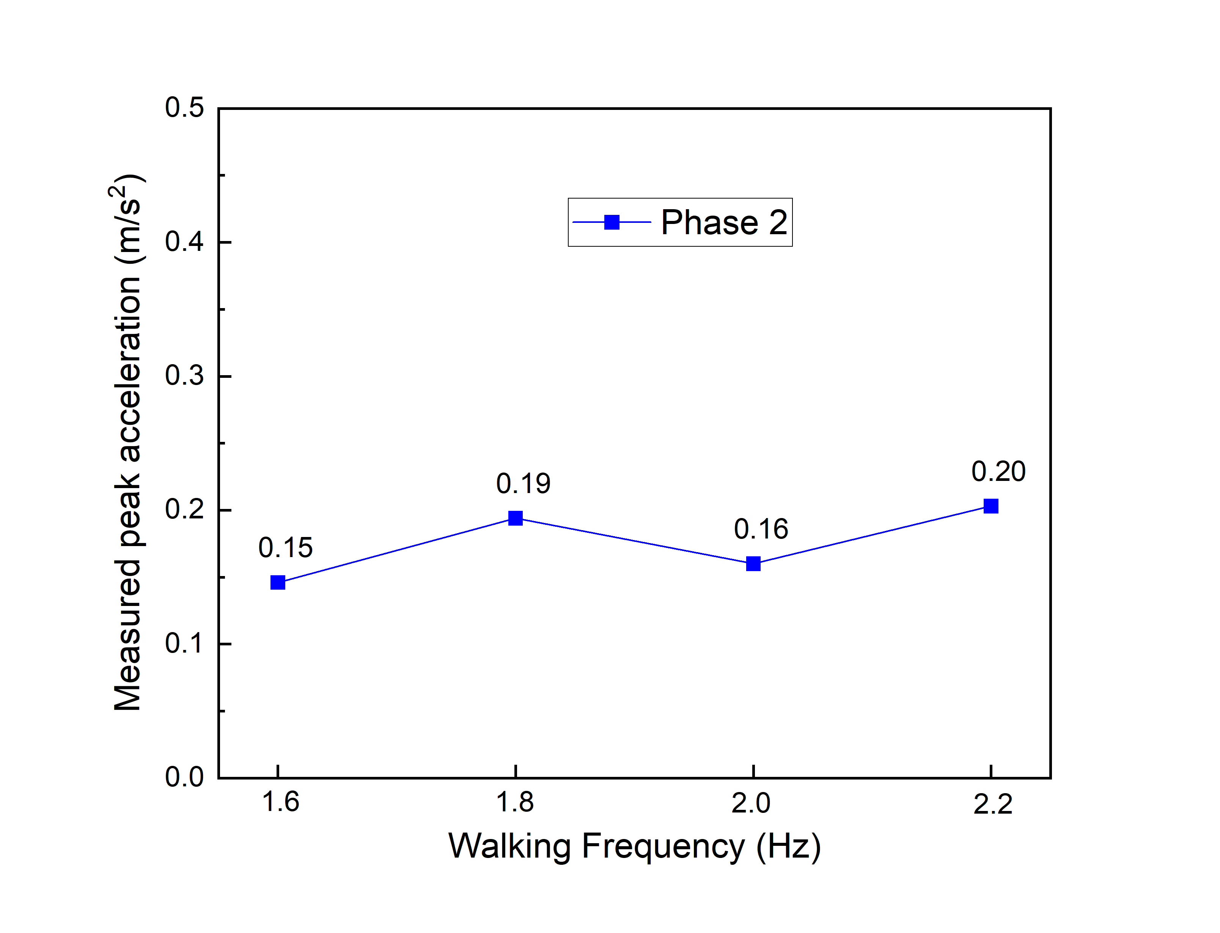
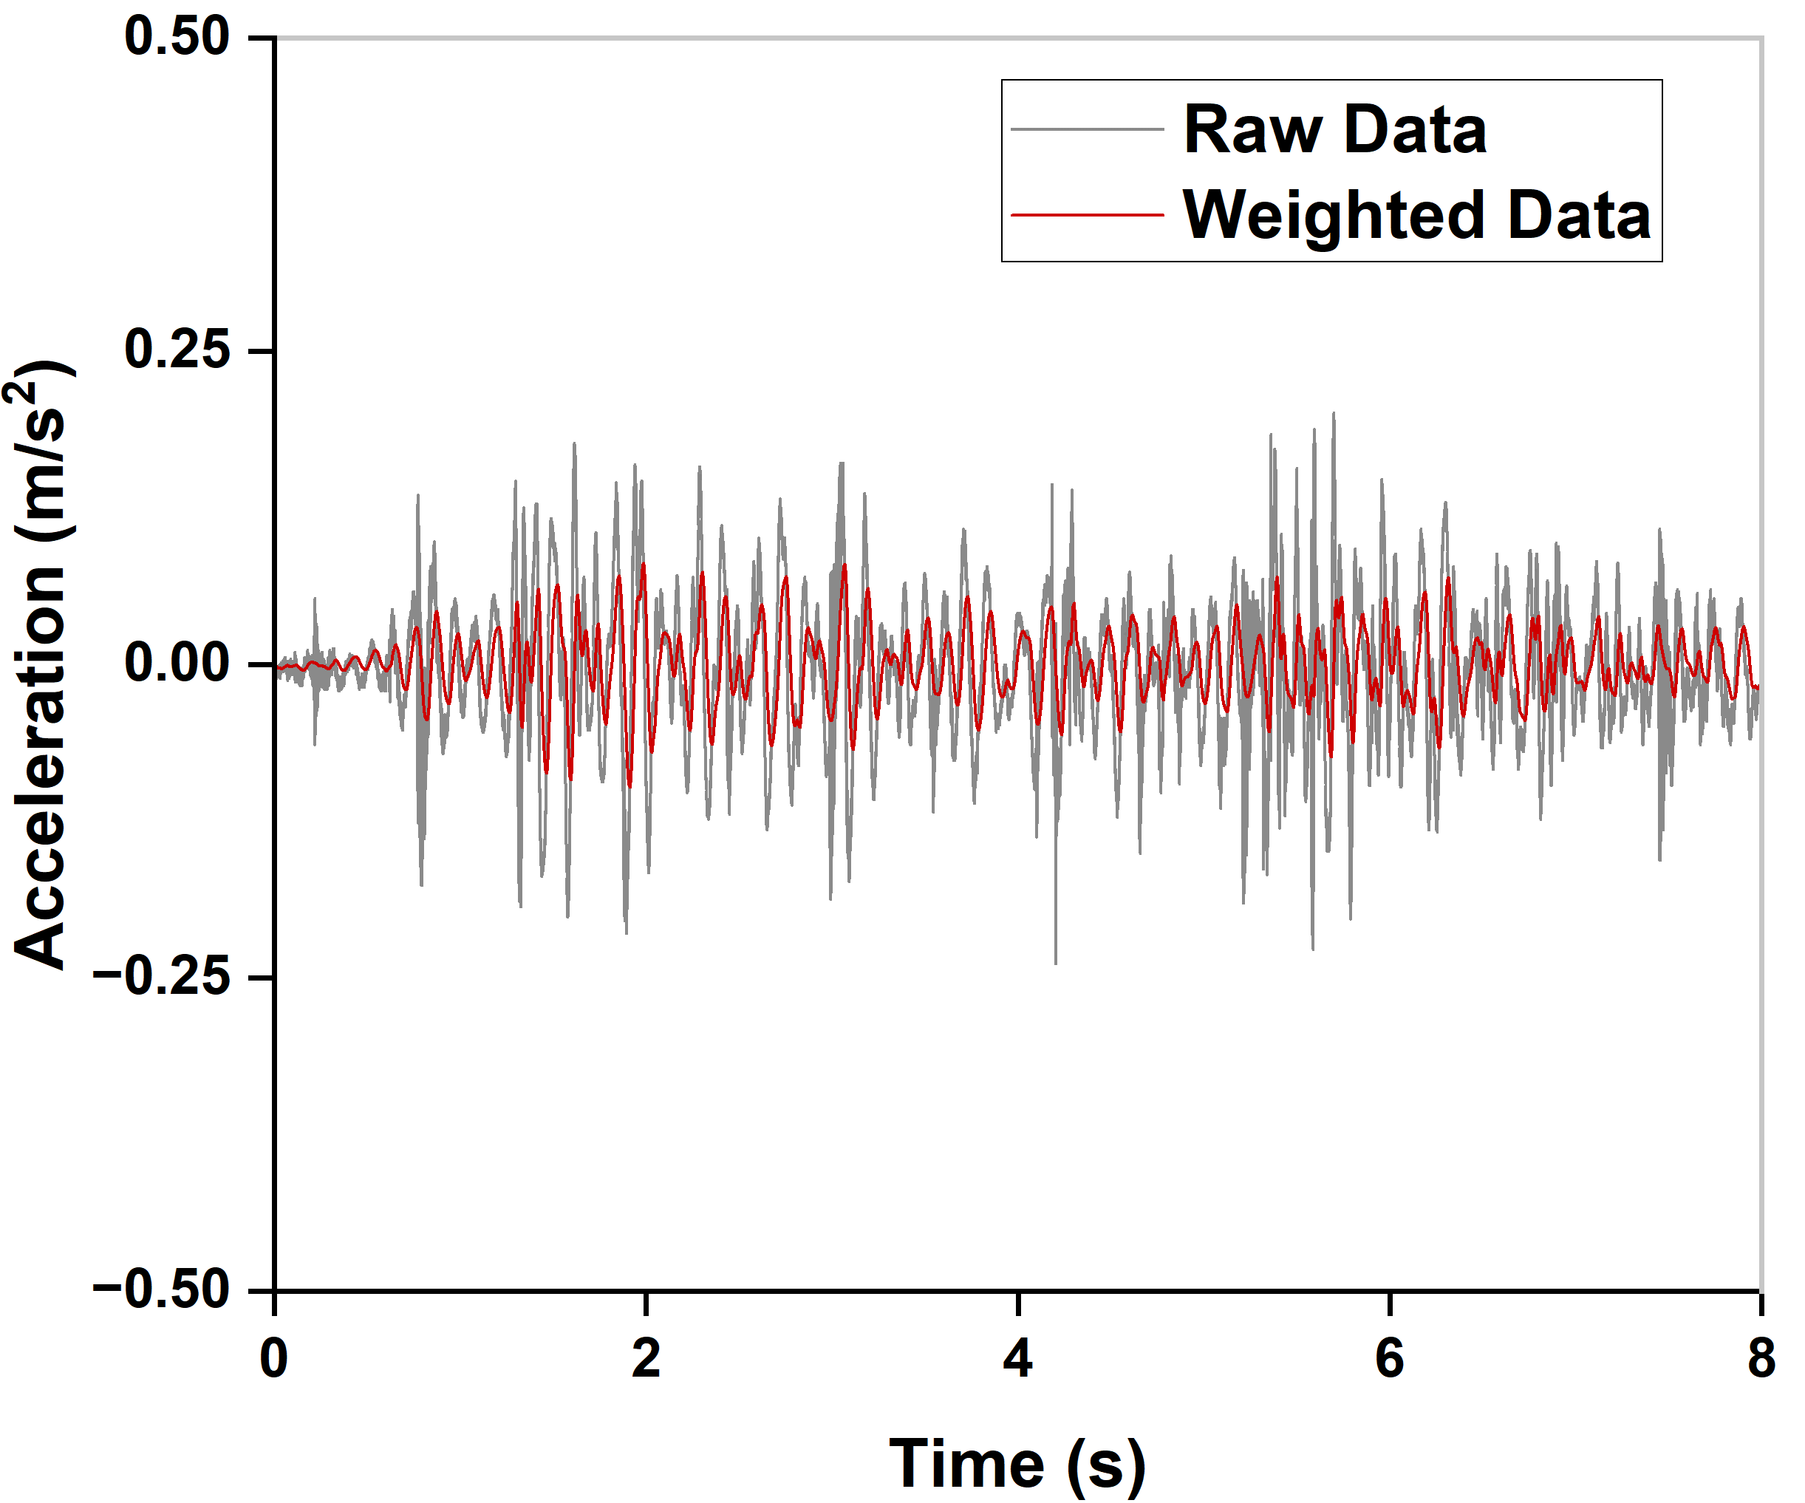
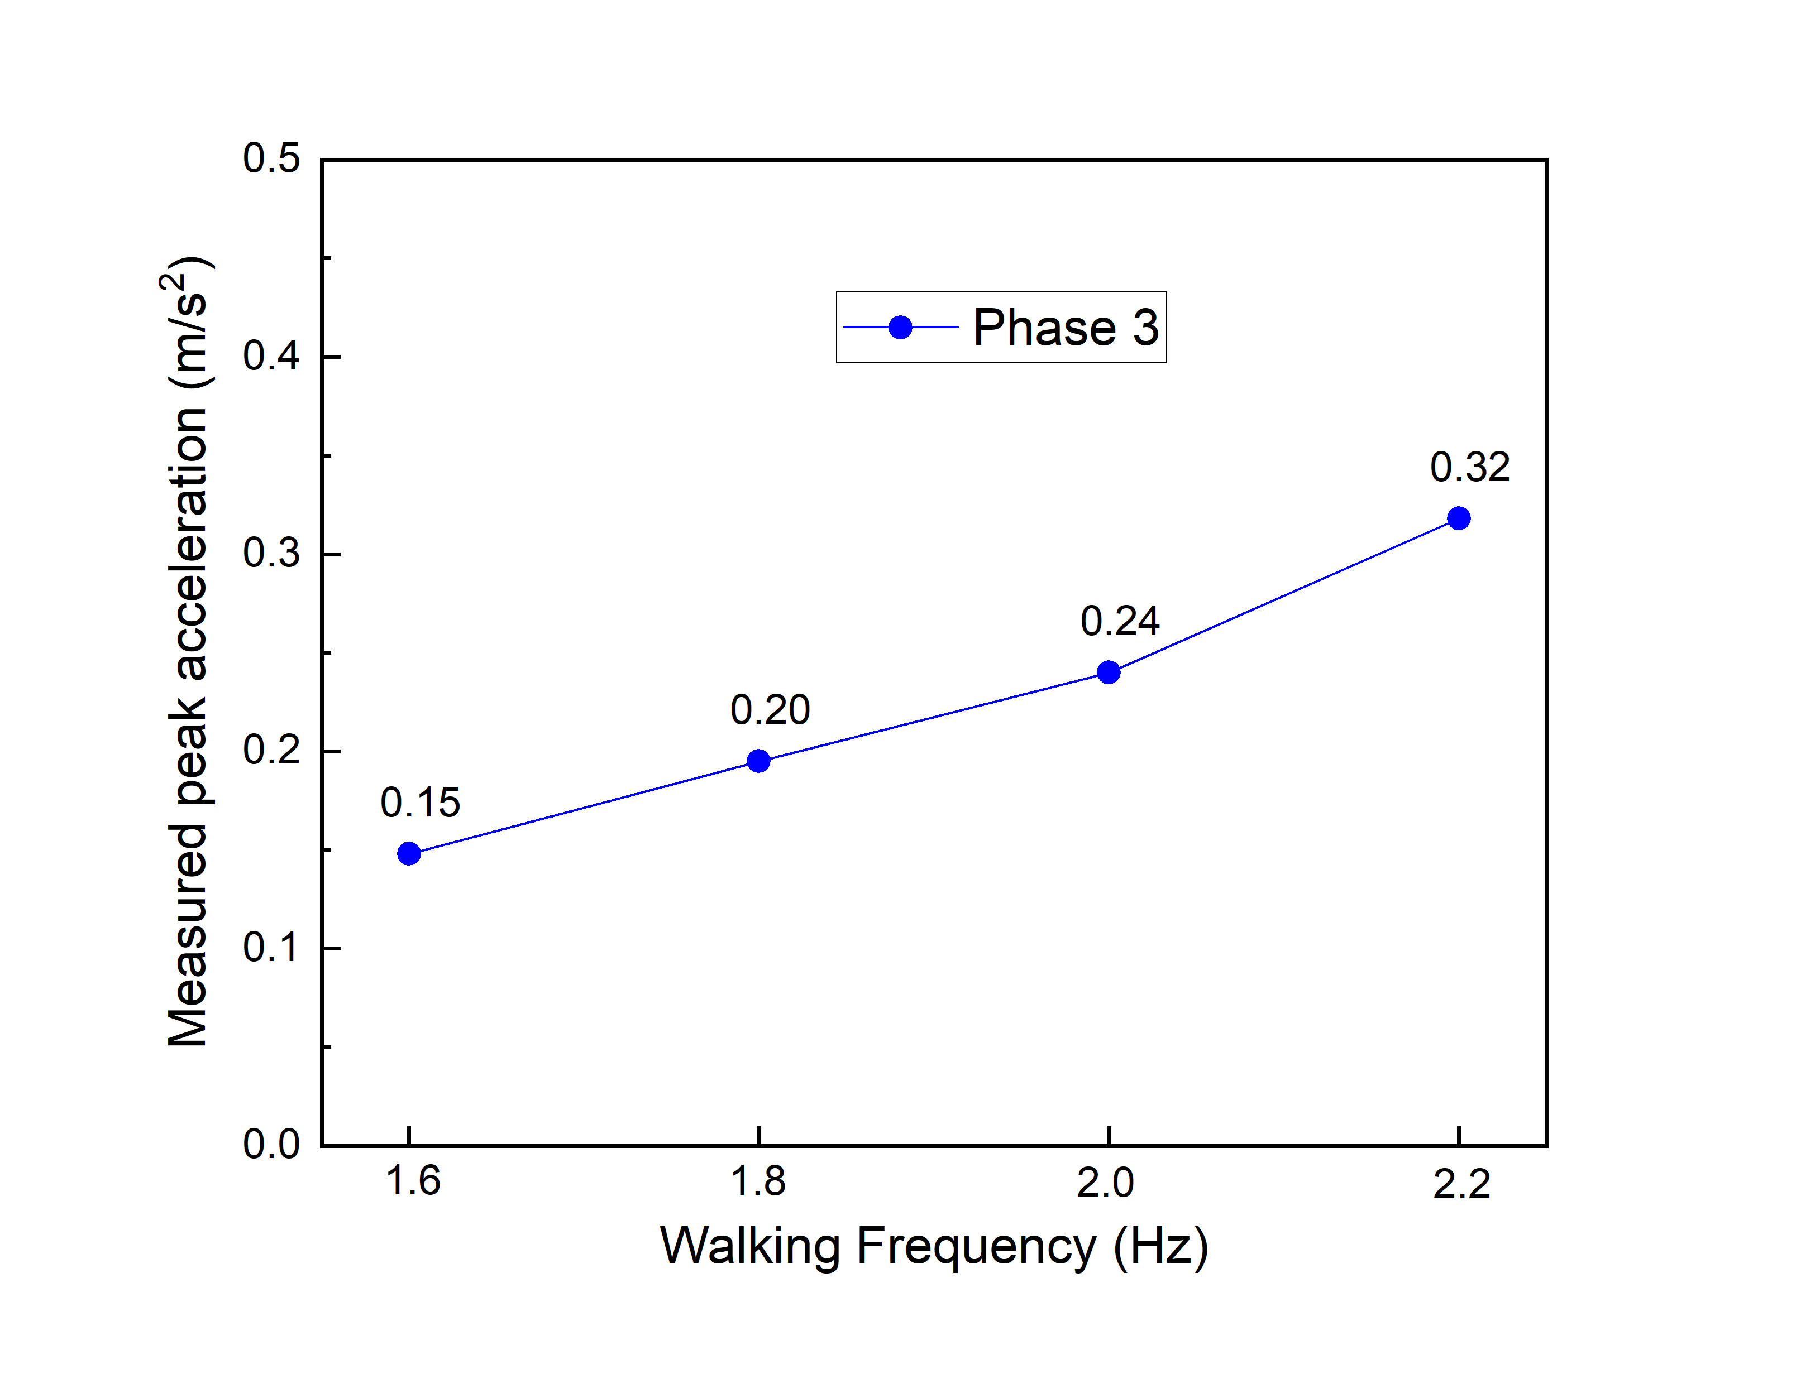
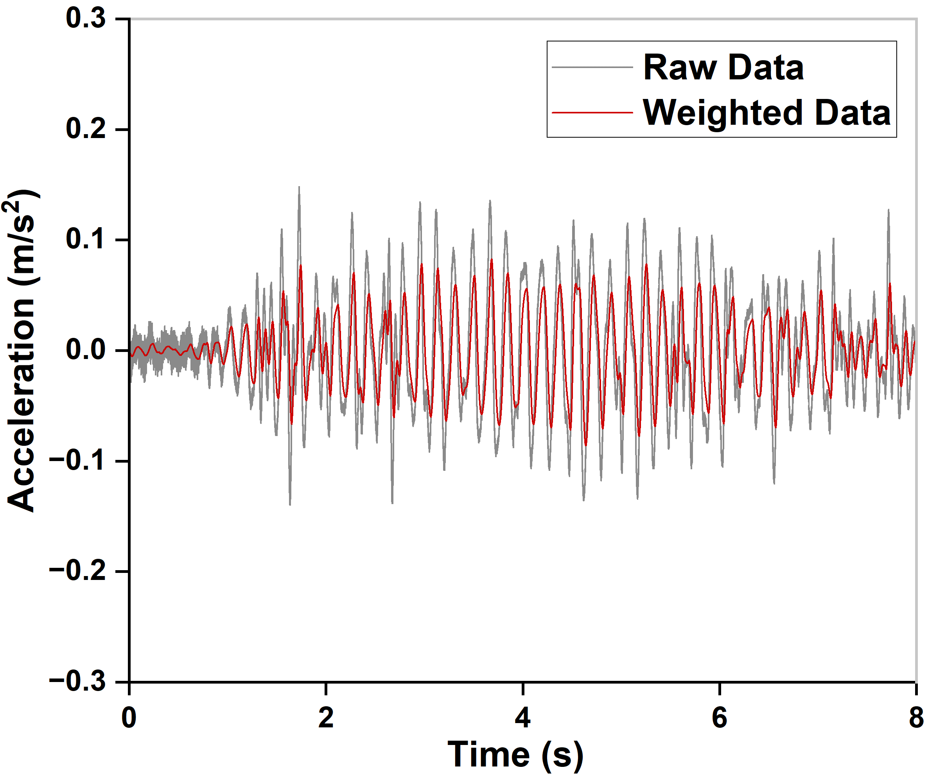
Results
3. Acceleration
Measured peak acceleration (maximum) by different walking frequency
Time history acceleration
(Weighted based on ISO 2631)
Resonant response under normal human walking
Walking frequency affects the measured acceleration
Notes:
From the measured time history of acceleration of the floors, we can observe a resonant response of the floor under the human-walking. And by walking in different frequency ranging from 1.6 to 2.2, the collected response were also affected, could be two times higher.

Slide 20
Results
4. Vibration performance
CSA O86 method
Not applicable for beam-supported floor
2. ASIC DG11 method (check peak acceleration)
Tolerance limit: 0.05 m/s²
Phase 2: 0.15-0.20 m/s² 3-4 times higher
Phase 3: 0.15-0.30 m/s² 3-6 times higher
3. Eurocode 5 method (check deflection, RMS acceleration when f₁<8 Hz)
Phase 2 and 3:
Deflection < 0.25 mm
R factor: 7-8 Quality choice (the highest level)
 | Phase 2 (with plywood) | Phase 3 (with concrete topping)
Mean | 3.2 (Marginal) | 4.6 (Acceptable)
Maximum | 5.0 | 5.0
Minimum | 2.0 | 4.0
Coefficient of variation | 30.0% | 9.1%
Notes:
Last part is the floor’s vibration performance. Since the bare floor phase, the panel was not continuous, so the subjective evaluation was only conducted on the floor with plywood and concrete topping. For the floor with plywood, the performance was deemed to be marginal, which means they can feel the vibration on the floor but they are ok with it. With the addition of concrete topping, the performance increased to accepetable, means they can’t feel the vibration and they can accept the floor.
Comparing with the current design methods which I mentioned in the introduction, the Canadian design method is not applicable for beam-supported floor, so pass. The ASIC method suggested 0.05 as the limitation. But from our measurement, both of the floors showed 3 to 6 times higher acceleration higher than this value, but still perform great in vibration.
And for the new Eurocode 5 method, we checked the floor’s deflection and RMS acceleration, both of the floor could be categorized to quality choice based on this method, that is the highest level. However, the floor with plywood did not perform as well as predicted using this method.

Slide 21
Conclusion
Support conditions could largely affect the same floor’s fundamental natural frequency
Change from rigid to beam support, f₁ decreased by 50 %
Extra sheathing panel or concrete topping on the floor has a significant effect:
The concrete topping decreased the floor’s f₁ by 20 %
The plywood sheathing and concrete topping decreased the floor’s deflection by 40 %
The concrete topping improved the floor’s vibration performance, from marginal to definitely acceptable
Current-used timber floor vibration criteria all showed limitations to such beam-supported mass timber floor systems
Notes:
To conclude, from this research, …

Slide 22

Outcomes and Future Work
Laboratory test data was used to support the construction of the academic wood tower
Use laboratory test data to verify the analytical equations and numerical models for beam-supported floor (Guo,2023)
Conduct field test to obtain data and compare the same floor’s performance both in both laboratory and real-world settings
Utilize a comprehensive experimental test database for developing a comprehensive vibration design framework for mass timber floors
(Academic Wood Tower, Toronto)

Slide 23





Thanks for your listening!
Email: cg9@ualberta.ca

