Slide 1




NSERC Alliance Grant Project ‘NEXT-GENERATION WOOD CONSTRUCTION’
A CWCRN Initiative
Rolling shear and punching shear of CLT
Houman Ganjali
Ph.D. Candidate, University of Northern British Columbia

Slide 2







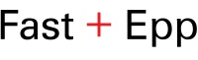
Dr. Jianhui Zhou
Supervisory committee member
Carla Dickof
Industry partner
Dr. Thomas Tannert
Supervisor
Dr. Md Shahnewaz
Supervisory committee member
Industry partner
Dr. Marjan Popovski
Supervisory committee member

Slide 3
Content
Cross laminated Timber (CLT)
Point-supported CLT
Punching shear
CLT rolling shear
CLT punching shear
Project outlook

Slide 4
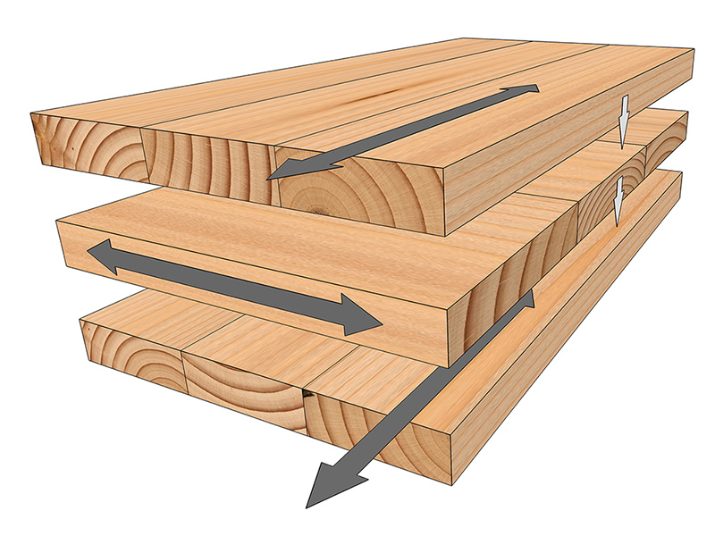
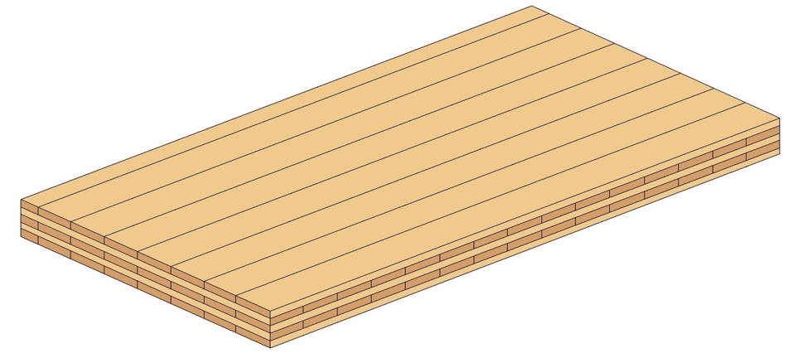
Cross laminated Timber (CLT)
https://www.reidmiddleton.com/reidourblog/timber-construction-using-clt/

Slide 5
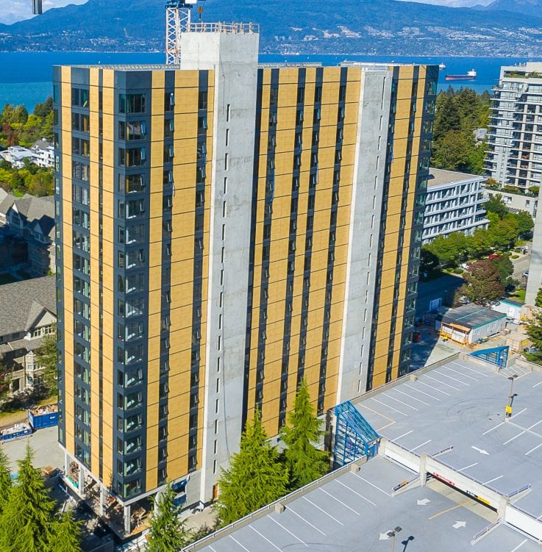
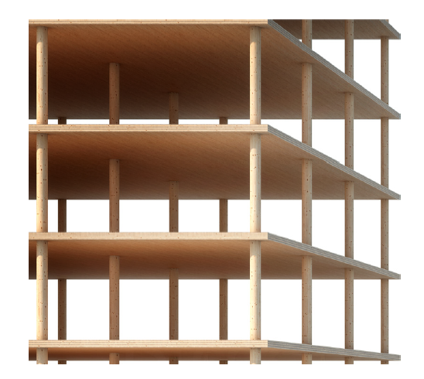
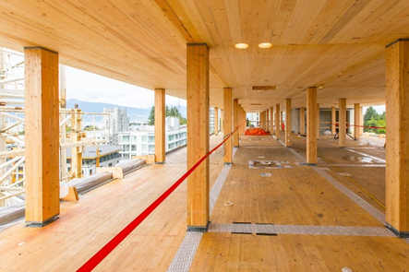
Point Supported CLT (Post+Plank)
Muster M. and Frangi A. 2020
Photo credit: Fast+Epp
Photo credit: Fast+Epp

Slide 6
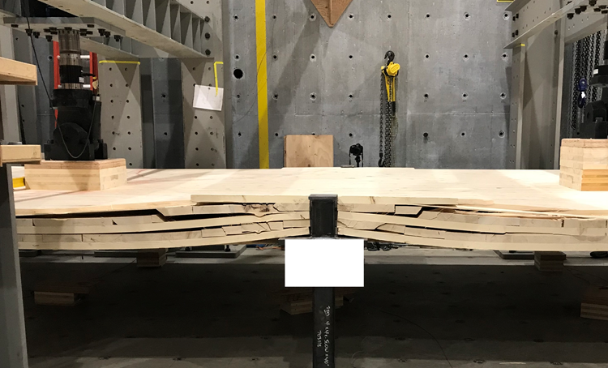
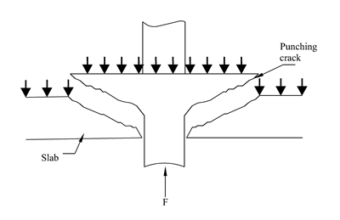
Punching shear in CLT
Photo credit: Dr. Thomas Tannert

Slide 7
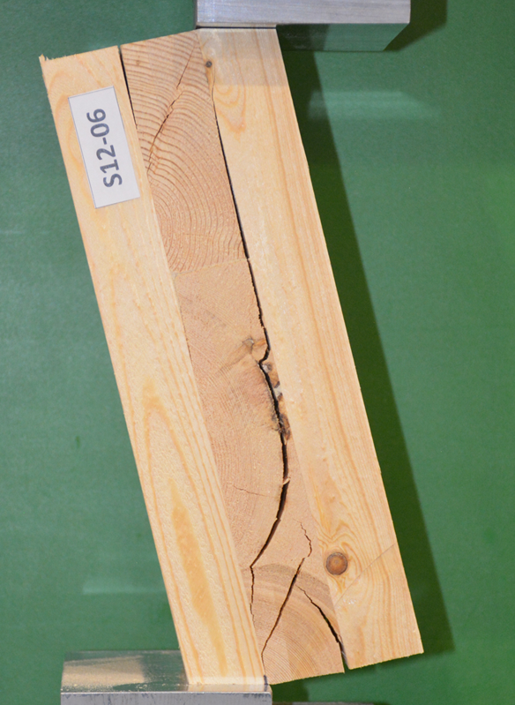
CLT rolling shear strength
CSA O86 rolling shear strength values
Predictors of higher RS strength
Compare test methods
Compare results with punching shear tests

Slide 8
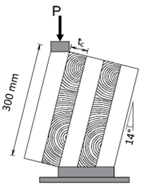
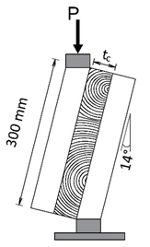
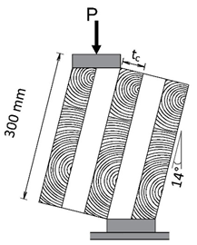
Modified rolling shear test
EN 408
Mestek’s modifications

Slide 9
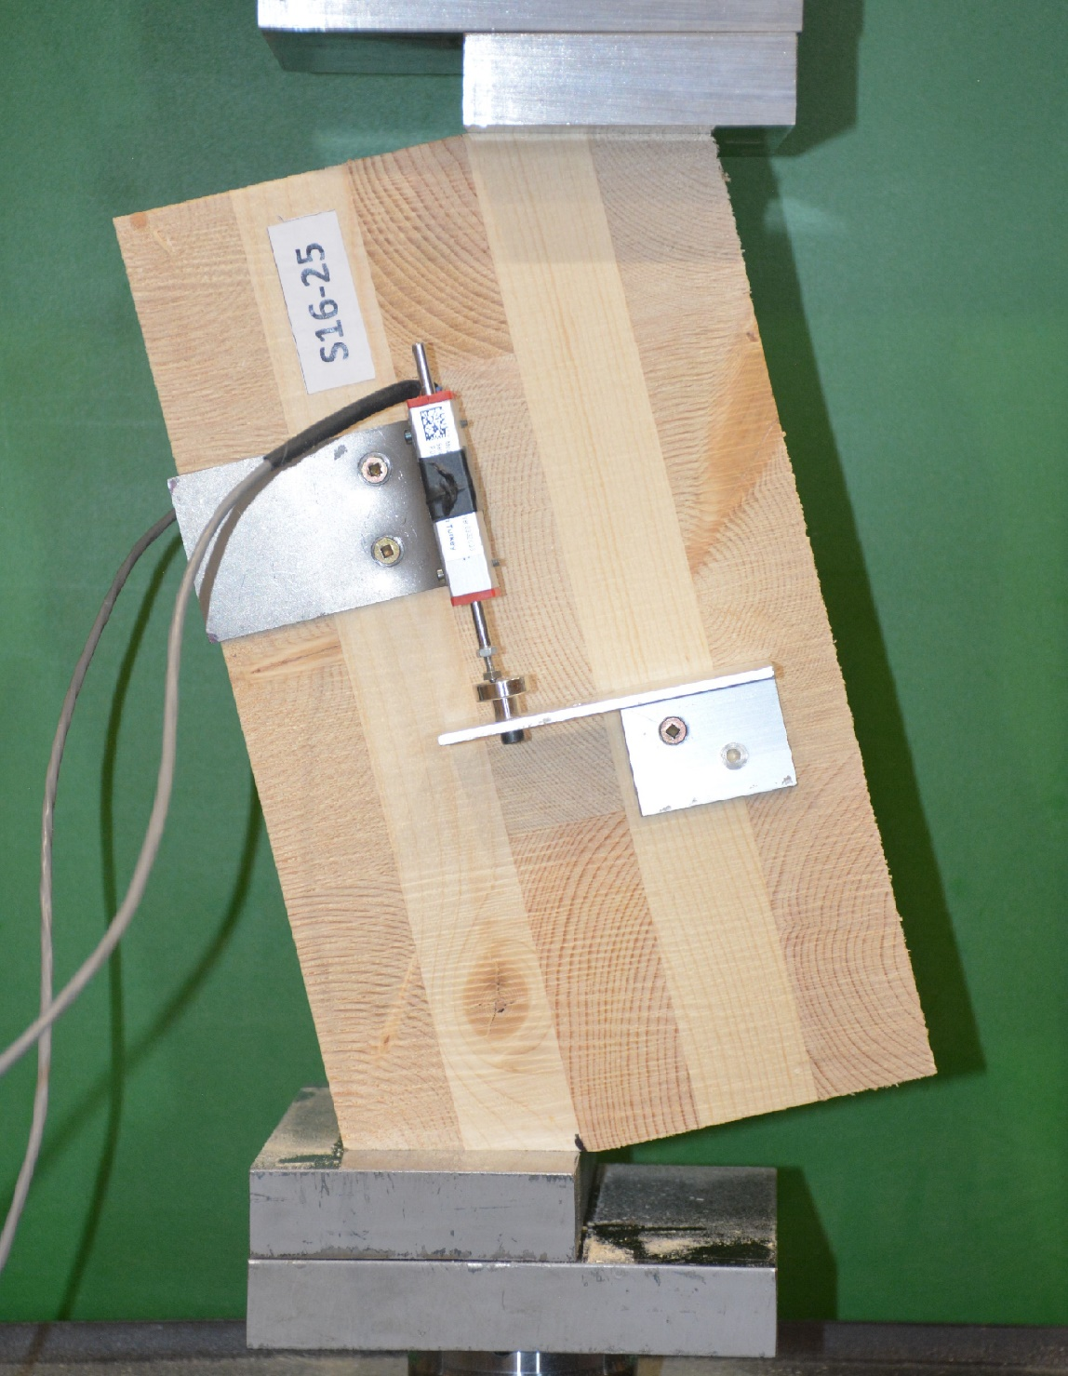
Rolling shear inclined tests
689 specimens
22 series
5 CLT providers
E1 & V2 stress grades
3- & 5-layered layups
4 species (Spruce, SPF, HEM, D-Fir)
Minor and major direction
2 test layer thicknesses
Edge glued and non-edge glued

Slide 10
Rolling shear inclined test results
Series | 5th% [MPa] | ADJ [MPa]
S1 | 1.02 | 0.89
S2 | 0.62 | 0.54
S3 | 0.73 | 0.64
S4 | 1.27 | 1.11
S5 | 1.24 | 1.08
S6 | 1.24 | 1.08
S7 | 0.84 | 0.73
S8 | 0.74 | 0.64
S9 | 0.74 | 0.64
S10 | 1.10 | 0.96
S11 | 0.71 | 0.61
S12 | 0.82 | 0.71
S13 | 1.08 | 0.94
S14 | 0.70 | 0.61
S15 | 0.88 | 0.77
S16 | 0.88 | 0.77
S17 | 0.87 | 0.76
S18 | 0.84 | 0.73
S19 | 0.88 | 0.77
S20 | 0.90 | 0.78
S21 | 1.14 | 0.99
S22 | 0.92 | 0.80
CSA RS ×1.1
CSA O86 RS value: 0.5-0.6 MPa
High RS predictor(s)?
CSA RS × 2.2

Slide 11
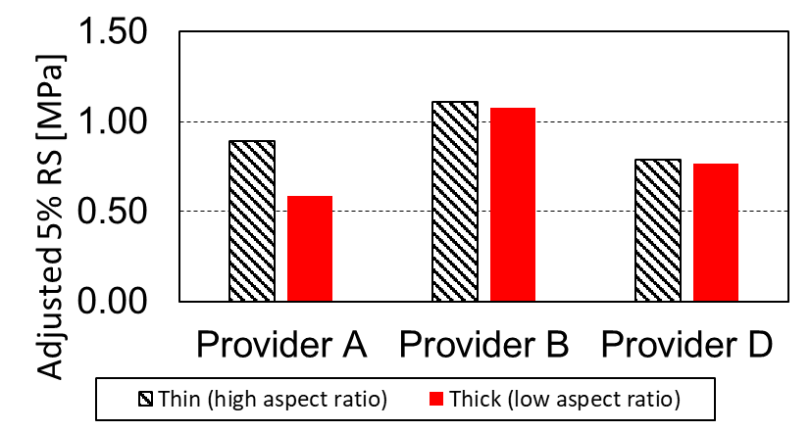
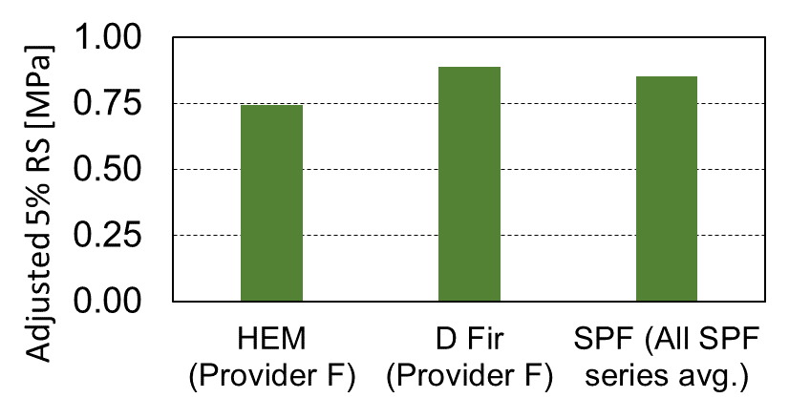
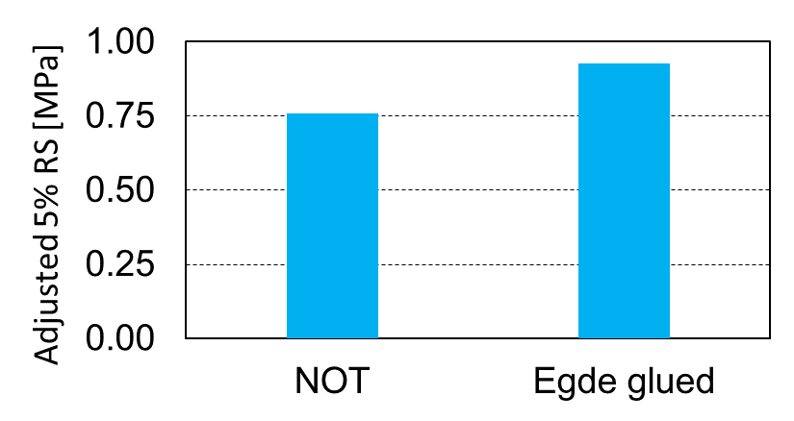
Rolling shear inclined test results
-CLT provider
-Board width to thickness ratio
Timber species
Edge gluing

Slide 12
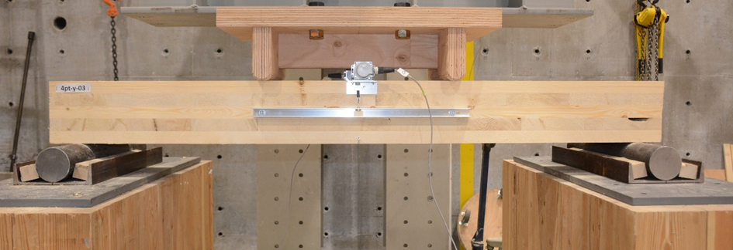
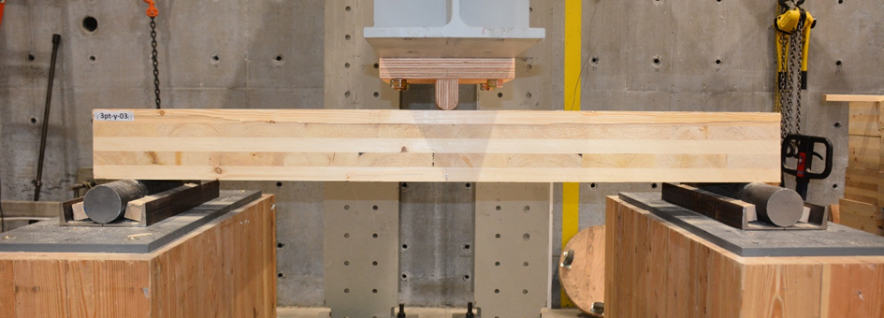
Four- & three-point bending tests
48 Specimens
1.7 m by 0.3 m
E1 stress grade
5-layered CLT
Major and Minor

Slide 13
Four- & three-point bending tests
Series | Mean [MPa] | 5th% [MPa] | ADJ [MPa]
3pt-y | 1.10 | 0.98 | 0.85
3pt-i | 1.28 | 0.98 | 0.85
4pt-y | 1.47 | 1.20 | 1.04
4pt-i | 1.29 | 1.10 | 0.96
> 0.5-0.6 MPa
Mean RS strength from
modified inclined test
Major 1.62 MPa
Minor 1.14 MPa

Slide 14
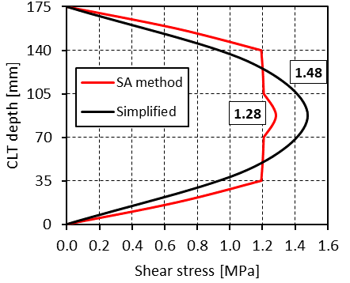
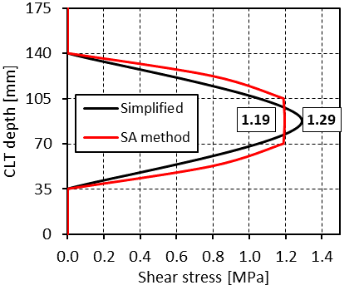
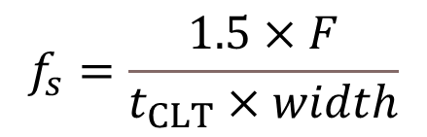
Four- & three-point bending tests
-Simplified method
-Shear analogy (SA) method
$$f_{s}=\frac{1.5×F}{t_{CLT}×width}$$
Rolling shear stresses based on simplified and SA methods: major (left); minor(right)

Slide 15
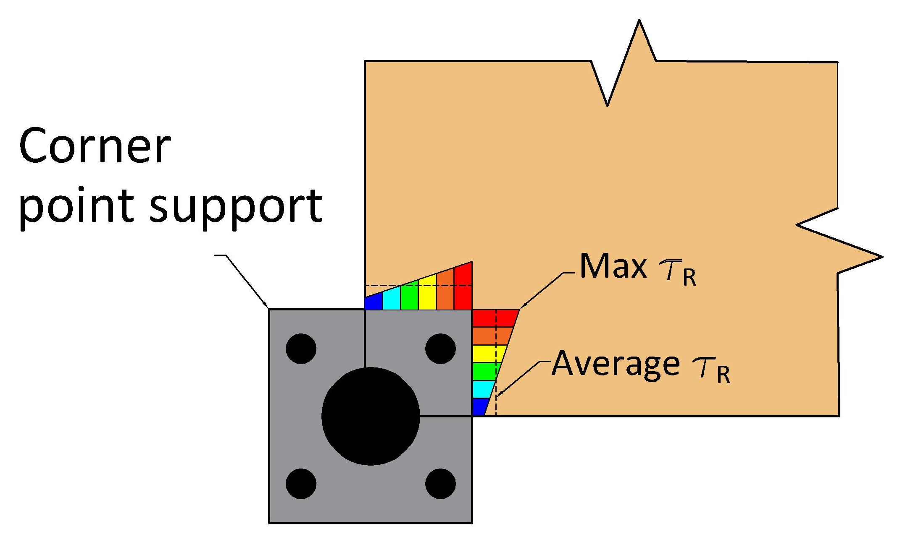
Punching shear tests
Influencing parameters on the punching shear capacity of CLT

Slide 16
Punching shear test overview
Series | Producer | Grade | Thickness [mm] | Species | Support [mm x mm] | Support | Reinforcem.
S1 | D | V2 | 175 | SPF | 200 x 200 | Edge | None
S2 | D | E1 | 175 | SPF | 200 x 200 | Edge | None
S3 | A | E1 | 175 | Spruce | 200 x 200 | Edge | None
S4 | B | E1 | 175 | SPF | 200 x 200 | Edge | None
S5 | B | E1 | 175 | SPF | 300 x 300 | Edge | None
S6 | F | V2 | 175 | SPF | 200 x 200 | Edge | None
S7 | F | E1 | 175 | SPF | 200 x 200 | Edge | None
S8 | F | E1 | 175 | D Fir | 200 x 200 | Edge | None
S9 | F | E1 | 175 | HML | 200 x 200 | Edge | None
S10 | F | E1 | 175 | SPF | 460 x 180 LLP | Edge | None
S11 | F | E1 | 175 | SPF | 460 x 180 SLP | Edge | None
S12 | F | E1 | 175 | SPF | Ø 219 | Edge | None
S13 | F | E1 | 175 | SPF | 200 x 200, 10⁺ | Edge | None
S14 | F | E1 | 175 | SPF | 200 x 200, 25⁺ | Edge | None
S15 | F | E1 | 175 | SPF | 300 x 300 | Edge | None
S16 | F | E1 | 175 | SPF | 200 x 200* | Edge | None
S17 | F | E1 | 245 | SPF | 300 x 300 | Edge | None
S18 | F | E1 | 175 | SPF | 200 x 200 | Edge | STS
S19 | F | E1 | 175 | SPF | 200 x 200 | Edge | STS
S20 | F | E1 | 175 | SPF | 200 x 200 | Edge | STS
S21 | F | E1 | 175 | SPF | 400 x 400 | Edge | STS
S22 | F | E1 | 175 | SPF | 200 x 200 | Edge | STS
S23 | F | E1 | 175 | SPF | 200 x 200** | Edge | None
S24 | F | E1 | 175 | SPF | 200 x 200 | Interior | None
S25 | F | E1 | 175 | SPF | Ø 219 | Interior | None
S26 | F | E1 | 175 | SPF | 200 x 200 | Interior | None
S27 | F | E1 | 175 | SPF | 200 x 200 | Interior | None
S28 | F | E1 | 175 | SPF | 200 x 200 | Interior | None
S29 | F | E1 | 245 | SPF | 300 x 300 | Interior | None
S30 | F | E1 | 175 | SPF | 200 x 200 | Perimeter | None
S41 | F | E1 | 175 | SPF | 200 x 200 | Corner | None
S42 | F | E1 | 245 | SPF | 200 x 200 | Corner | None
32 series (so far)
4 provider
2 grades
2 thicknesses
3 species
3 support geometry
4 column conditions
STS reinf. levels
16

Slide 17
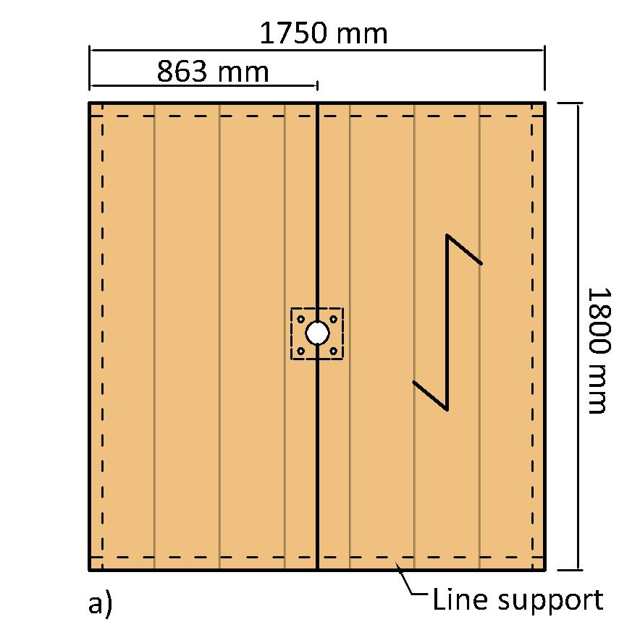
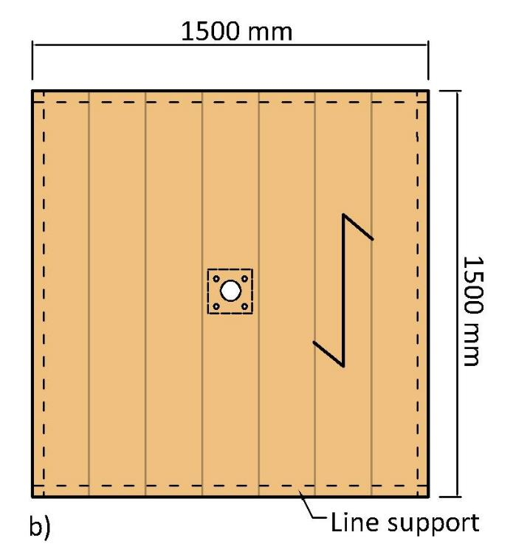
Edge support
Centre support

Slide 18
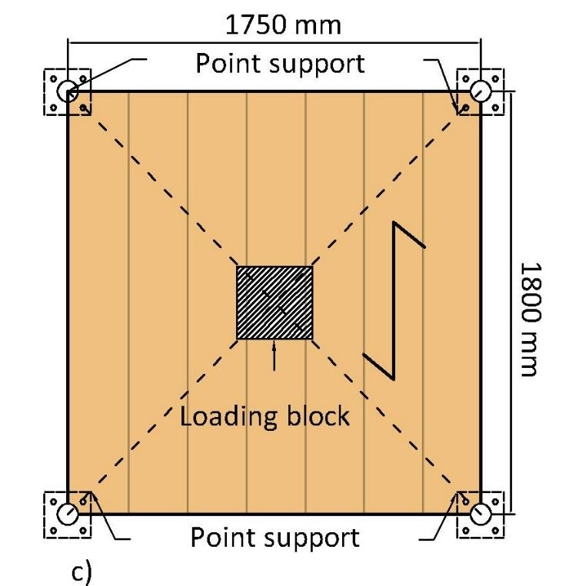
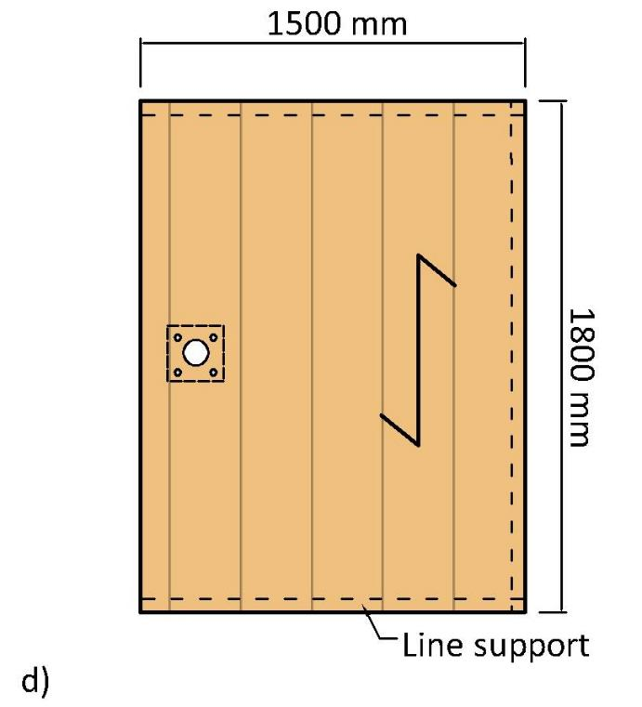
Corner support
Perimeter support

Slide 19
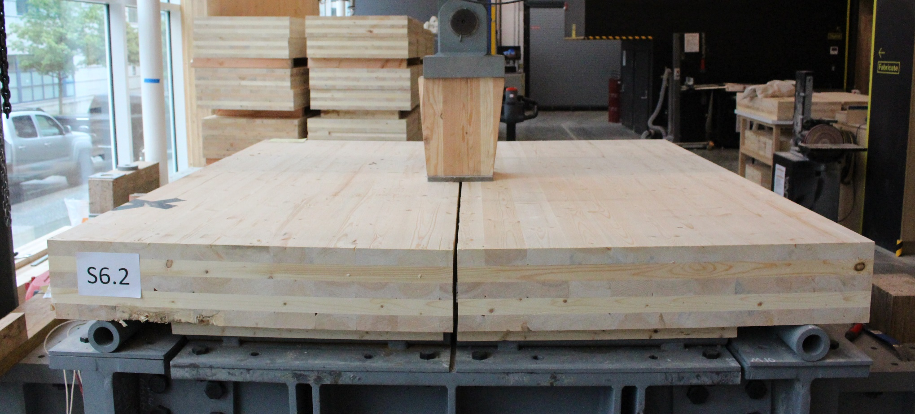
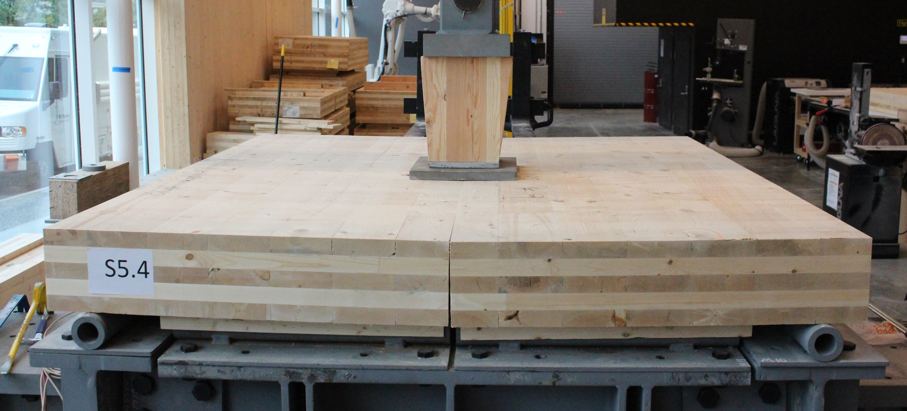
Column geometry
Square plate + wooden stub
200×200 mm
300×300 mm

Slide 20
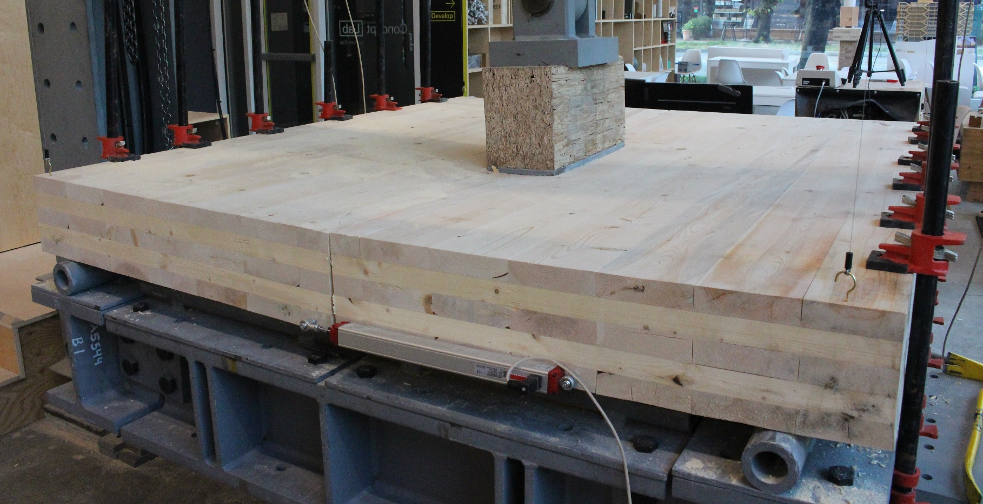
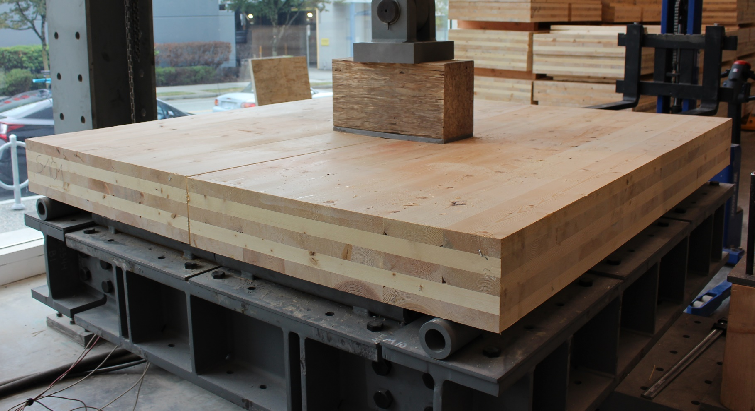
Column geometry
Rectangular + wooden stub
X- and Y-oriented

Slide 21
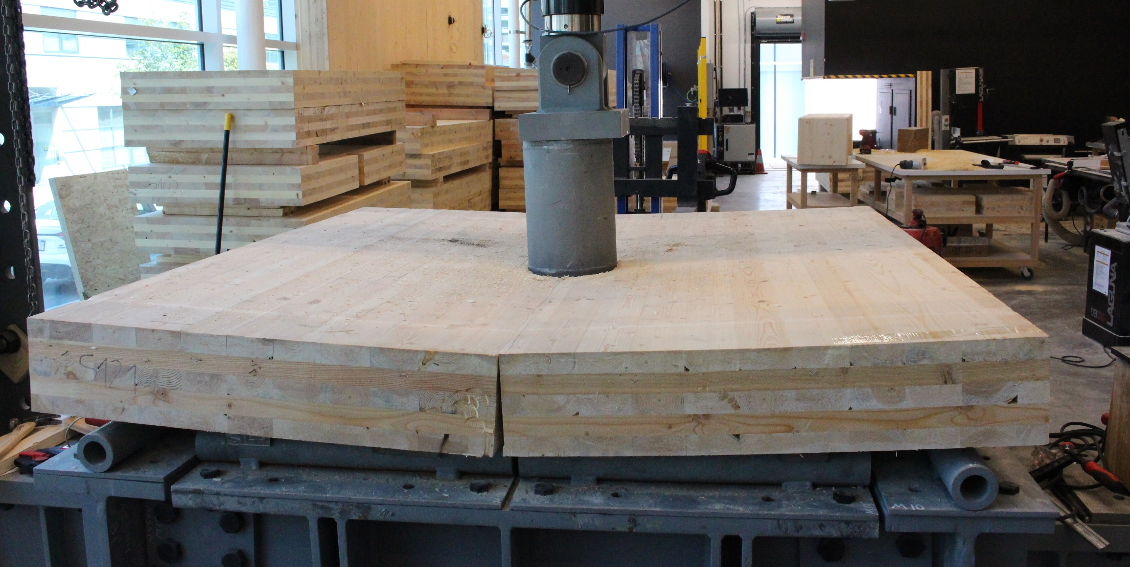
Column geometry
Round + stub

Slide 22
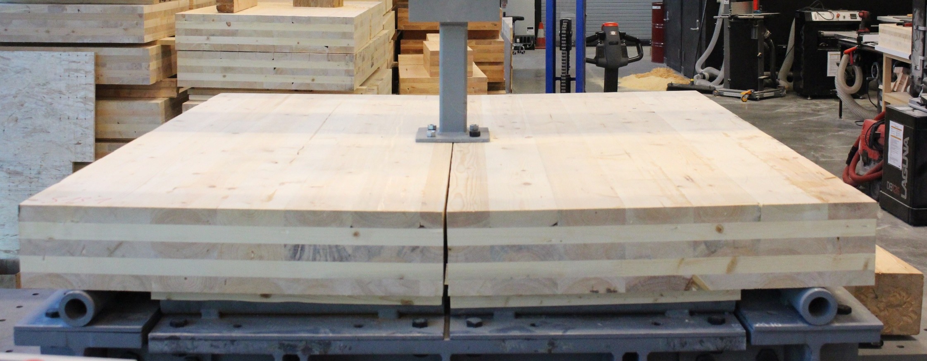
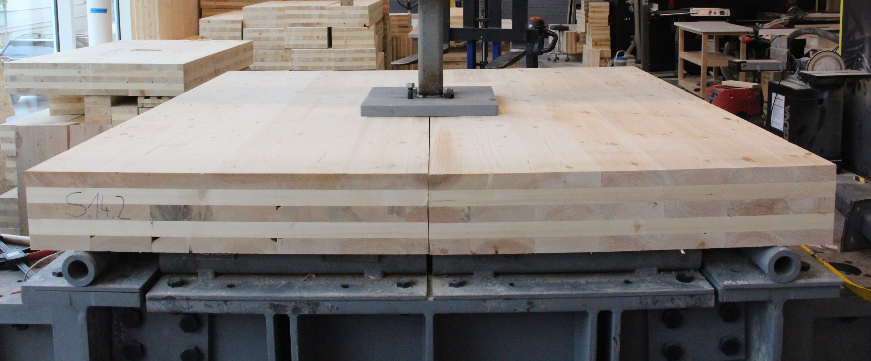
Column geometry
Square plate & NO stub
200×200 mm, low out of plane stiffness
400×400 mm, high out of plane stiffness

Slide 23
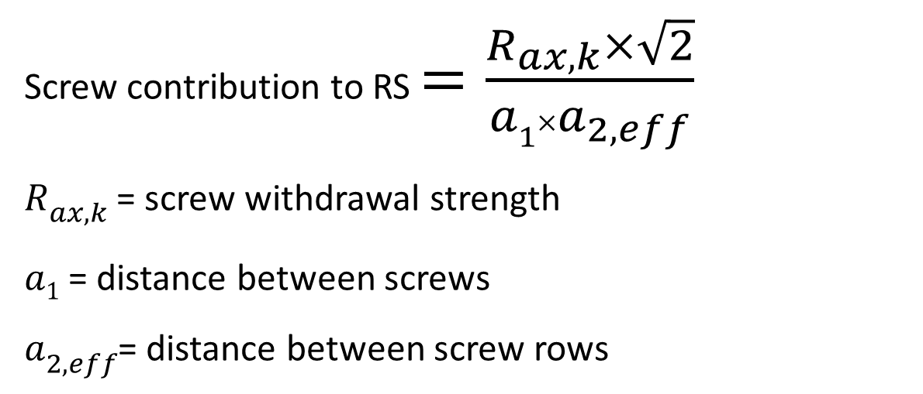
Screw reinforcement design (@45°)
Equivalent RS strength [MPa] =
RS strength of wood
+ Screw contribution to RS
Screw contribution to RS $=\frac{R_{ax,k}×\sqrt{2}}{a1{×a}_{2,eff}}$
$R_{ax,k}$ = screw withdrawal strength
$a1$ = distance between screws
$a_{2,eff}$= distance between screw rows
Reinforcement zone length?
Reinforcement direction?
5 series
Only 2 estimates: 42% and 27%

Slide 24
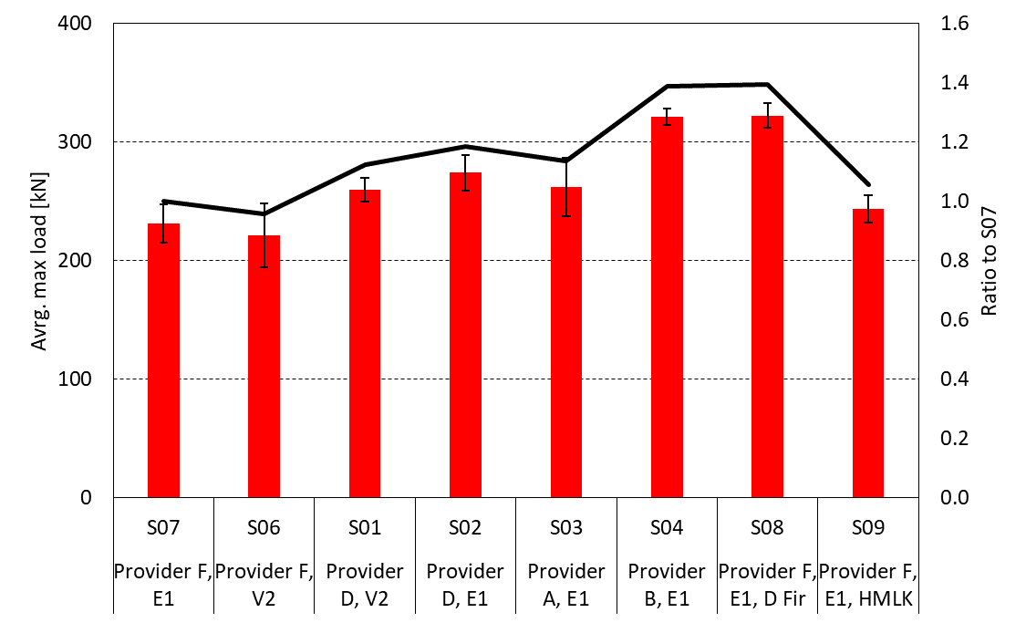
CLT punching shear results
Provider B CLT had the highest capacity
D Fir and Hemlock were stronger
E rated series were slightly stronger

Slide 25
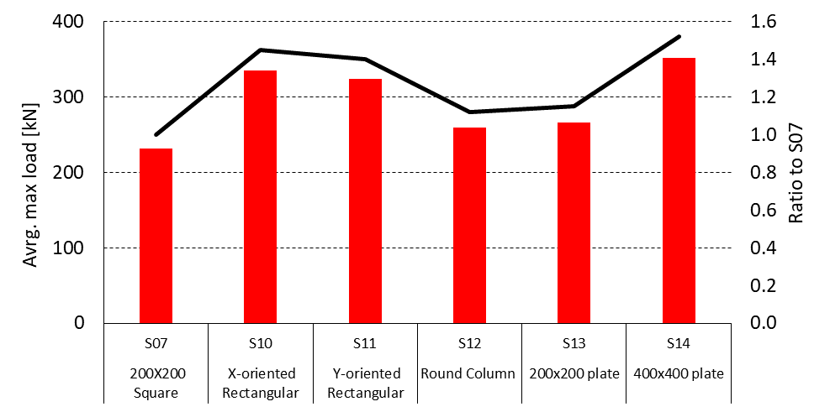
CLT punching shear results
- Round geometry = less stress concentration
- Softer loading plate = higher capacity

Slide 26
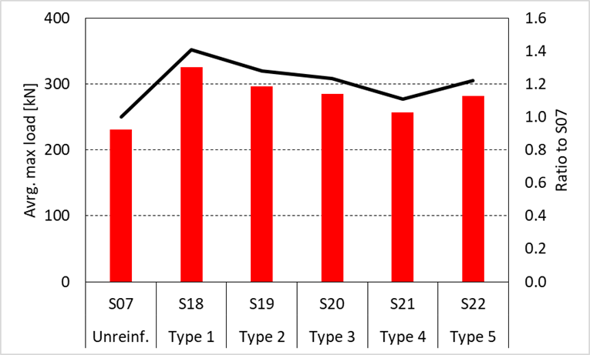
CLT punching shear results
Highest increase 41%:
- Largest reinf. zone
- Both directions
- Tight screw spacing
Important factors:
- Reinf. level
- Reinf. zone
- Reinf. direction

Slide 27
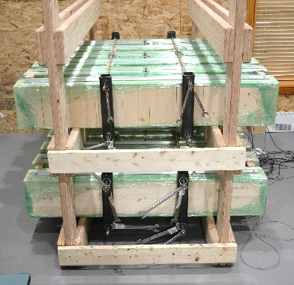
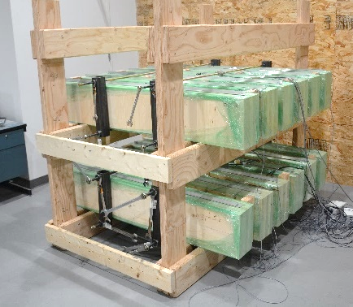
Project outlook
Long term 4-point bending test

Slide 28
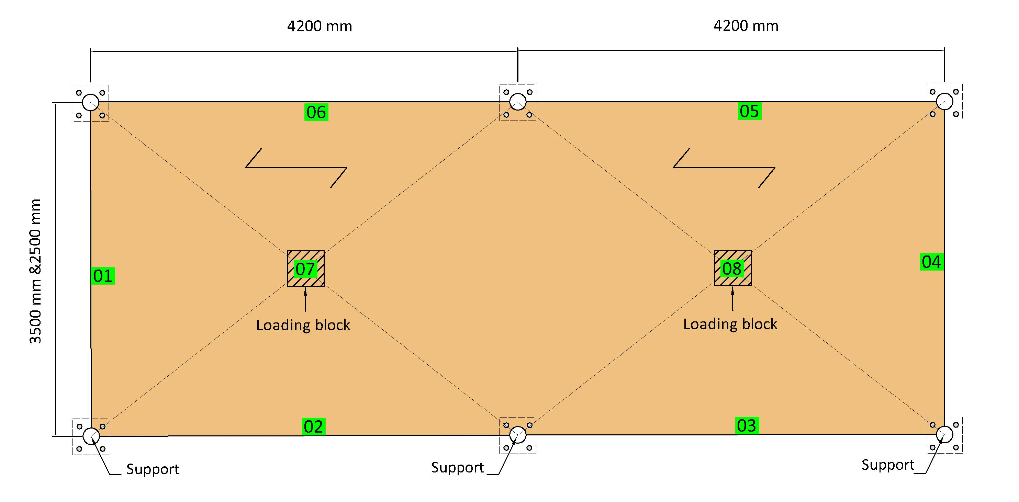
Project outlook
Full-scale floor tests

Slide 29
Project outlook
Design guidance for point-supported CLT floors punching shear
Stress distribution model
Adjustment factors
Material related
Support condition related

Slide 30
Thank You!
Rolling shear and punching shear of CLT
Houman Ganjali
Ph.D. Candidate, University of Northern British Columbia

