Slide 1
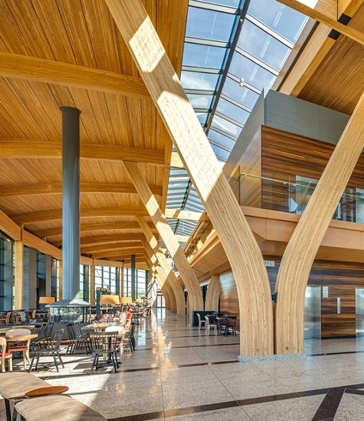





A CWCRN Initiative
NSERC Alliance Grant Project
‘NEXT-GENERATION WOOD CONSTRUCTION’
Burn Through Emissions Comparisons of Dimensional Lumber, CLT, LVL, and Glulam
Presenter: Jan Dabrowski
Affiliation: University of Waterloo
Supervised by Dr. E. Weckman
Picture Credit: Alberta WoodWORKS

Slide 2

Overview
Objective of the Study
Methods
Experimental Results
  Evolving Heat Release Rate, Emissions and Timeline
    CLT
    Glulam
    Dimensional Lumber
    LVL
Conclusion
  Study Findings

Slide 3
Objective of the Study
To improve the understanding of the following for engineered wood products (CLT, LVL, and Glulam):
  Emissions
  Charring Mechanism
  Evolving Heat Release Rate
To investigate the differences between wood products that contain glues or resins to wood products without them:
  Utilizing SPF dimensional lumber as a wood product baseline that contains no glues or resins.

Slide 4
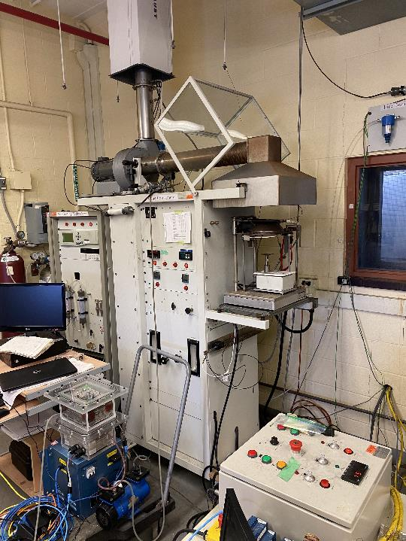
Methods
Sampling Line
Cone Calorimeter
  HRR
  O₂
  CO₂
  CO
Gas Sampling Instrumentation
  NH₃
  CH₄
  VOC
Gas Sampling Instrumentation
Pump
Exhaust Line

Slide 5
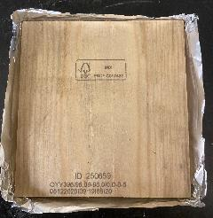
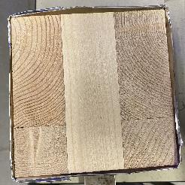
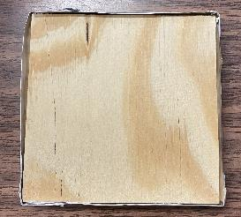
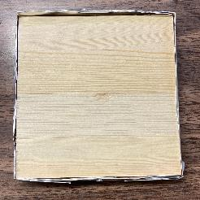
Methods
Specimens of 10 cm x 10 cm x 1 cm are cut from dimensional lumber, CLT, LVL, and Glulam.
CLT and Glulam specimens are cut such that the maximum amount of glue lines are exposed to the radiant heat flux.
An initial probe into whether any different gases from the glue could be seen.
Dimensional Lumber
CLT
LVL
Glulam

Slide 6
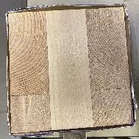
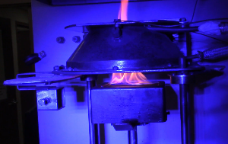
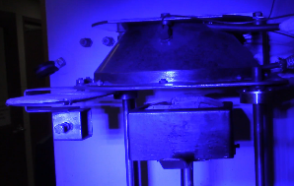
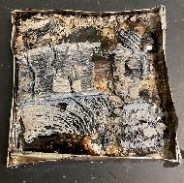
Methods
Two of each sample type is tested under 35 kW/m² and 50 kW/m² flux.
Tested from ignition to burn through under well-ventilated conditions.
CLT Sample Before:
35 kW/m² Radiant Heat Flux Exposure
Ignition
Flameout
CLT Sample After:
35 kW/m² Radiant Heat Flux Exposure

Slide 7
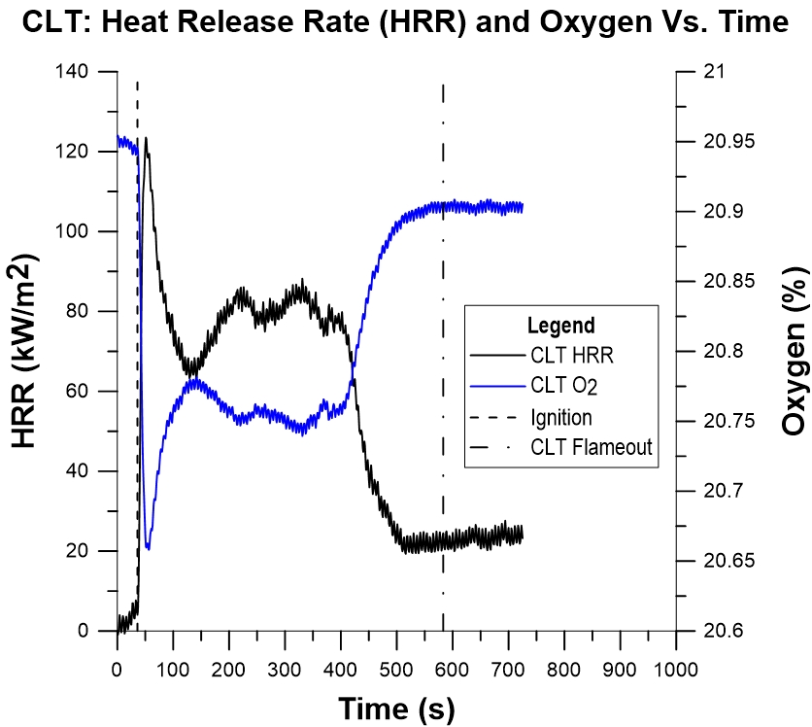
Experimental Results: CLT – HRR & Oxygen
HRR and oxygen depletion for CLT is observed to have a double peaked behavior.
Double peak behavior is observed for both heat fluxes.

Slide 8
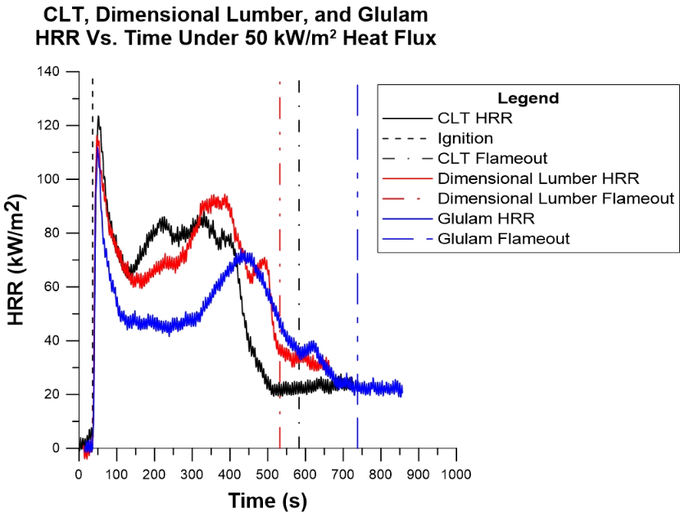
CLT, Dimensional Lumber, Glulam – HRR
Similar double peak behavior in HRR is observed for:
  Glulam
  Dimensional Lumber
CLT and Dimensional Lumber appear to have similar HRR Trends.
A period of steady HRR is observed for Glulam prior to peaking again.

Slide 9
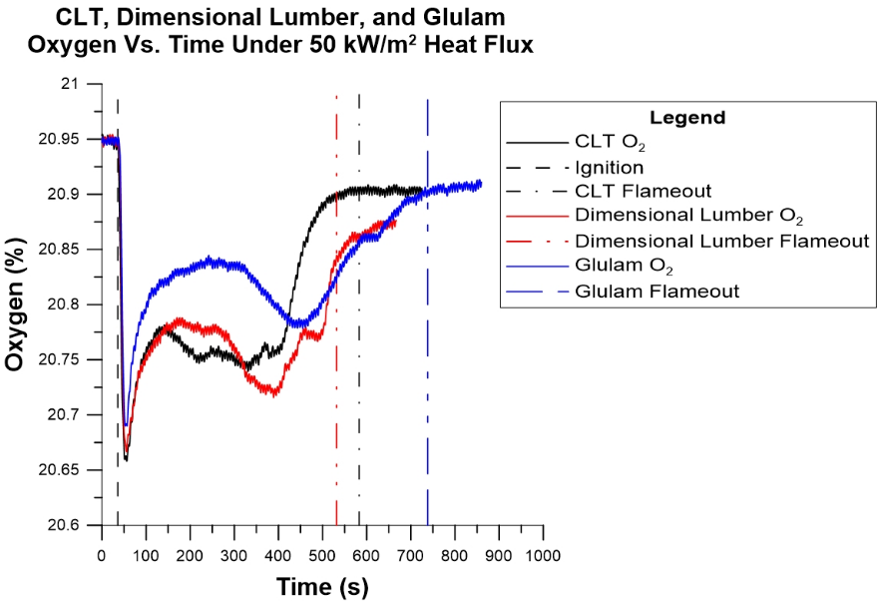
CLT, Dimensional Lumber, Glulam – Oxygen

Slide 10
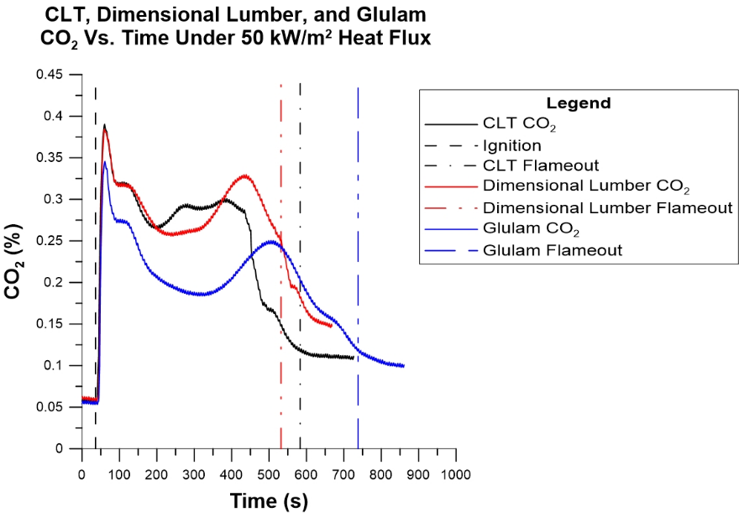
CLT, Dimensional Lumber, Glulam – CO₂

Slide 11
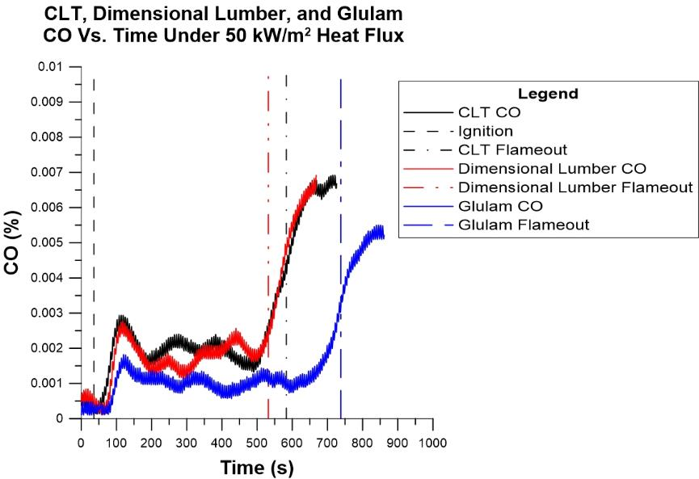
CLT, Dimensional Lumber, Glulam – CO

Slide 12
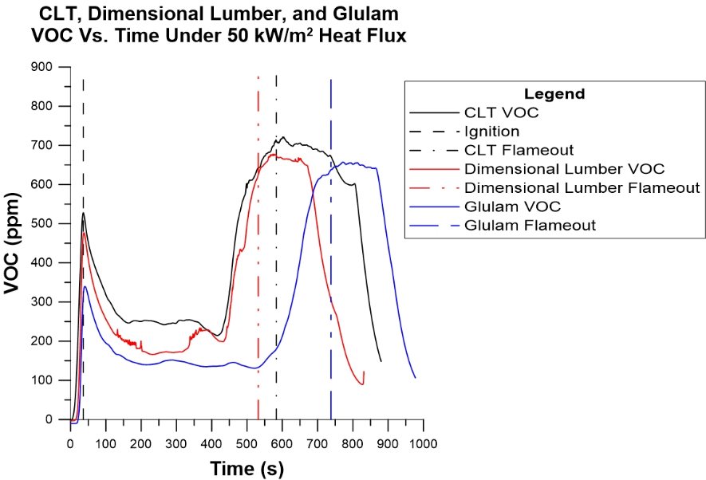
CLT, Dimensional Lumber, Glulam – VOC

Slide 13
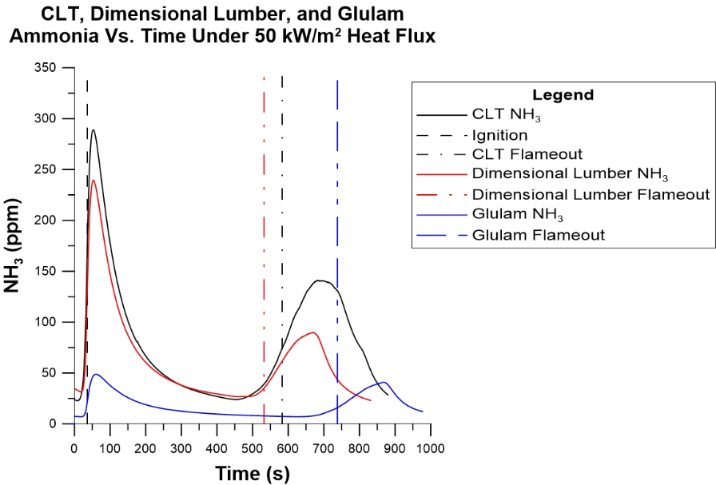
CLT, Dimensional Lumber, Glulam – Ammonia (NH₃)

Slide 14
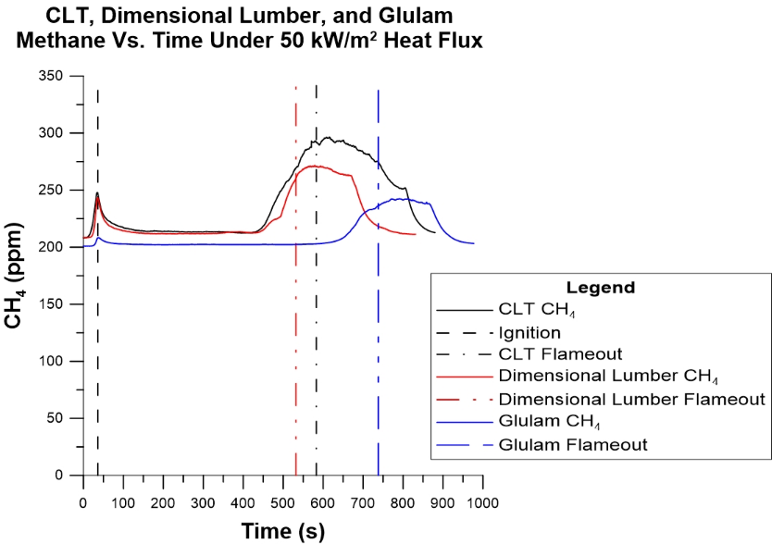
CLT, Dimensional Lumber, Glulam – Methane (CH₄)

Slide 15
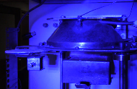
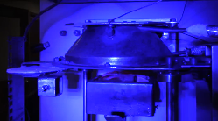
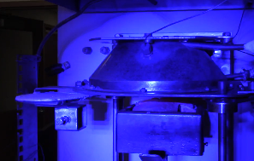
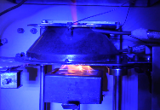
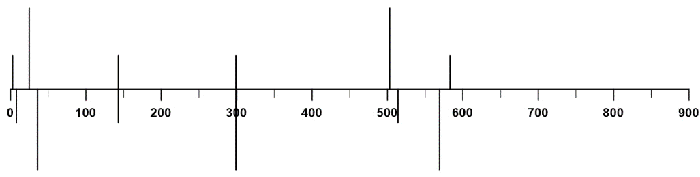
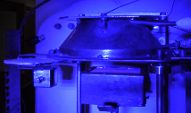
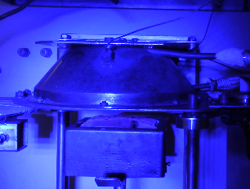
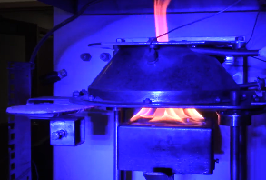
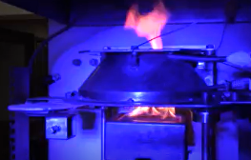
Burn Through Timeline: CLT – 50 kW/m²
Fully Charred Surface
Sample 1:
End of Arching
Visible
Smoke
Sample 1:
Start of Arching
Sample 1:
Flameout
Increase in
Smoke Intensity
Sample 2:
Start of Arching
Sample 2:
End of Arching
Ignition
Sample 2:
Flameout

Slide 16
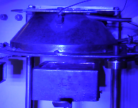
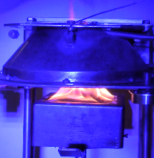
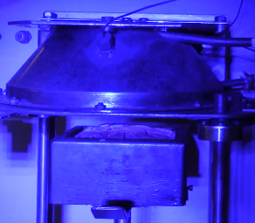
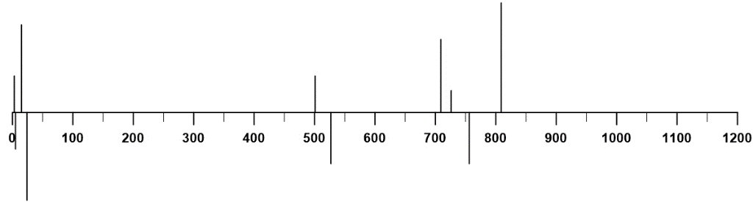
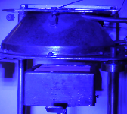
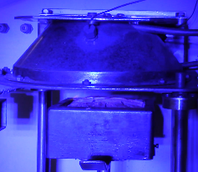
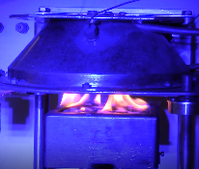
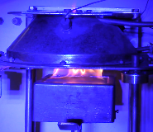
Burn Through Timeline: Glulam – 50 kW/m²
Sample 2:
Flameout
Fully Charred Surface
Sample 1:
End of Arching
Visible Smoke
Sample 1:
Start of Arching
Sample 1:
Flameout
Increase in
Smoke Intensity
Sample 2:
Start of Arching
Sample 2: End of Arching
Ignition

Slide 17
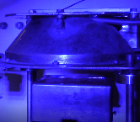
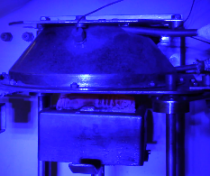
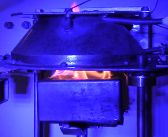
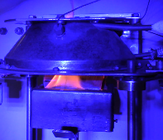
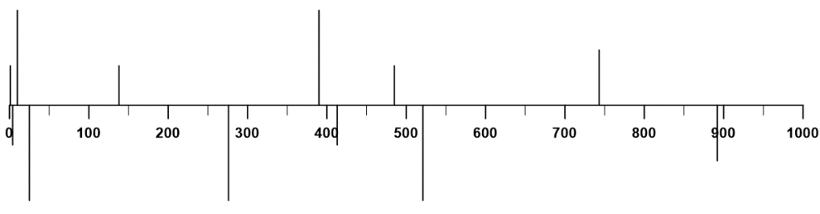
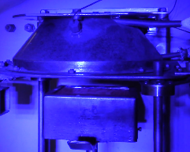
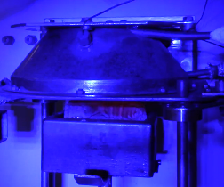
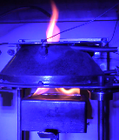
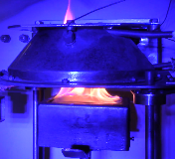
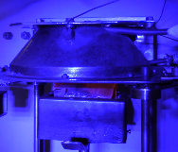
Burn Through Timeline: Dimensional Lumber – 50 kW/m²
Sample 2:
Start of
Arching
Fully
Charred Surface
Visible Smoke
Sample 2:
End of Arching
Sample 1: Peak Bowing
Sample 1: End of Arching
Sample 1:
Start of Arching
Sample 2: Flameout
Increase in
Smoke Intensity
Ignition
Sample 1: Return to Normal
Sample 1: Flameout

Slide 18
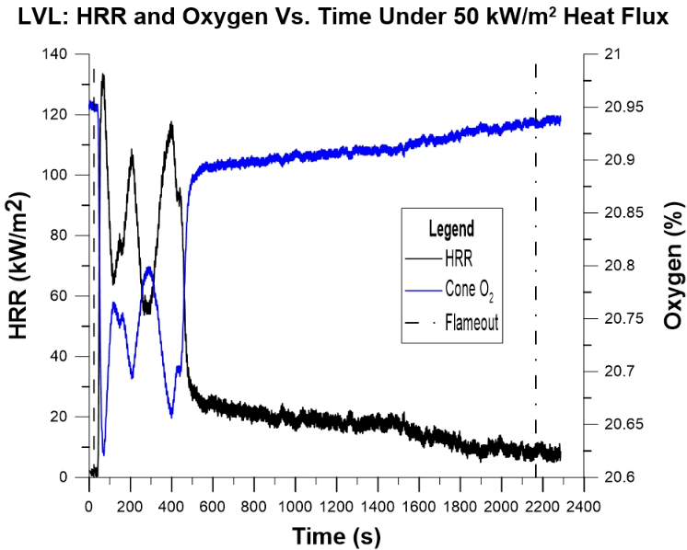
Experimental Results: LVL – HRR & Oxygen

Slide 19
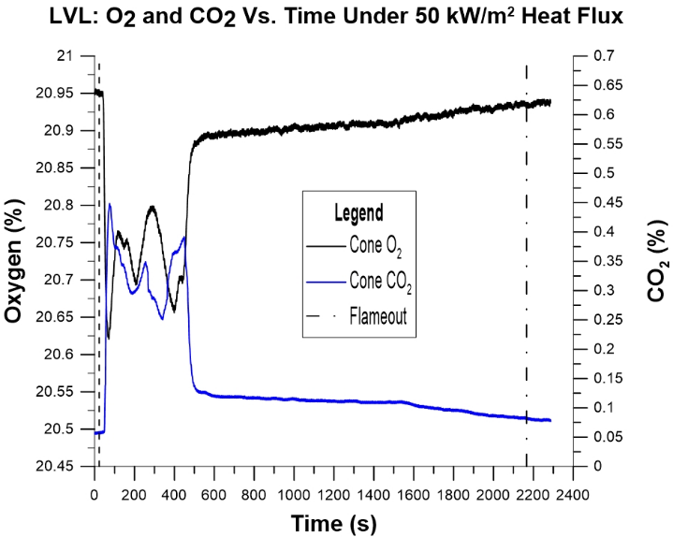
Experimental Results: LVL – O₂ & CO₂

Slide 20
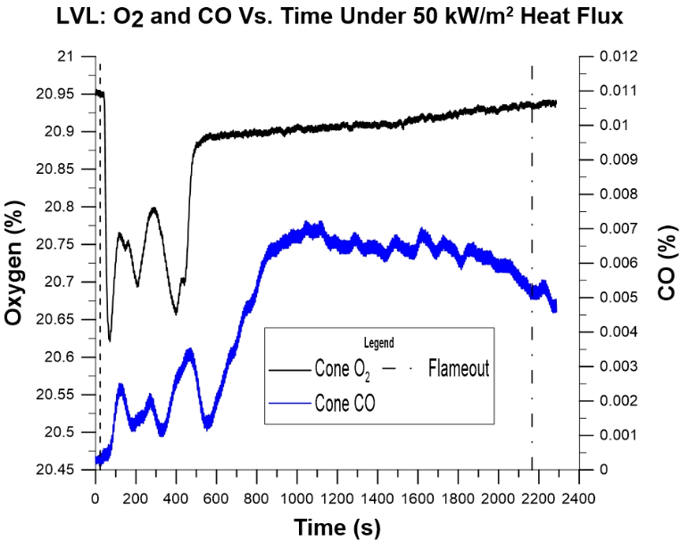
Experimental Results: LVL – O₂ & CO

Slide 21
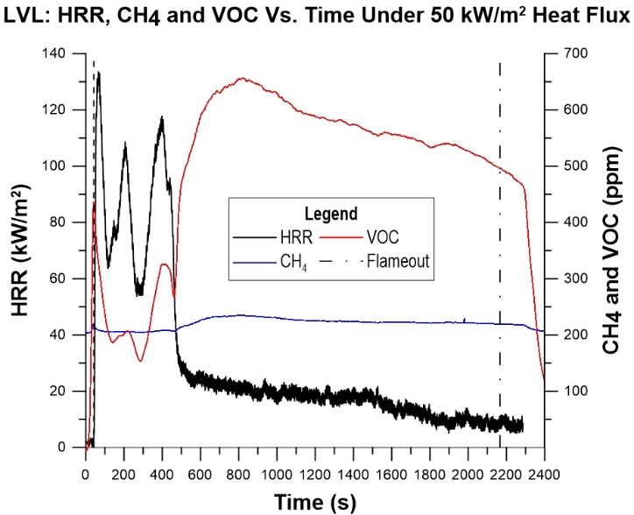
Experimental Results: LVL – VOC & CH₄

Slide 22
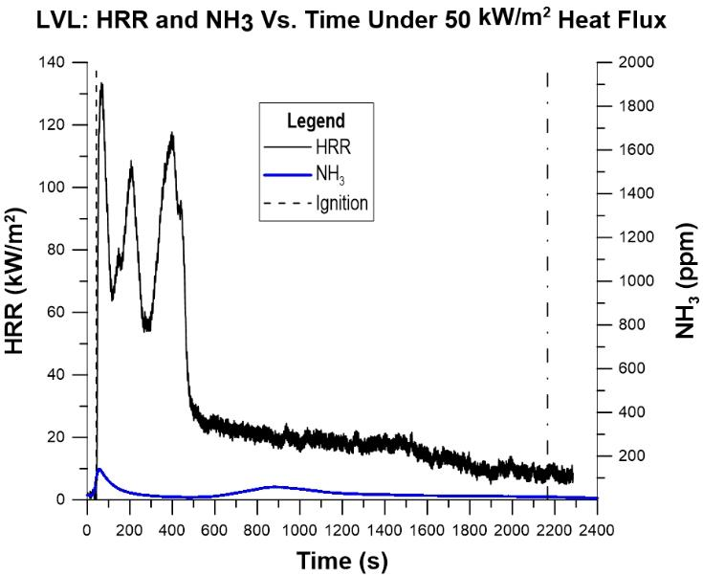
Experimental Results: LVL – HRR & NH₃

Slide 23








Burn Through Timeline: LVL – 50 kW/m²
Sample 2:
Peak
Bowing
Sample 2
Start Of
Arching
Sample 2: Flameout
Sample 2: End of Arching
Sample 1:
Peak Bowing
Sample 1: End of Arching
Sample 1: Flameout
Ignition
Sample 1: Start Of Arching

Slide 24











Burn Through Timeline: LVL – 35 kW/m²
Fully
Charred Surface
Sample 1: Peak Bowing
Sample 1: Start Of Arching
Sample 2: Flameout
Visible Smoke
Sample 2:
Peak Bowing
Sample 2:
Start Of Arching
Sample 1:
End of Arching
Increase in
Smoke Intensity
Sample 2:
Return to
Normal
Sample 1: Return to Normal
Sample 1: Flameout
Ignition
Sample 2: End of Arching

Slide 25
Conclusion – Study Findings
This initial investigation has revealed that for CLT and Glulam no differences in gases from the glue could be seen.
The evolving heat release rate and emissions (O₂, CO₂, and CO) for Glulam and CLT follow similar trends as dimensional lumber.
LVL has a different evolving heat release rate and emissions (O₂, CO₂, CO, and VOC).
The VOC, CH₄, and NH₃ all peak approximately at ignition and then peak for a second time near flameout:
  VOC and NH₃ from LVL are exceptions to this trend.
  NH₃ from Glulam is an exceptions to this trend.
CLT, Glulam, LVL, and dimensional lumber are observed to either arch or bow at different times.

Slide 26






Government Partners

Slide 27


Research Partners

Slide 28






Industry Partners

Slide 29
Questions?

