Slide 1





NSERC Alliance Grant Project
‘NEXTGEN WOOD CONFERENCE-2024’
A CWCRN Initiative
New Encapsulation Technique for Strengthening and Enhanced Fire Resistance of Mass Timber Structural Elements
Presenter: Izaz Ahmad (PhD Student) – Supervisor: Prof. Sam Salem
Project No. T2-2-B: Encapsulation of Timber Elements Subjected to Fire

Slide 2
Introduction
Green Construction
Alternative

Slide 3
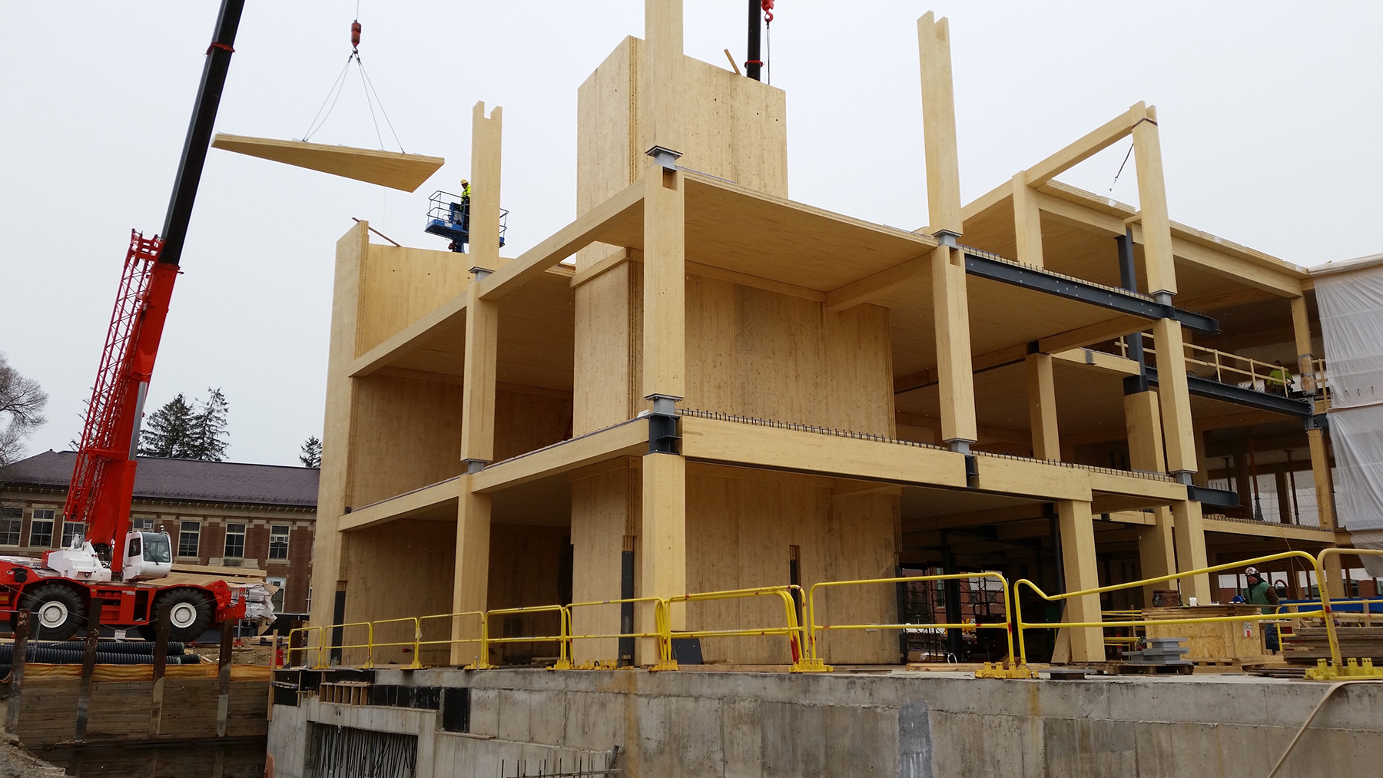
Pros
Higher strength-to-weight ratio
Lower energy consumption
Glulam
Stable dimensions
Aesthetic attributes
Easy onsite assembling
Cons
Non-ductile nature
Vibration issues
CLT
Fire safety issues (combustible nature
Engineered mass timber products ^{1,2}

Slide 4
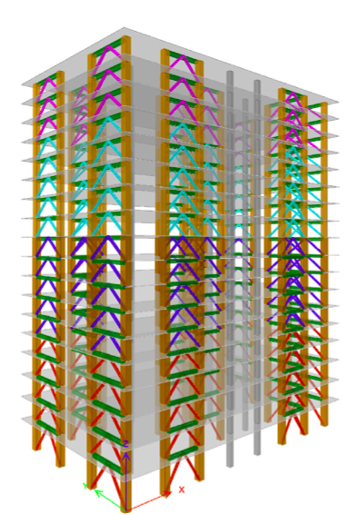
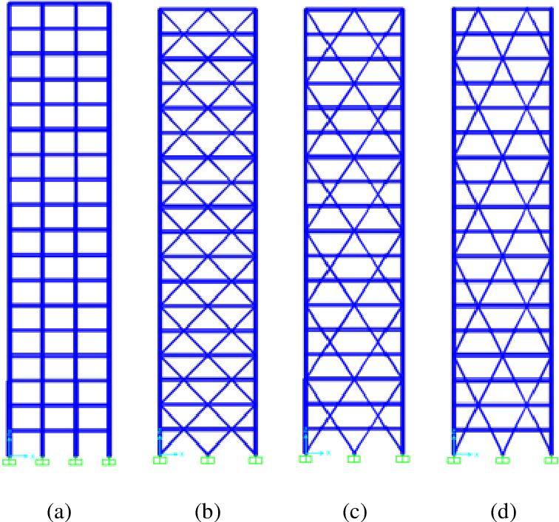
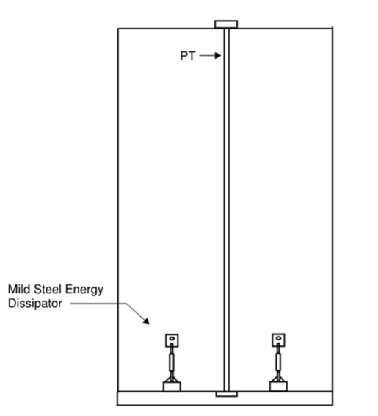
Innovative mass timber structural systems for high rise construction
Frame system
Shear wall system
Diagrid system
Buckling restrained braced glulam frame
(Prakash S. Badal 2024 ³)
Alternate systems
(Ussher 2023 ⁴)
Rocker shear wall system
(Bailey 2022⁵)

Slide 5
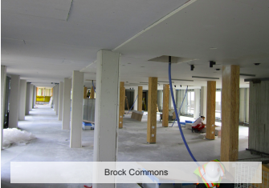
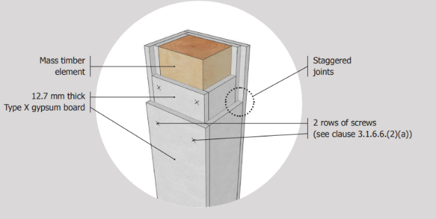
Passive fire protection techniques for mass timber structural elements
Gypsum plasterboards ^{6,7,8}

Slide 6
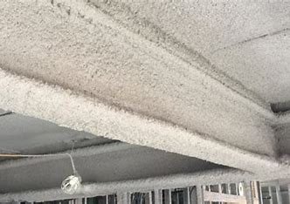
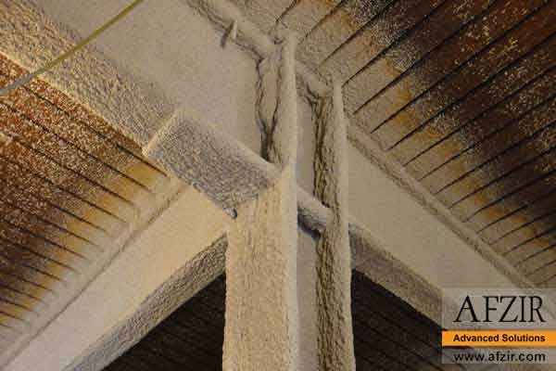
Passive fire protection techniques for mass timber structural elements
Spray-applied fire-resistive material (SFRM) ^{8,9}

Slide 7
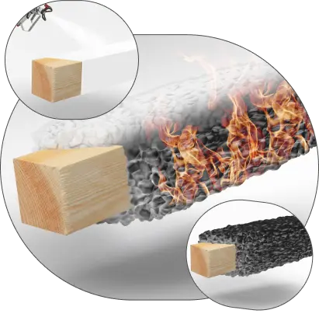
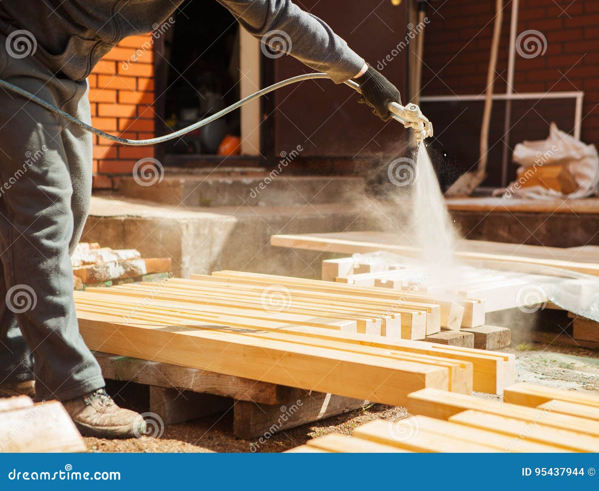
Passive fire protection techniques for mass timber structural elements
Intumescent coating ¹⁰
Fire retardant chemical ¹¹

Slide 8
Building category | OBC Designation | Maximum Building Area (area per floor | Maximum Physical Height | Sprinklers | Floor Assembly Construction | Stairwell Construction | Elevator Shaft Construction
(Low-Rise ≤ 4 Storeys) | Acceptable Solution (Parts 3 & 4) | 1 storey: 7200 m² 2 storey: 3600 m² 3 storey: 2500 m² 4 storey: 1800 m² | ------ | NFPA 13R | 1-hour fire resistance rating | 1-hour fire resistance rating | 1-hour fire resistance rating
(Low-Rise & Mid-Rise ≤ 6 Storeys) | Acceptable Solution (Parts 3 & 4) | 1 storey: 9000 m² 2 storeys: 4500 m² 3 storeys: 3000 m² 4 storeys: 2250 m² 5 storeys: 1800 m² 6 storeys: 1500 m² | 18 m from ground floor to top floor | NFPA 13R for 1-4 storeys; NFPA 13 for 5th and 6th storey | 1-hour fire resistance rating | 1.5-hour fire resistance rating for all exit enclosures (non-combustible construction) | 1-hour fire resistance rating
Mid-Rise (7-12 Storeys) | Alternate solution
High-Rise (>12 Storeys) | Alternate solution
Code requirements for timber buildings (OBC/NBCC)

Slide 9
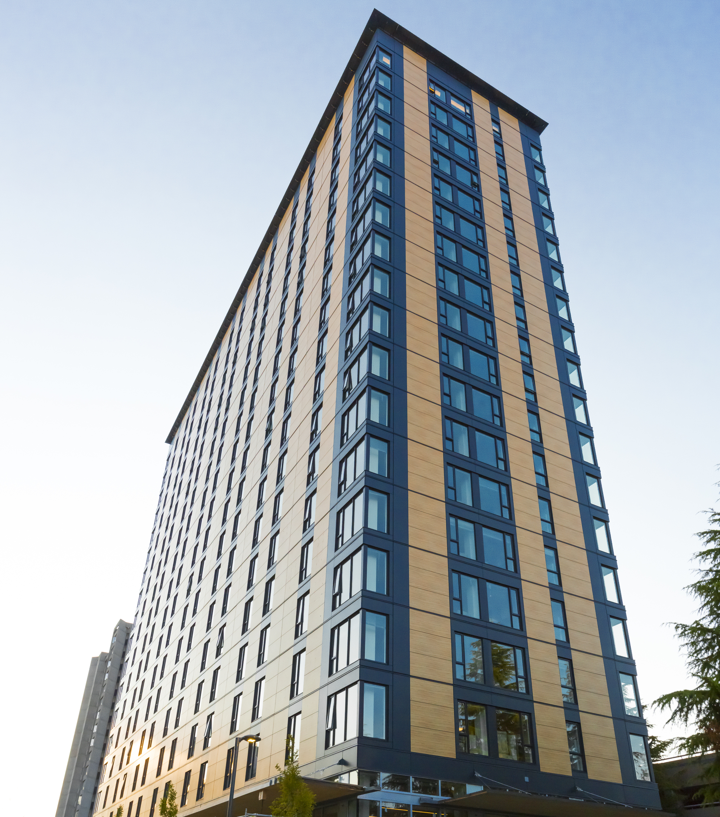
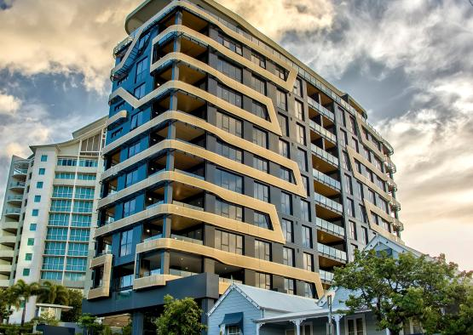
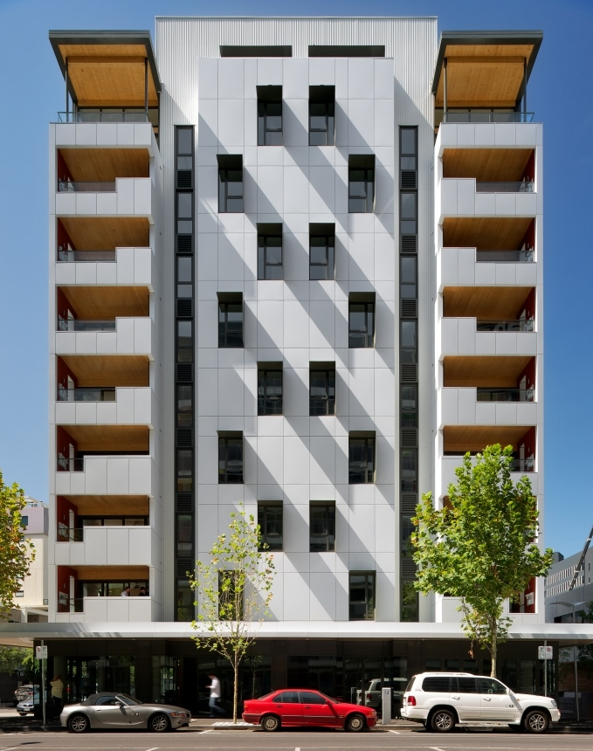
Recommended alternate solution is the encapsulation/protection^{6,12,13} of mass timber structural elements with non-combustible materials
The Brock Commons
The Monterey Kangaroo Point
The Forté building in Melbourne

Slide 10
Research Motivation
National Building Code of Canada allows timber structures up to heights of 137 ft (42 m), provided they are encapsulated with fire-rated noncombustible materials such as gypsum plasterboard
A novel approach for the encapsulation employing Textile-Reinforced Mortar (TRM), which is also called Fabric-Reinforced Cementitious Mortar/Matrix (FRCM)
FRCM may be considered a suitable option to significantly improve fire resistance alongside structural performance of mass timber structural elements.

Slide 11
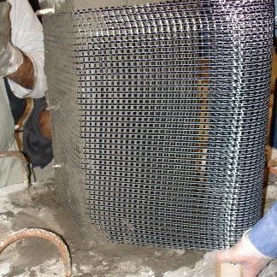
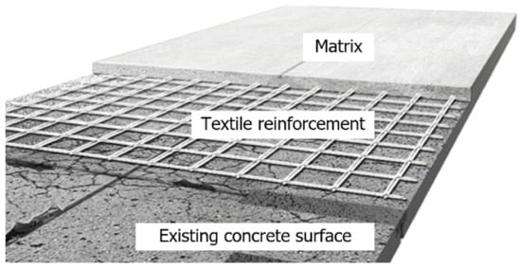
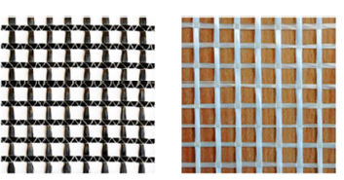
Cementitious matrix
FRCM/TRM
Composition
High-strength fabric reinforcement (i.e., carbon, glass or basalt)
Fabric reinforcement
TRM application to column
TRM application

Slide 12
FRCM/TRM: Key Properties
FRCM exhibits pseudo-ductile response¹⁴
FRCM has greater thermal stability inherent to inorganic mortar
FRCM experiences notable strength degradation above 600 °C¹⁵
Portland cement (PC) mortar of the FRCM can be replaced with thermally more stable mortars, such as refractory cement mortar¹⁶, geopolymer mortar¹⁷ or gypsum mortar¹⁸
Mix type | Thermal conductivity (W/m.K)
OPC mortar | 1.186
Silica Fume mortar (10,20,30%) | 0.972, 0.818 and 0.715
Fly Ash mortar (10,20,30%) | 1.016, 0.879 and 0.792
Slag mortar (10,20,30%) | 1.034, 1.033 and 1.017
Demirboǧa et. al 2003 ¹⁹

Slide 13
Research Objectives
To evaluate the optimal mix design of mortar based on mechanical and microstructural investigations at ambient and elevated temperatures
Objective 1
To investigate FRCM systems at ambient and elevated temperatures
Objective 2
To assess structural/fire performance of FRCM encapsulated/strengthened glulam columns under standard fire exposure.
Objective 3

Slide 14
Research Methodology
Design of mortar mixes incorporating OPC, CAC, Blended cement, and Geopolymer.
Evaluation of mortar mixes: Compressive strength tests (ambient temperature and after exposure to standard fire), XRD, TGA, BET, and Thermal Conductivity analysis.
Task 1: Mechanical and microstructural assessment of mortars
Task 2: Mechanical investigations of FRCM systems
Design of FRCM systems: Tensile strength evaluation at ambient and elevated temperatures.
Encapsulating/Strengthening glulam columns with FRCM systems.
Full-size fire testing of encapsulated mass timber columns (FRCM and gypsum boards) to investigate encapsulation rating, fire resistance rating and structural performance under standard fire exposure.
Developing design guidelines for the novel encapsulation technique.
Task 3: Structural and fire performance of full-scale FRCM encapsulated mass timber columns

Slide 15
Research Progress: Task 1 (Mortar mixes scheme)
S. No. | Mix Type | Mix Constituents
 |  | Fine Aggregate | Cementitious materials (CM)
 |  |  | CM-1 | CM-2 | CM-1 % | CM-2 %
1 | Portland Mortar | Sand | Portland cement | ------ | 100% | 0
2 | Calcium Aluminate Cement Mortar | Sand | Calcium Aluminate Cement | ------ | 100% | 0
3 | Portland-Fly Ash Mortar | Sand | Portland cement | Fly Ash | 50-90% | 10-50%
4 | Portland-Slag Mortar | Sand | Portland cement | Slag | 50-90% | 10-50%
5 | Calcium Aluminate-Portland Mortar | Sand | Calcium Aluminate Cement | Portland cement | 50-90% | 10-50%
6 | Calcium Aluminate-Fly Ash Mortar | Sand | Calcium Aluminate Cement | Fly Ash | 50-90% | 10-50%
7 | Calcium Aluminate-Slag Mortar | Sand | Calcium Aluminate Cement | Slag | 50-90% | 10-50%
8 | Geopolymer Mortar | Sand | Fly Ash | ------ | 100% | 0

Slide 16
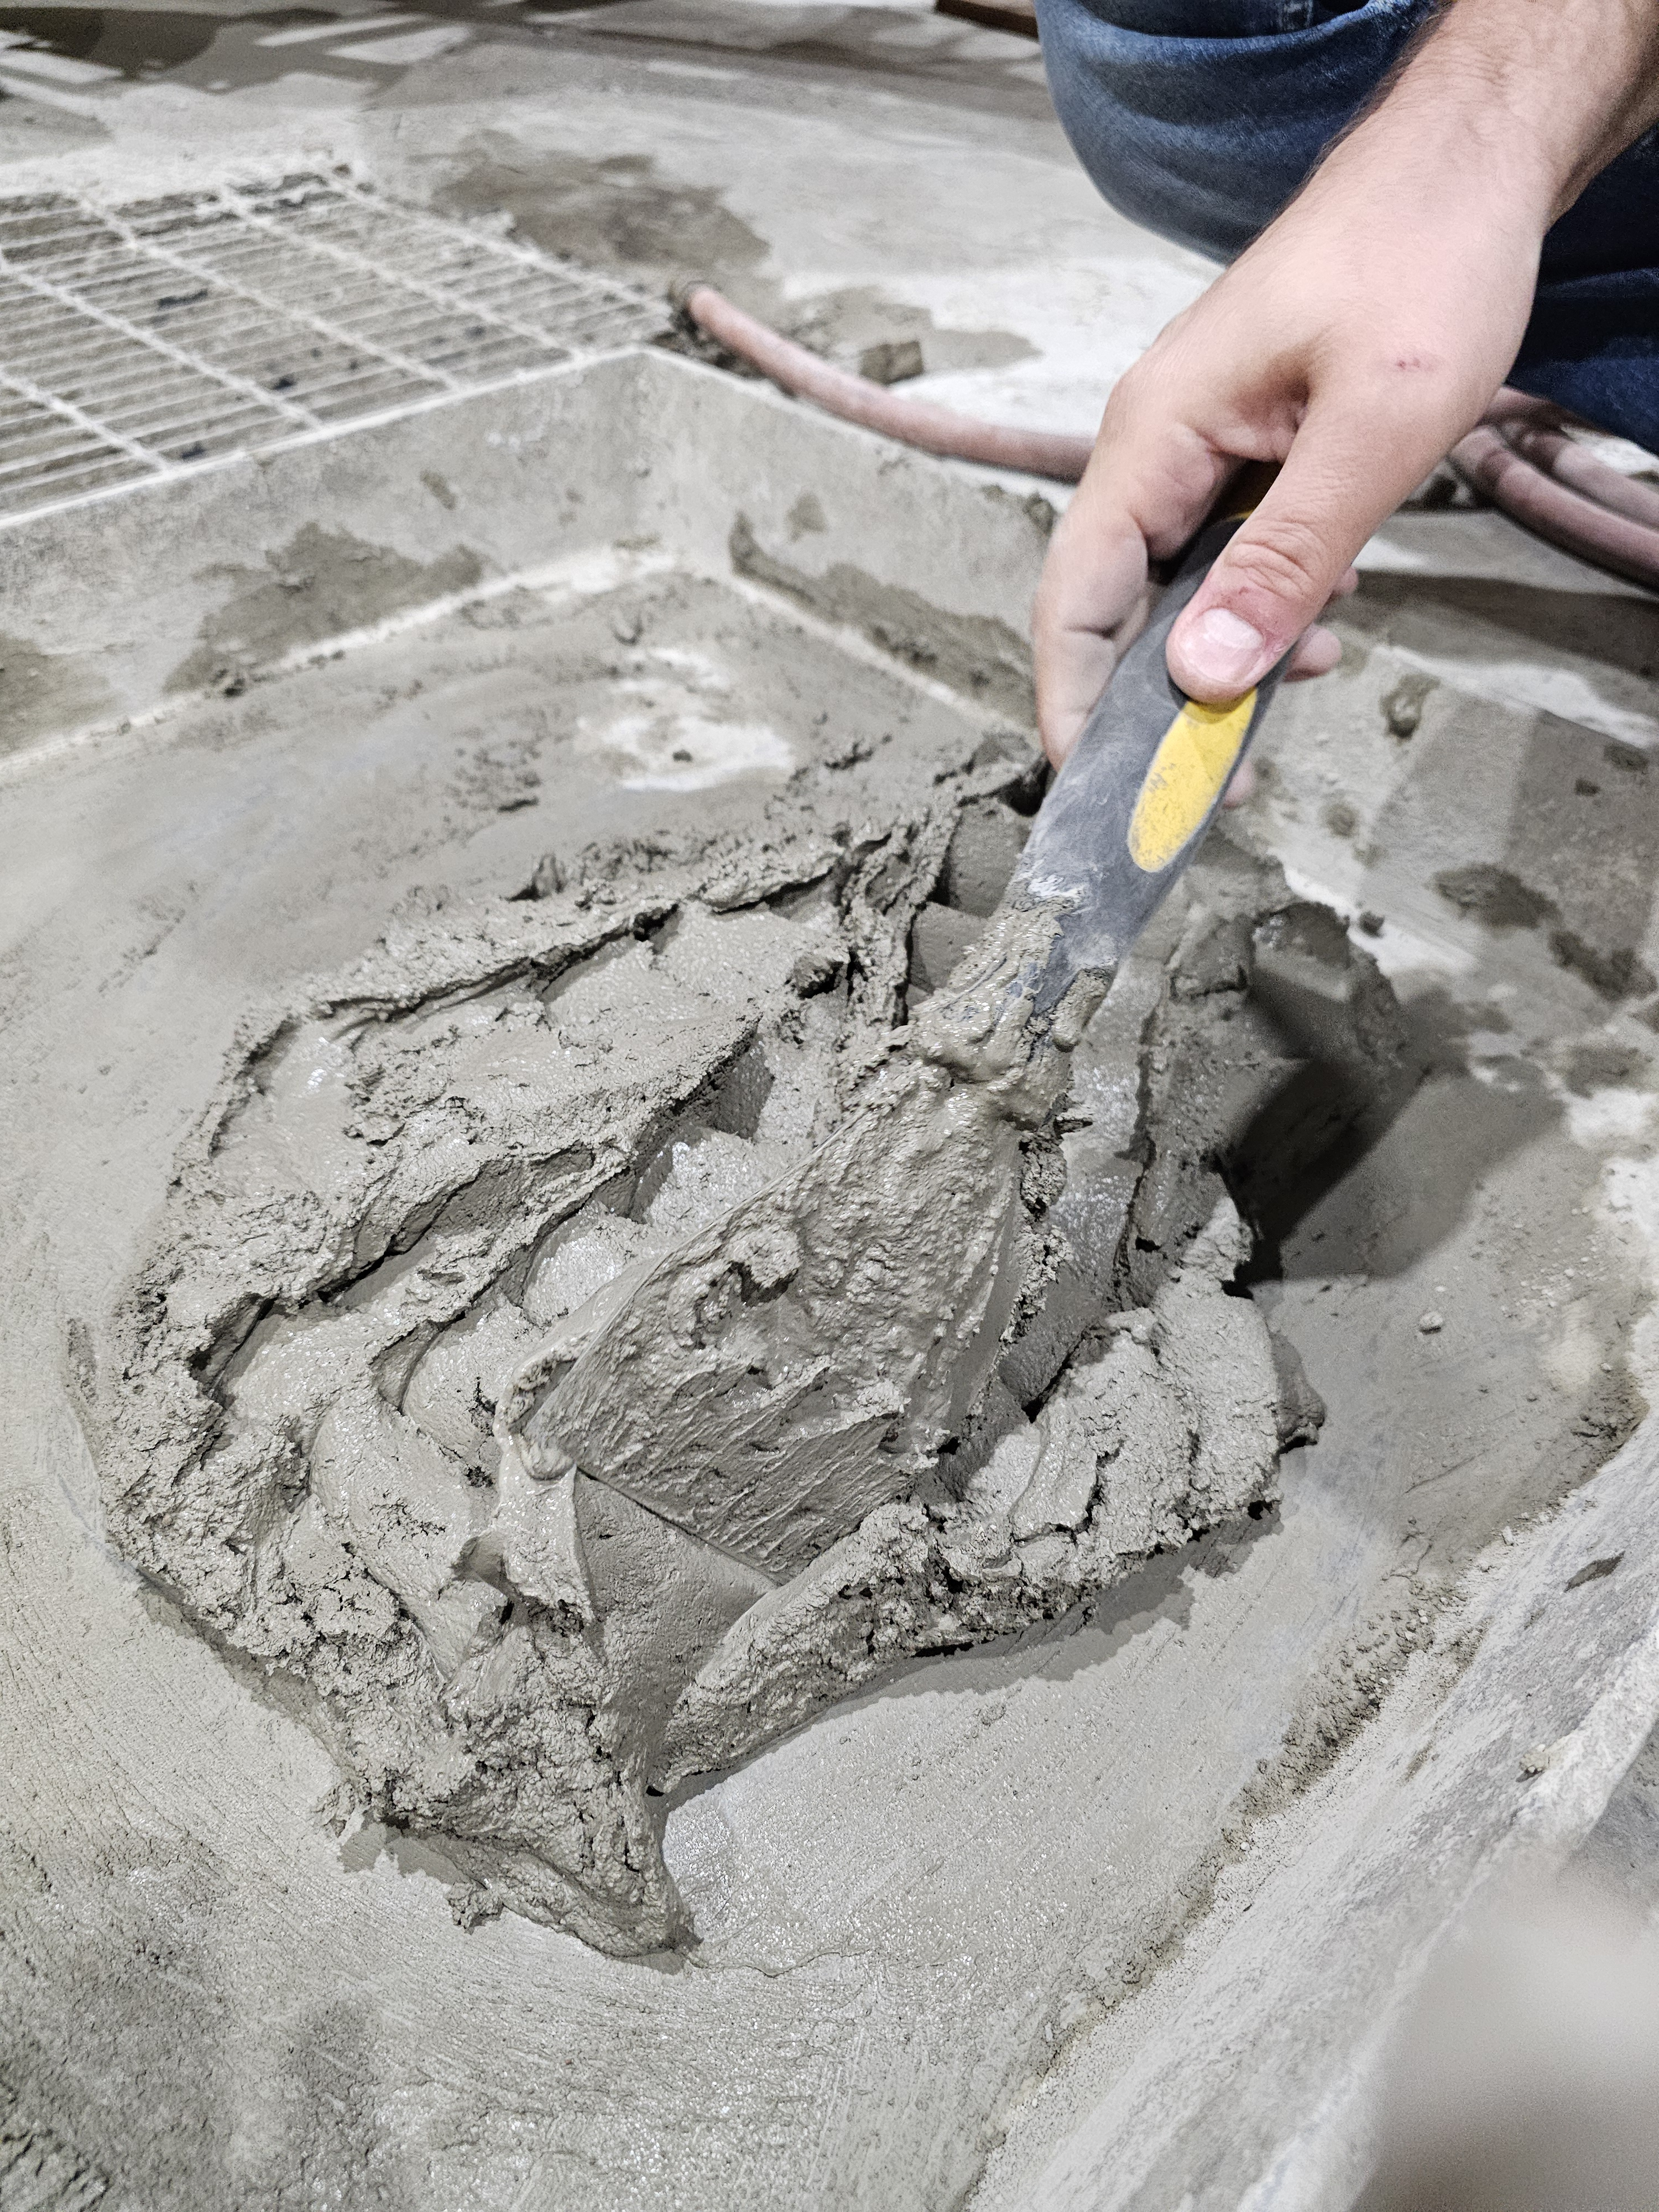
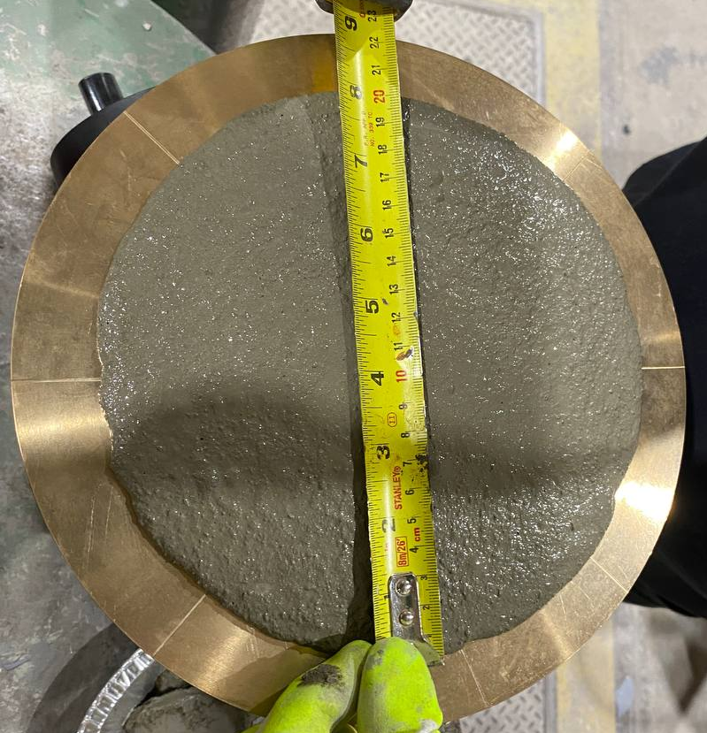
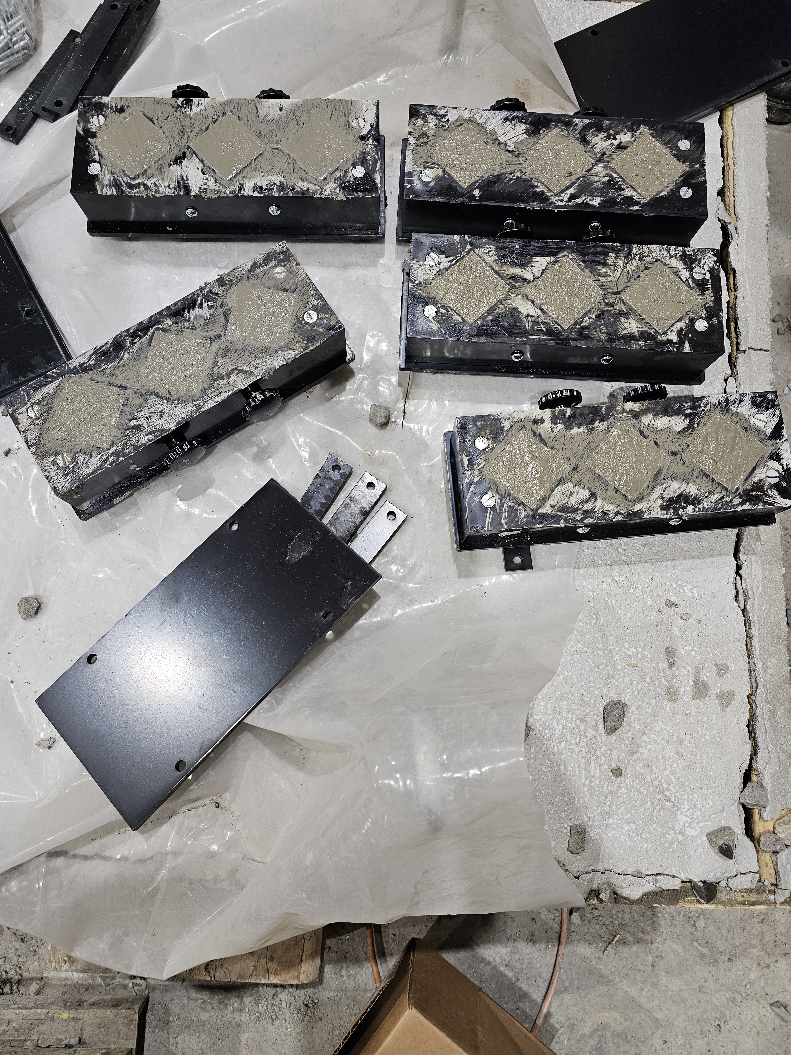
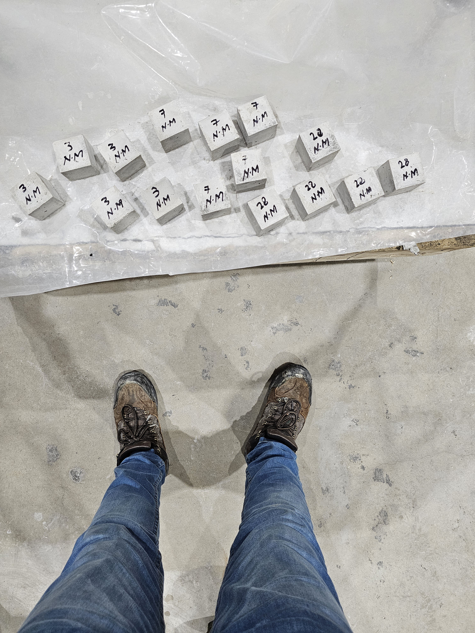
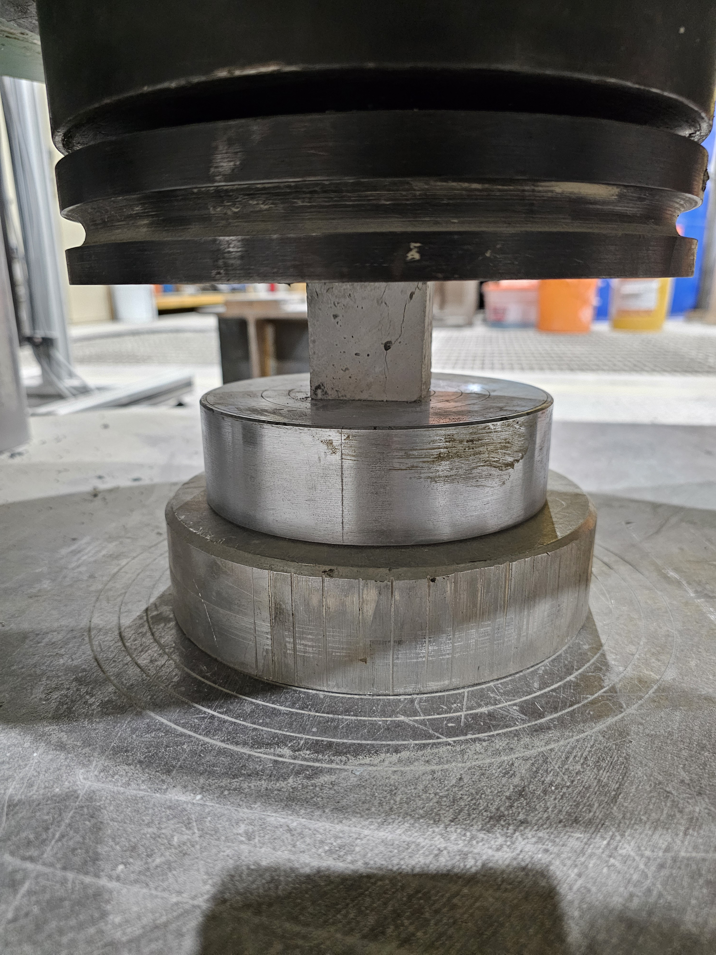
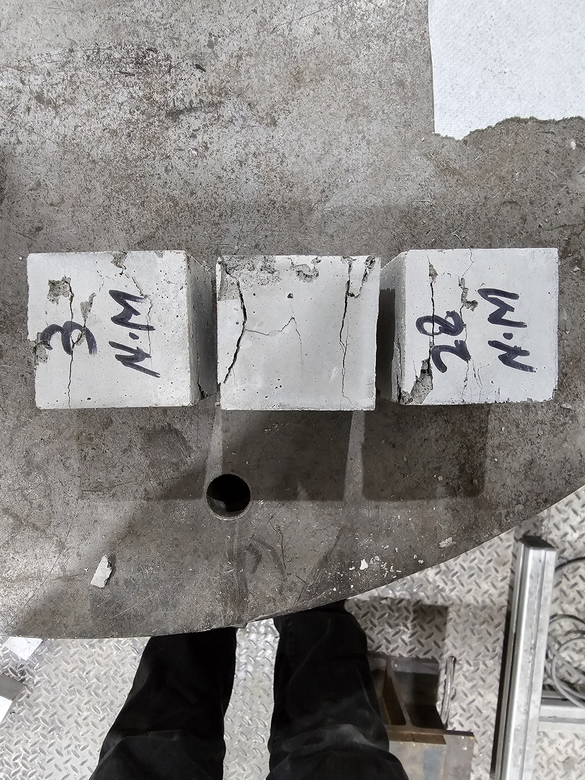
Research Progress: Task 1 (Mortar mix casting/ Mechanical investigations)
Mortar mixing
Flow table test
Mortar cube casting
Mortar Cubes
Compression test
Crushed specimens

Slide 17
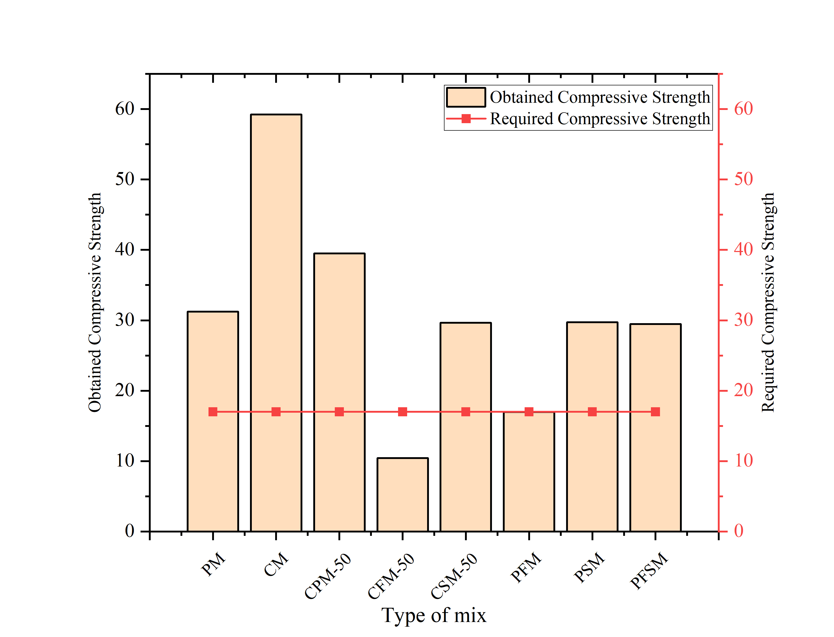
Research Progress: Task 1 (Mortar Mixes Compressive Strengths - MPa)
P= Portland Cement, M= Mortar, C= Calcium Aluminate Cement, F= Fly Ash, S= Slag

Slide 18
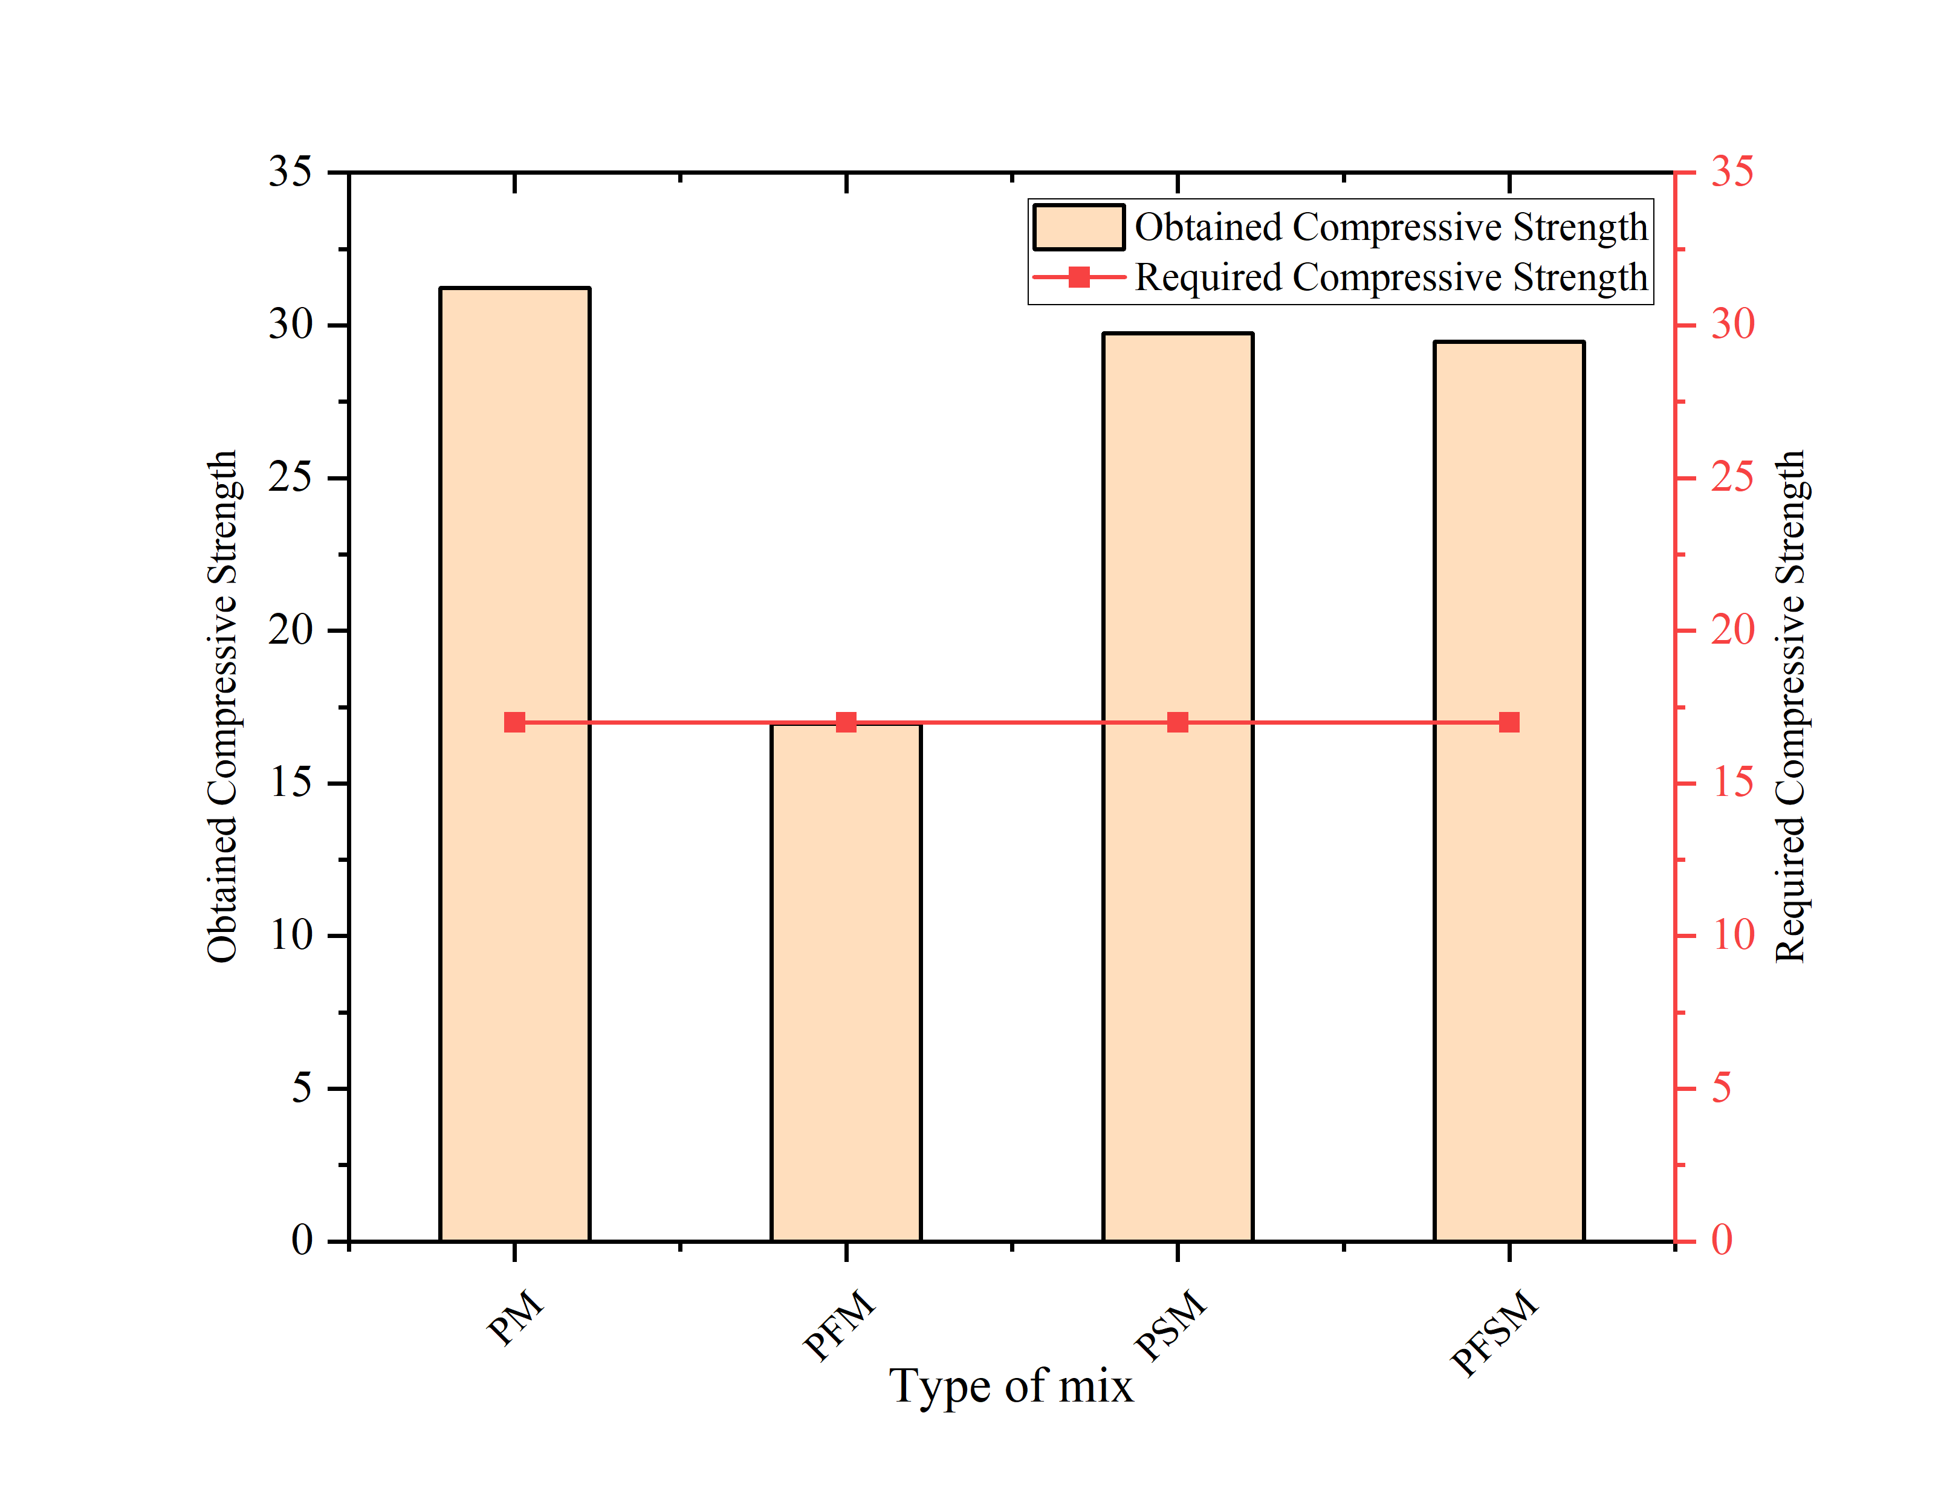
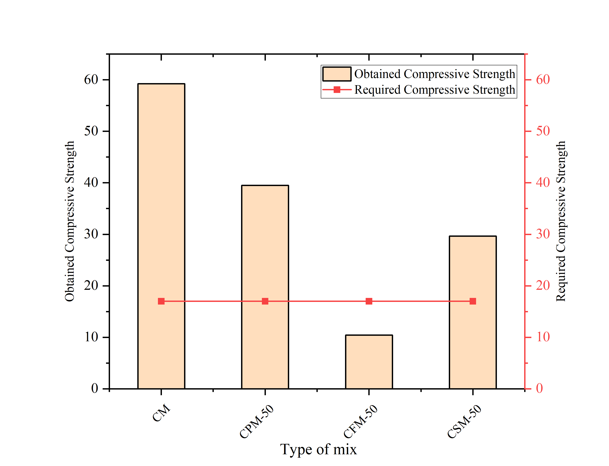
Research Progress: Task 1 (Mortar Mixes Compressive Strengths - MPa)

Slide 19
Research Progress: Future directions
Mechanical, microstructural, and thermal assessment of mortar mixes
Task 1 Completion (Spring/Summer 2024)
Mechanical investigations of FRCM systems
Task 2 Completion (Fall 2024)
Task 3 Completion (Winter 2025)
Structural and fire performance of full-size FRCM encapsulated mass timber columns

Slide 20
Anticipated Outcomes
Developing a comprehensive insight into the applications of the FRCM systems for mass timber composite construction
Understanding the synergic behaviour of FRCM to improve fire resistance and structural performance of mass timber structures.
Disseminate research findings in leading scientific journals and top-tier international conference proceedings, which is anticipated to assist in developing structural design guidelines for the use of the FRCM systems in mass timber structures.

Slide 21
References
Issa, C.A. and Z. Kmeid, Advanced wood engineering: glulam beams. Construction and Building Materials, 2005. 19(2): p. 99-106
Brandner, R., Flatscher, G., Ringhofer, A., Schickhofer, G., & Thiel, A. (2016). Cross laminated timber (CLT): overview and development. European Journal of Wood and Wood Products, 74, 331-351
Badal, P.S. and S. Tesfamariam, Seismic collapse performance of high-rise mass timber building with buckling-restrained braced frames. Soil Dynamics and Earthquake Engineering, 2024. 177: p. 108369.
Ussher, E., A. Aloisio, and S. Rathy, Effect of lateral resisting systems on the wind-induced serviceability response of tall timber buildings. Case Studies in Construction Materials, 2023. 19: p. e02540.
Bailey, D. (2022). Innovations in mass timber lateral systems.
Chorlton, B. and J. Gales, Fire performance of heritage and contemporary timber encapsulation materials. Journal of Building Engineering, 2020. 29: p. 10118.
Su, J., et al., Fire safety challenges of tall wood buildings-phase 2: task 3-cross laminated timber compartment fire tests. 2018.’
Hasburgh, L., et al. Fire performance of mass-timber encapsulation methods and the effect of encapsulation on char rate of cross-laminated timber. in Proceedings of the World Conference on Timber Engineering, Vienna, Austria. 2016
Covi, P., et al., Seismic experimental analysis of a full-scale steel building with passive fire protections. Engineering Structures, 2024. 300: p. 117203
Lucherini, A., L. Giuliani, and G. Jomaas, Experimental study of the performance of intumescent coatings exposed to standard and non-standard fire conditions. Fire Safety Journal, 2018. 95: p. 42-50.
Laranjeira, J. P. D. S., Cruz, H., Pinto, A. P. F., Pina dos Santos, C., & Pereira, J. F. (2015). Reaction to fire of existing timber elements protected with fire retardant treatments: Experimental assessment. International Journal of Architectural Heritage, 9(7), 866-882

Slide 22
References
White, R.H., Fire resistance of wood members with directly applied protection. Fire and materials, 2009: p. 971
Jong, K.Y.J., et al. Fire Resistance and Mechanical Properties of the Fire-Resistant Board. in Advances in Material Science and Engineering: Selected articles from ICMMPE 2020. 2021. Springer.
Mobasher, B., Mechanics of fiber and textile reinforced cement composites. 2011: CRC press.
Estevan, L., Varona, F. B., Baeza, F. J., Torres, B., & Bru, D. (2022). Textile Reinforced Mortars (TRM) tensile behavior after high temperature exposure. Construction and Building Materials, 328, 127116.
Baradaran-Nasiri, A. and M. Nematzadeh, The effect of elevated temperatures on the mechanical properties of concrete with fine recycled refractory brick aggregate and aluminate cement. Construction and Building Materials, 2017. 147: p. 865-875.
Cheng, T. W., & Chiu, J. P. (2003). Fire-resistant geopolymer produced by granulated blast furnace slag. Minerals engineering, 16(3), 205-210.
Caetano, H., Laím, L., Santiago, A., Durães, L., & Shahbazian, A. (2022). Development of passive fire protection mortars. Applied Sciences, 12(4), 2093.
Demirboǧa, R. (2003). Influence of mineral admixtures on thermal conductivity and compressive strength of mortar. Energy and buildings, 35(2), 189-192.

Slide 23
Acknowledgments
This is to acknowledge the financial support of the Natural Sciences and Engineering Research Council of Canada (NSERC) through the Alliance Advantage program, Natural Resources Canada (NRCan), Alberta Innovates, BC - Forestry Innovation Investment Ltd (BC-FII), Ministère des Ressources naturelles et des Forêts (MRNF), Ontario Ministry of Northern Development, Mines, Natural Resources and Forestry (NDMNRF), Alberta WoodWORKS!, National Lumber Grades Authority (NLGA), Nordic Structures, Western Archrib, and Element5. We also thank research partners FPInnovations and the National Research Council (NRC) for their in-kind contributions.
Thanks, are also extended to my graduate supervisor, Prof. Sam Salem for his contribution, guidance and support.

Slide 24
THANK YOU
Contact Email: iahmad1@lakeheadu.ca

