Slide 1





Peter Berghuis, MASc Candidate
Dr. Jeffrey Erochko
Dr. Christian Viau
Dr. Ghasan Doudak
NSERC Alliance Grant Project ‘NEXT-GENERATION WOOD CONSTRUCTION’
A CWCRN Initiative
Performance of Cross-Laminated Timber In-Plane Panel-to-Panel Connections with Tension Straps
Picture Credit: Alberta WoodWORKS

Slide 2
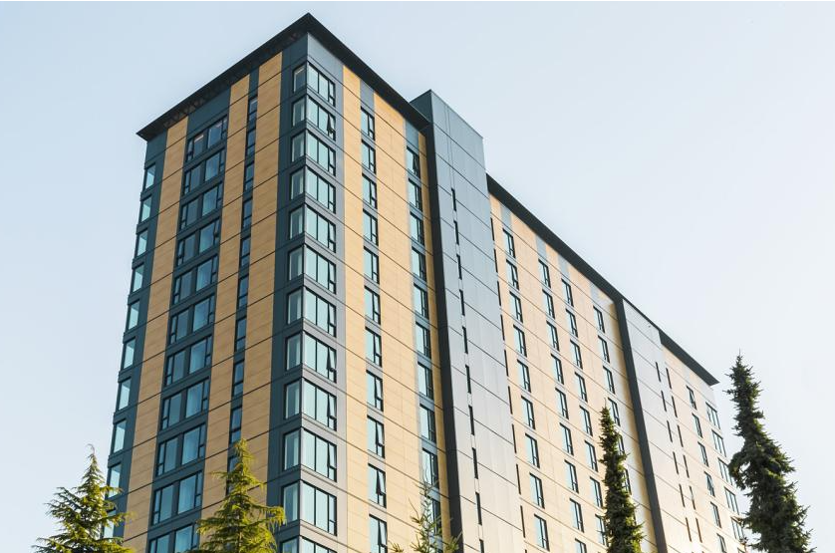
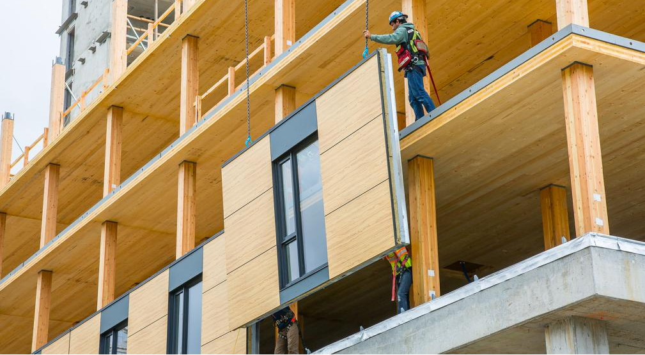
Introduction
Mass timber is on the rise!
Less carbon intensive than concrete and steel
Faster construction
Cross-Laminated Timber (CLT): diaphragms and walls
Connections are important!

Slide 3
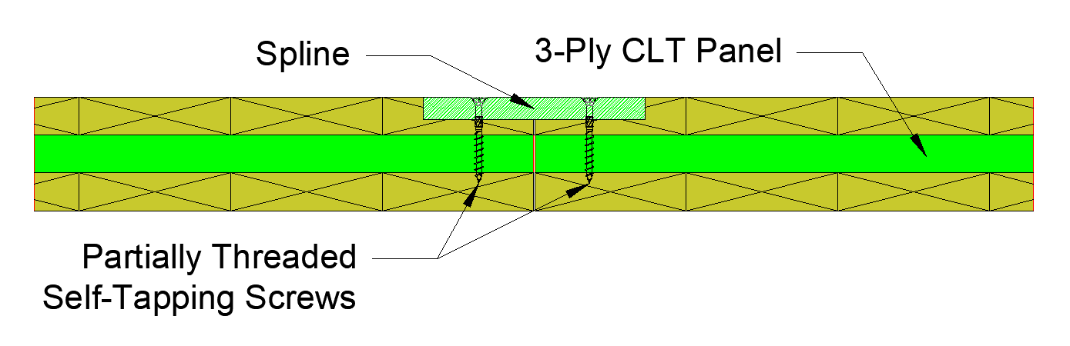
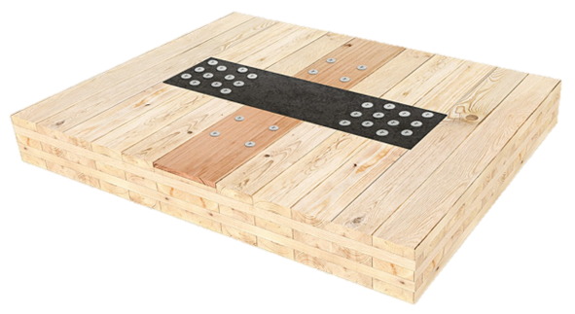
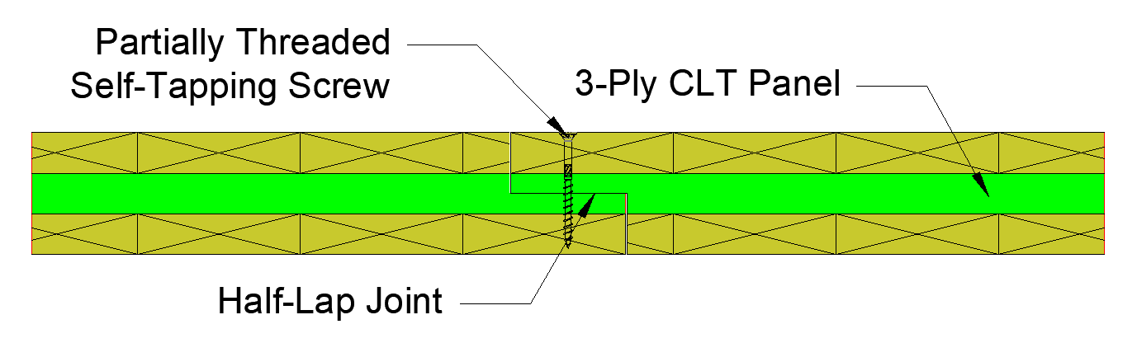
Introduction
Different types of diaphragm connections:
- Spline
- Half-lap
Uncertainty in connection strength perpendicular to joint (tension)
Steel tension straps provide this resistance (collectors, opening reinforcement, chord reinforcement)
Spline connection cross-section
Half-lap connection cross-section
Mass Timber Strap 15 (MTS15) from MTC Solutions

Slide 4
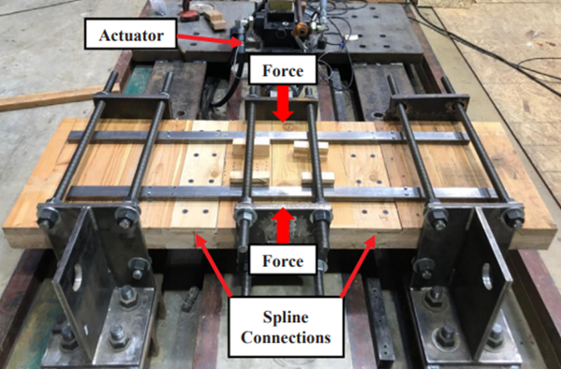
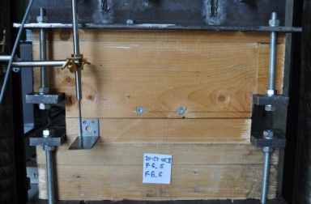
Background
Shear test setup (from Taylor et al., 2020)
Many previous studies on shear performance
Only one noteworthy study on tension performance
No known study on interaction with tension straps
Tension test setup (from Gavrić, 2012)

Slide 5
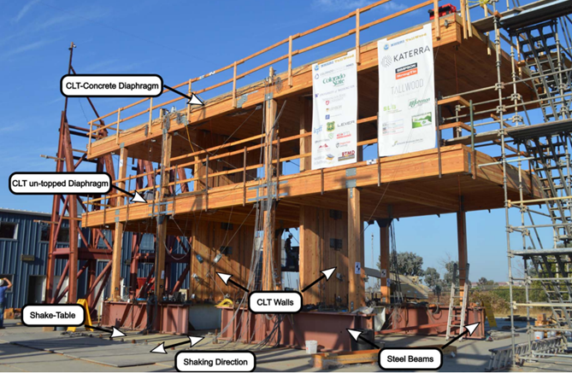
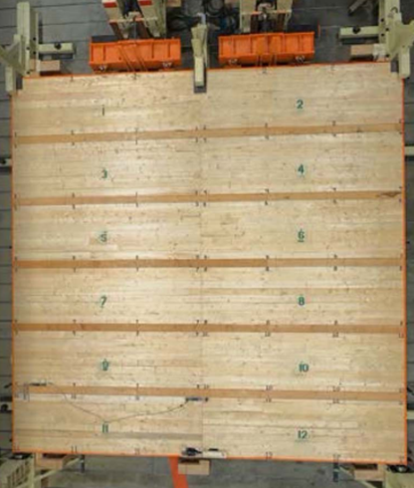
Background
Two-storey shake table testing (from Barbosa et al., 2021)
Large scale tests on CLT diaphragms have been performed
Indicate they are viable solutions capable of resisting seismic loads
Full-scale diaphragm testing (from Line et al., 2022)

Slide 6
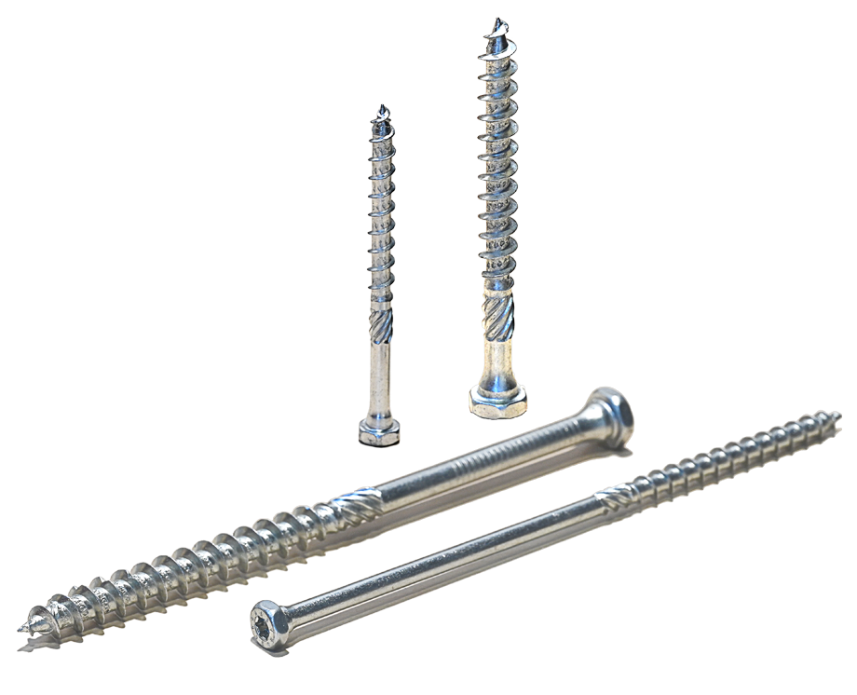
Background
Self-Tapping Screws and CSA O86:19
Self-tapping screws:
- Similar to lag screws, but no predrilling required
- No provisions in O86:19 (but expected in next ed.)
Clause 11.9.2.2 Lateral resistance of CLT diaphragms:
“The lateral resistance of CLT diaphragms shall be governed by the resistance of connections between the diaphragms and the supporting structure and connections between the individual panels, calculated using methods of mechanics.”

Slide 7
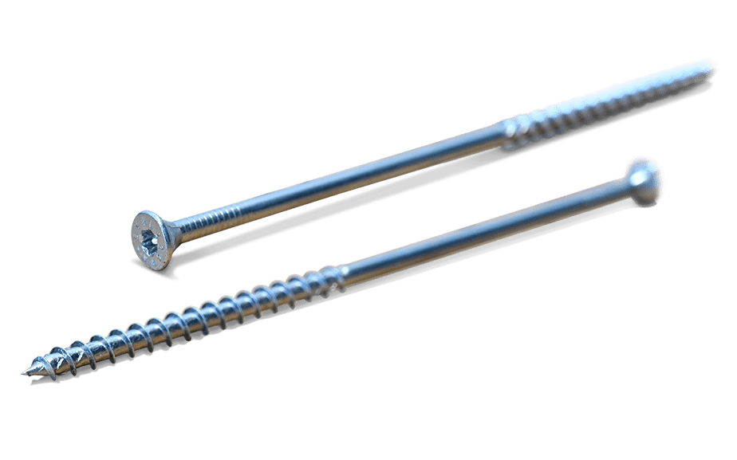
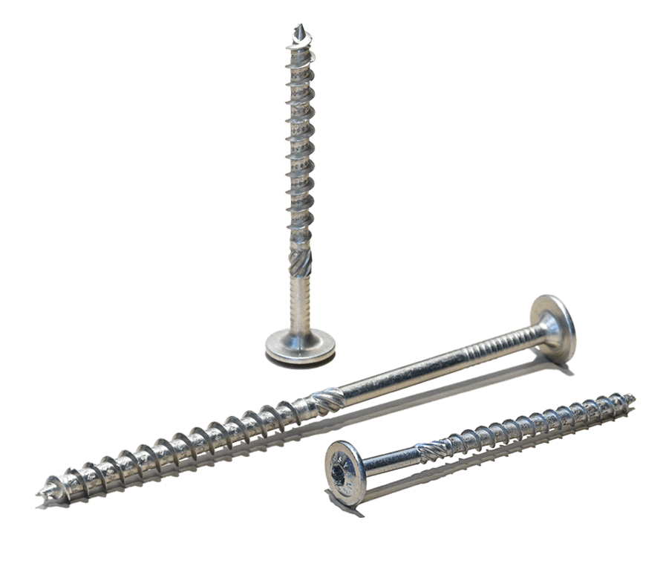
Research Objectives
Experimentally study in-plane tension and shear behaviour of:
- ¾” plywood spline with ASSY Ecofast 8x80 and SK 8x80 screws
- ¾” plywood spline with 3-1/4” power-driven spiral nails
- 14-gauge steel spline with SDS screws (Simpson Strong-Tie)
- Half-lap with ASSY Ecofast 8x100 screws
Perform tests with and without custom steel tension straps

Slide 8
Experimental Design
 |  | Panel-to-Panel Connection Type
 |  | Plywood spline with ASSY Ecofast 8x80 | Plywood spline with spiral nails | 14-gauge steel spline with SDS screws | Half-lap joint with ASSY Ecofast 8x100
Load Direction, with or without Tension Strap | Tension, without tension strap | M | M | M | M
 |  | C | C | C | C
 |  | C | C | C | C
 | Tension, with tension strap | M | M | M | M
 |  | C | C | C | C
 |  | C | C | C | C
 | Shear, without tension strap | M | M | M | M
 |  | C | C | C | C
 |  | C | C | C | C
 | Shear, with tension strap | M | M | M | M
 |  | C | C | C | C
 |  | C | C | C | C
Testing Plan: Main Test Matrix
One monotonic and two cyclic tests per specimen type
Cyclic tests based on ISO 16670 in ASTM E2126-19

Slide 9
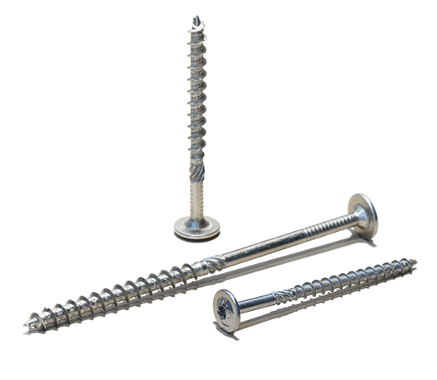
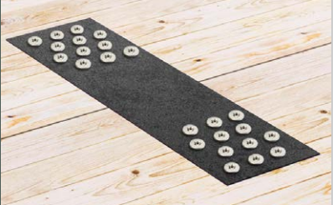
Experimental Design
Testing Plan: ASSY SK and Isolated Tension Strap Tests
 | Load Direction
 | Tension | Shear
Plywood Spline with ASSY SK 8x80 | Cyclic | Cyclic
 | Cyclic | Cyclic
 | Cyclic | Cyclic
 | Load Direction
 | Tension | Shear
Mass Timber Strap with ASSY Kombi 8x80 | Monotonic | Monotonic
 | Cyclic | Cyclic

Slide 10
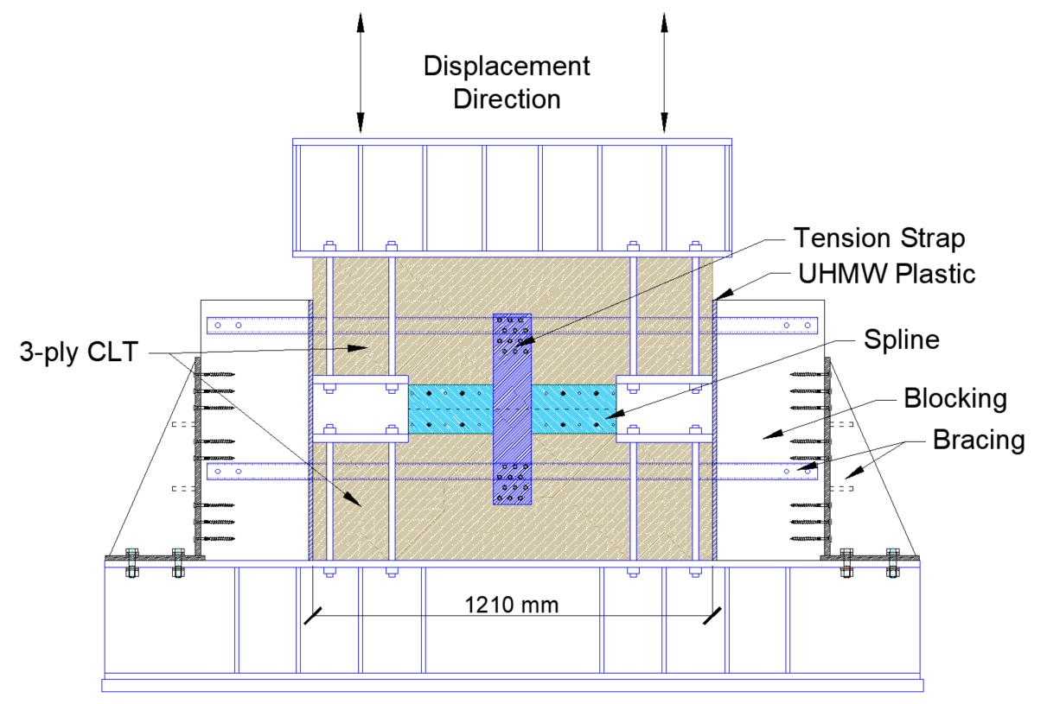
Experimental Design
Testing Apparatus: Tension Setup
Bottom beam anchored to strongfloor
Top beam attached to two 250 kN actuators
Lateral bracing in both out-of-plane directions

Slide 11
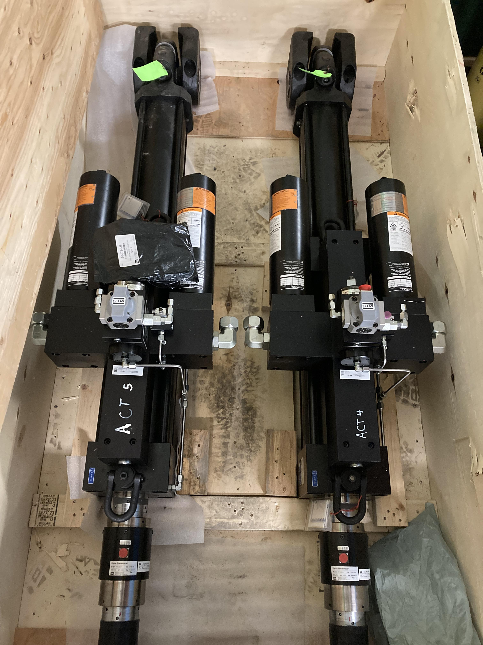
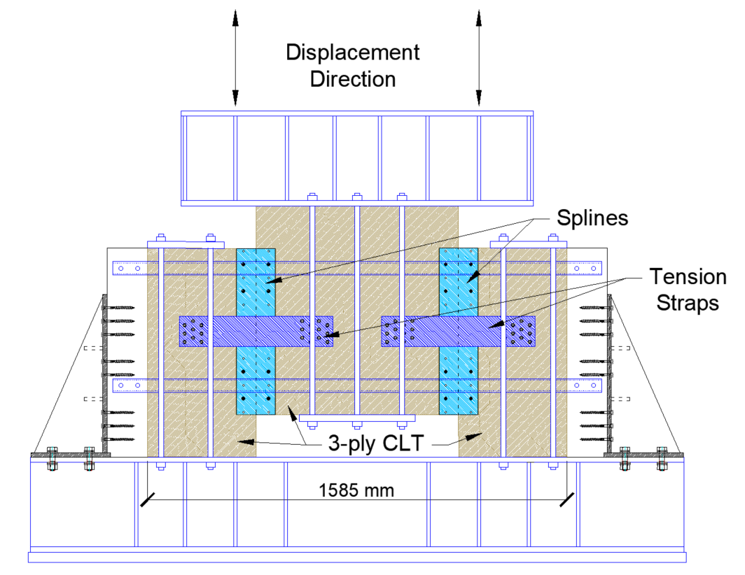
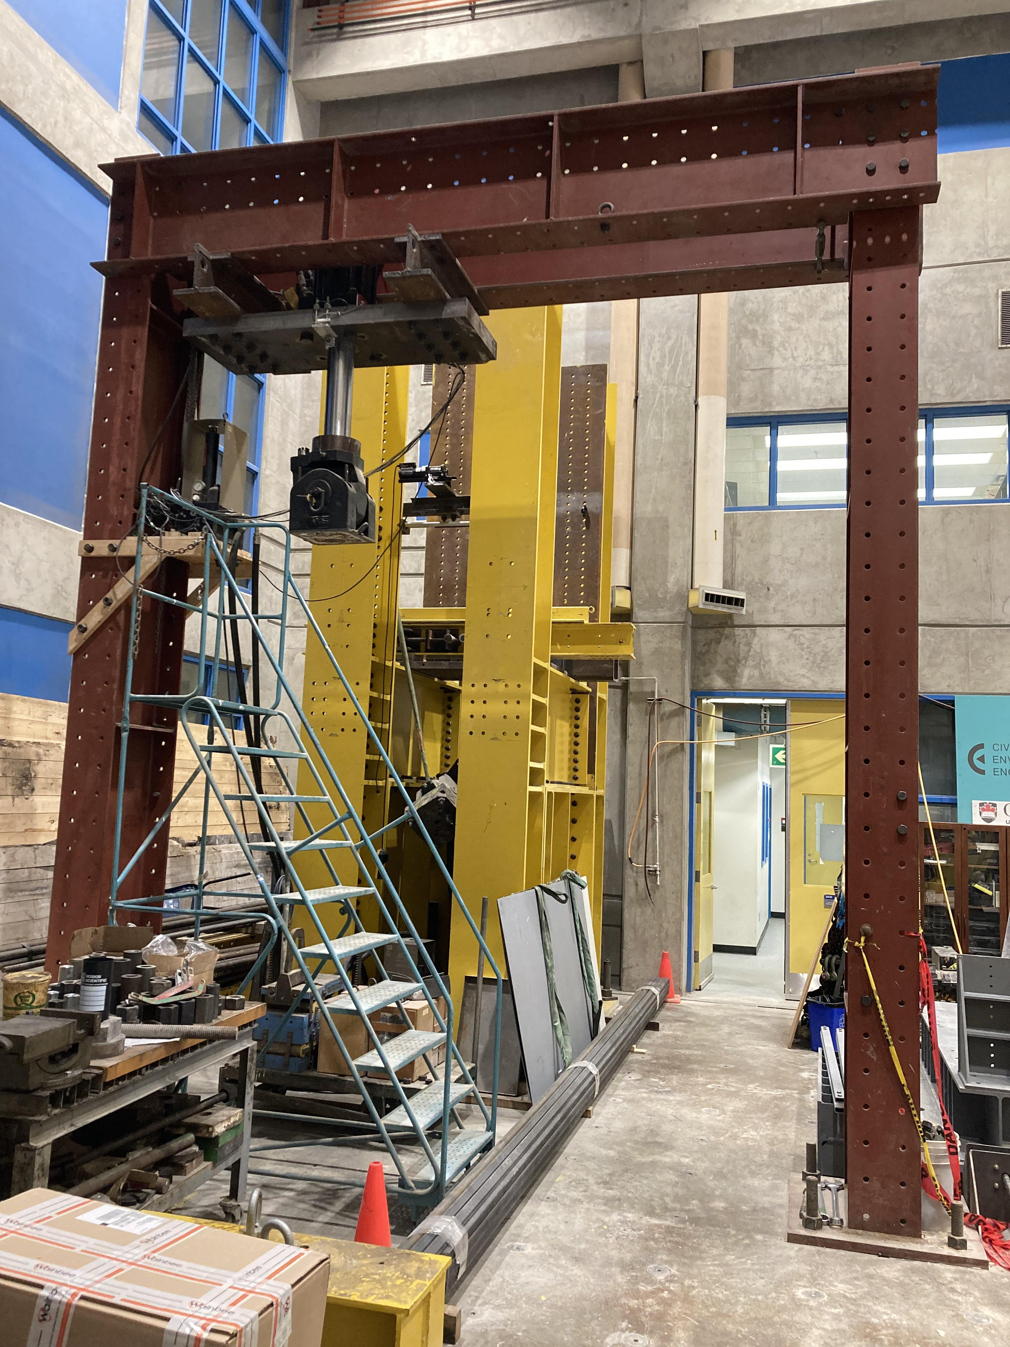
Experimental Design
Testing Apparatus: Shear Setup
MTS DuraGlide 244.31 250 kN actuators
Red Test Frame

Slide 12
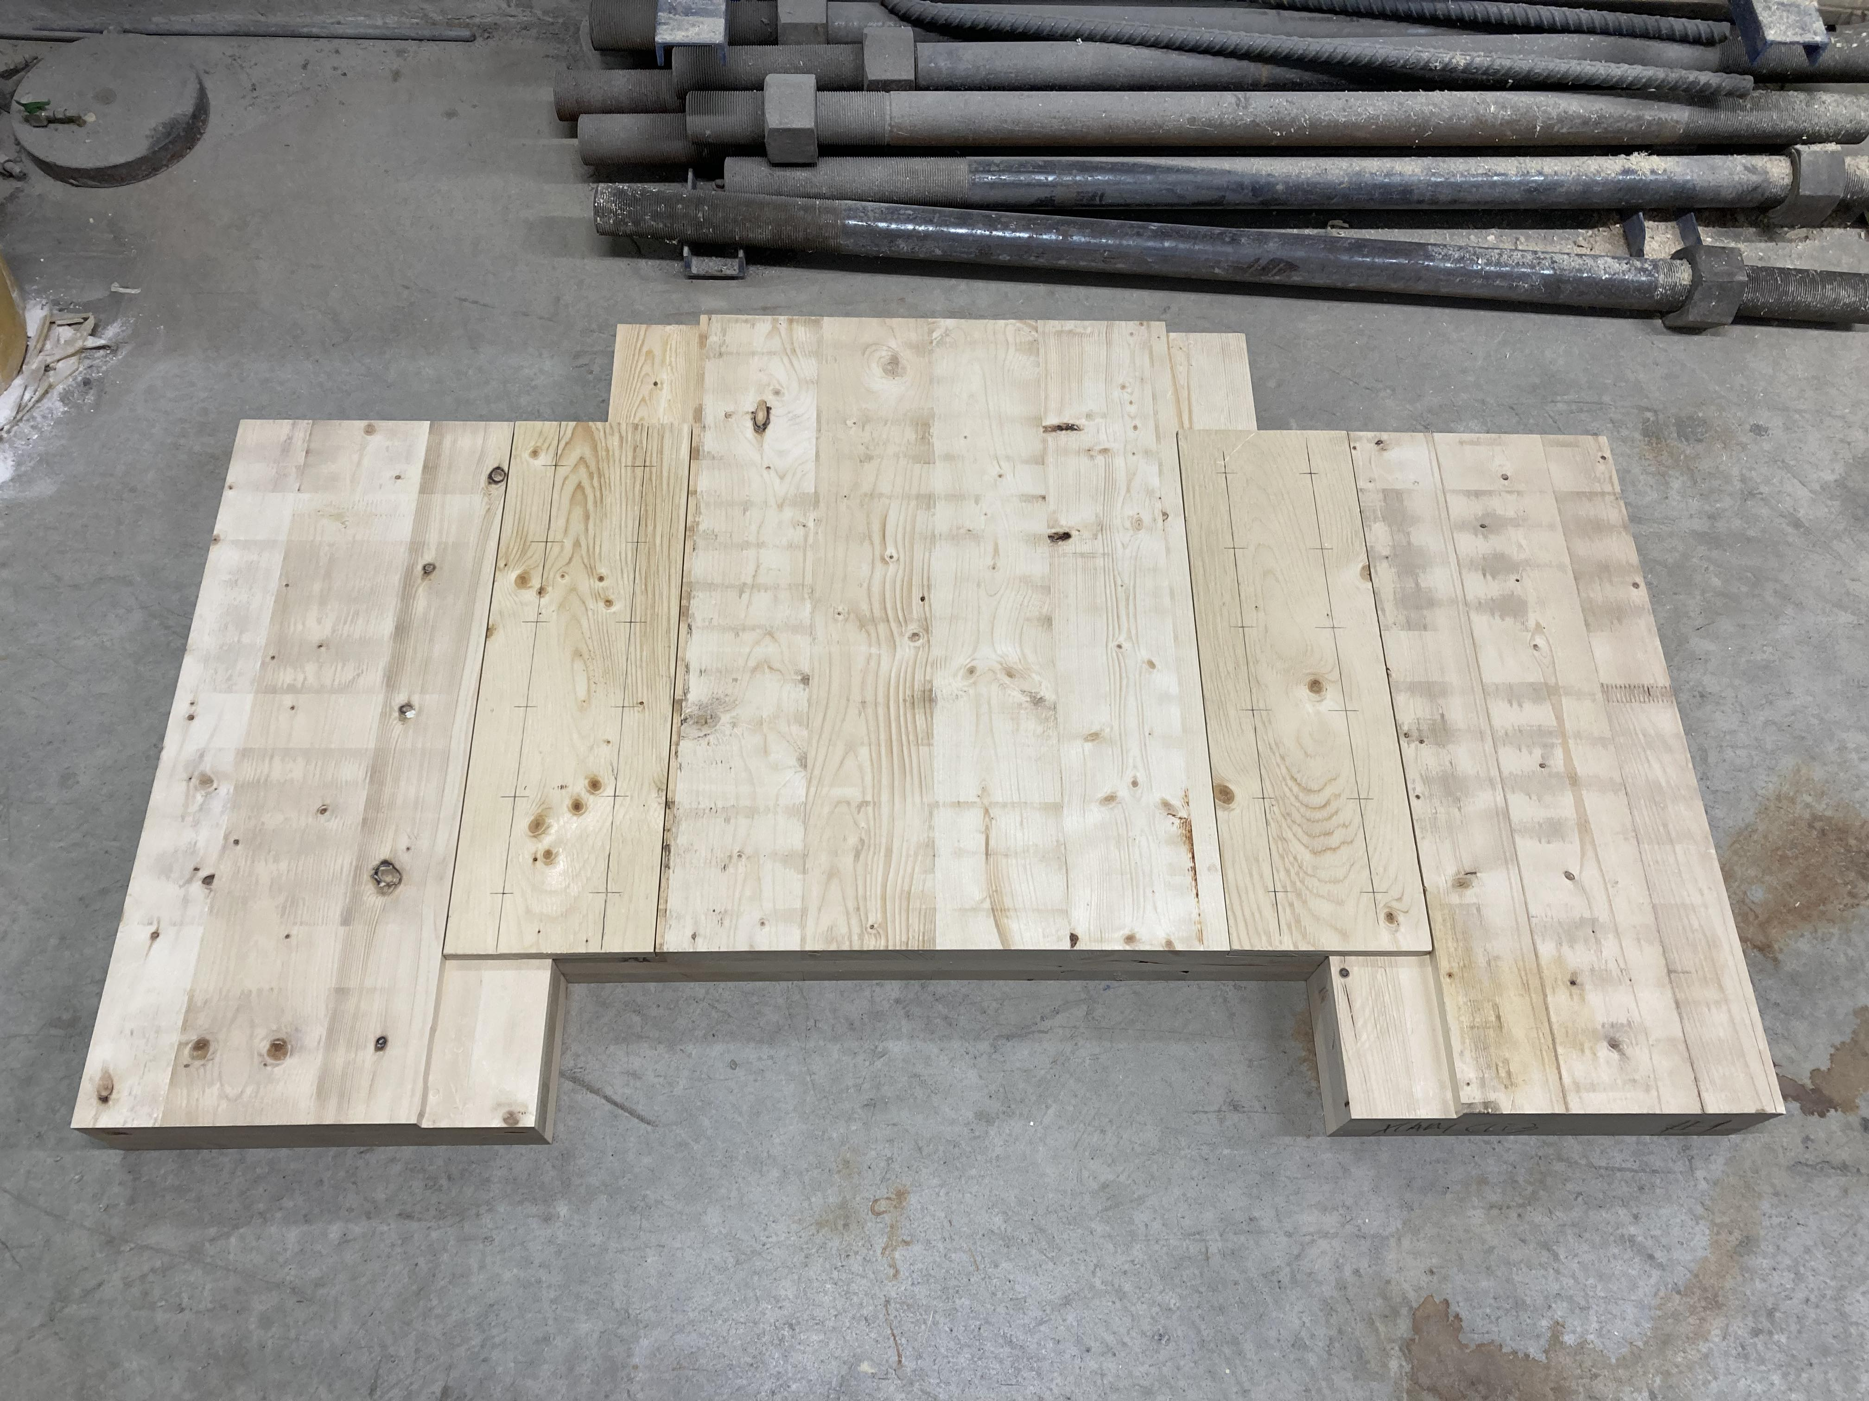
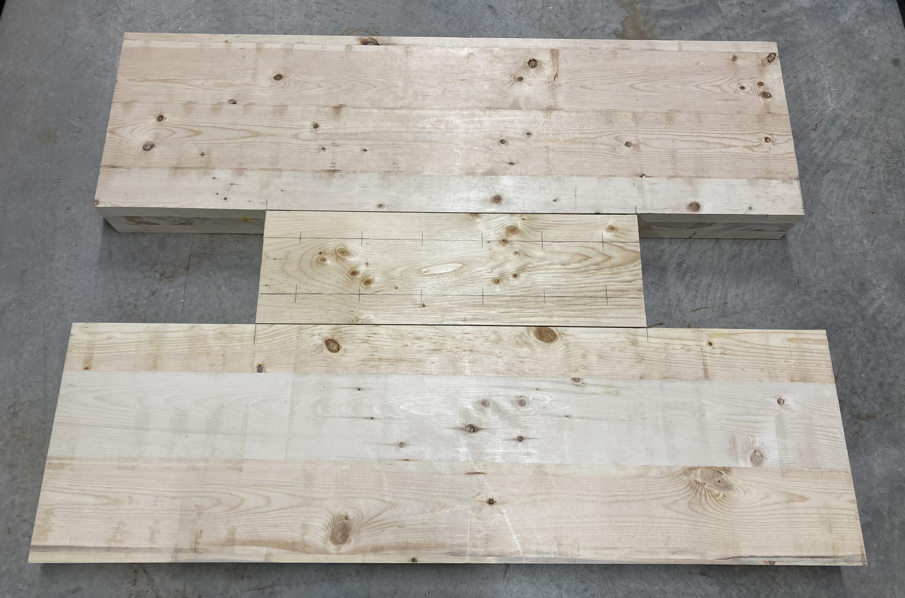
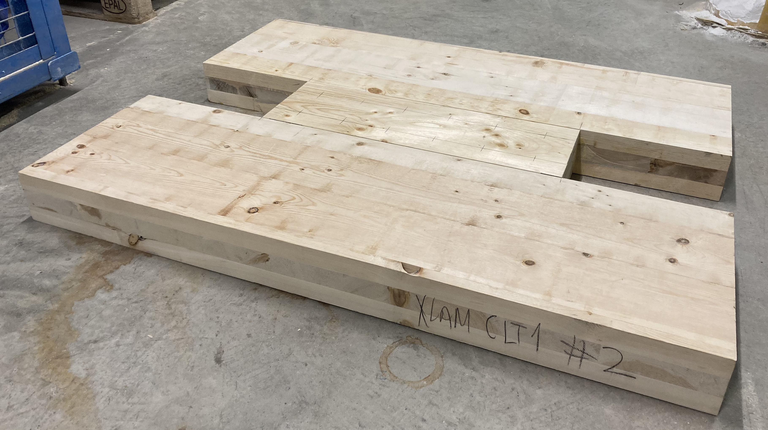
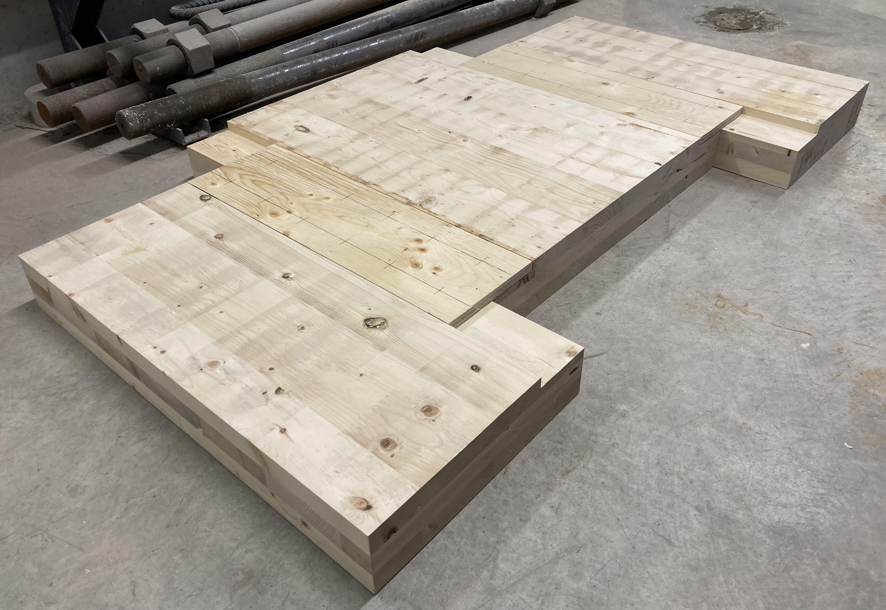
Experimental Design
Plywood Spline Specimens
Tension
Shear

Slide 13
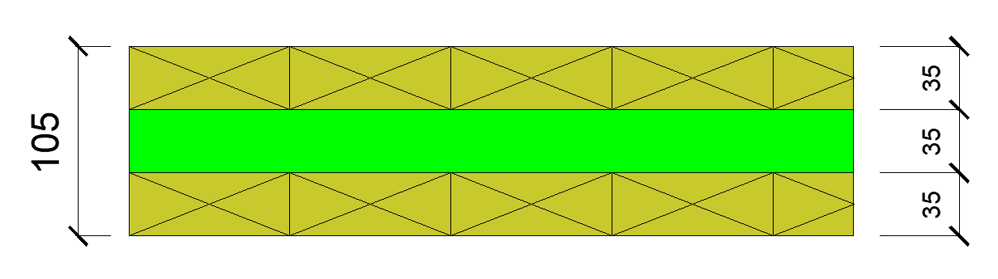
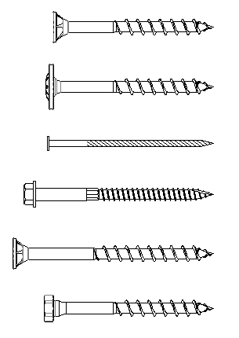
Experimental Design
Materials and Hardware
CLT: 3-ply V2 SPF with 35 mm plies
Splines: ¾” SPF plywood and 14 ga. steel
Fasteners:
- ASSY Ecofast 8x80 (with plywood splines)
- ASSY SK 8x80 (with plywood splines)
- Power-driven spiral nails (with plywood splines)
- SDS25312 (with steel splines)
- ASSY Ecofast 8x100 (with half-lap)
- ASSY Kombi 8x80 (with tension strap)

Slide 14
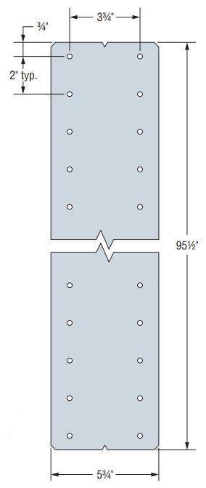
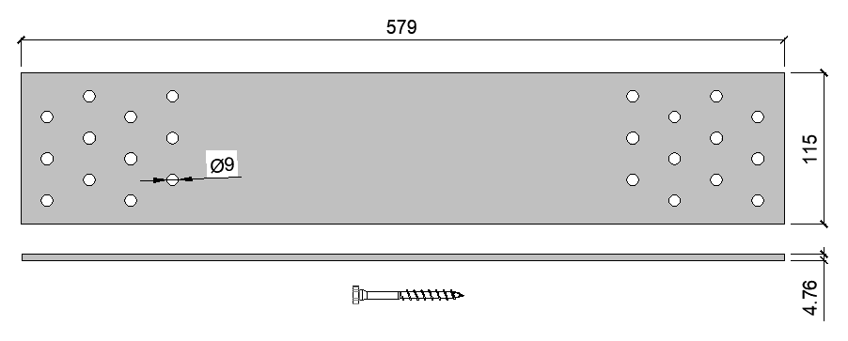

Experimental Design
Materials and Hardware
Steel tension strap from MTC Solutions
Special Thanks:
- Element5 (CLT)
- MTC Solutions (connection hardware)
- Simpson Strong-Tie (connection hardware)
14 ga. spline from Simpson Strong-Tie (MDSS96)

Slide 15
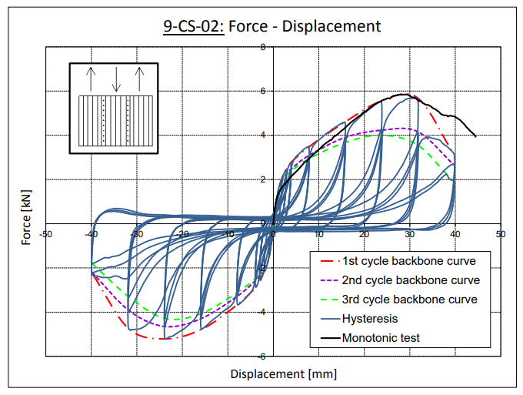
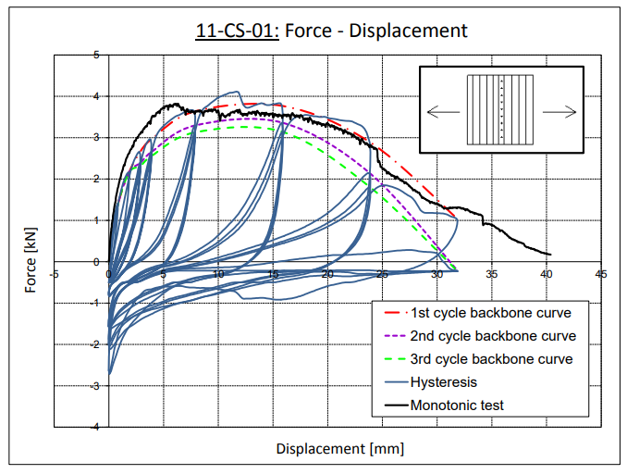
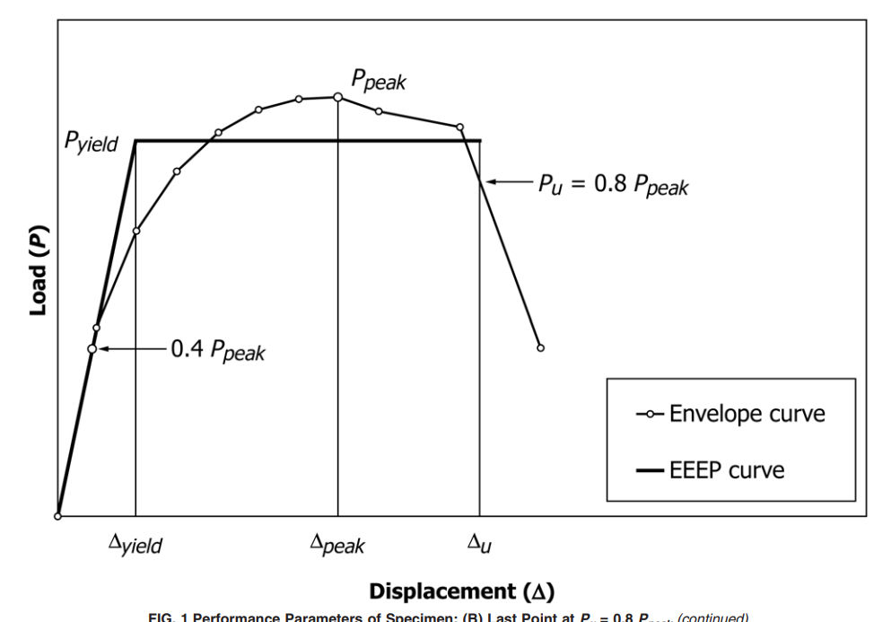
Anticipated Outcomes
Example shear results from Gavrić (2012)
Example tension results from Gavrić (2012)
EEEP curve definition (from ASTM International, 2019)

Slide 16
Anticipated Outcomes
Comparison of performance (strength, stiffness, ductility, etc.) between connection types
Comparison of performance between shear and tension loading
Quantify tension strength of different connections
Quantify effect of tension straps
Nailed spline connection expected to be most ductile, lowest yield strength
Screwed half-lap connection expected to be stiffest, potential brittle failure modes

Slide 17
THANK YOU!
QUESTIONS?

Slide 18
Image Sources
Brock Commons Tallwood House
https://livinglabs.ubc.ca/projects/brock-commons-tallwood-house
MTS15:
https://mtcsolutions.com/products/mts15/
ASSY Kombi screws:
https://mtcsolutions.com/products/assy-kombi-3/
ASSY Ecofast screws:
https://mtcsolutions.com/products/assy-ecofast-4/
ASSY SK screws:
https://mtcsolutions.com/products/assy-sk-3/
MDSS96:
https://www.strongtie.com/straightstraps_strapsandties/mdss_strap/p/mdss

Slide 19
References
ASTM International. (2019). E2126-19: Standard test methods for cyclic (reversed) load test for shear resistance of vertical elements of the lateral force resisting systems for buildings.
Barbosa, A. R., Rodrigues, L. G., Sinha, A., Higgins, C., Zimmerman, R. B., Breneman, S., Pei, S., van de Lindt, J. W., Berman, J., & McDonnell, E. (2021). Shake-table experimental testing and performance of topped and untopped cross-laminated timber diaphragms. Journal of Structural Engineering, 147(4), Article 04021011.
Gavrić, I. (2012). Seismic behaviour of cross-laminated timber buildings [Doctoral dissertation, University of Trieste].
Line, P., Nyseth, S., & Waltz, N. (2022). Full-scale cross-laminated timber diaphragm evaluation. I: Design and full-scale diaphragm testing. Journal of Structural Engineering, 148(5), Article 04022037.
Taylor, B., Barbosa, A. R., & Sinha, A. (2020). Cyclic performance of in-plane shear cross laminated timber panel-to-panel surface spline connections. Engineering Structures, 218, Article 110726.

