Slide 1
Building a Fundable Narrative: Essential Insights for Grant Success
Bioindustrial and Circular Innovation Team
November 12, 2024

Slide 2

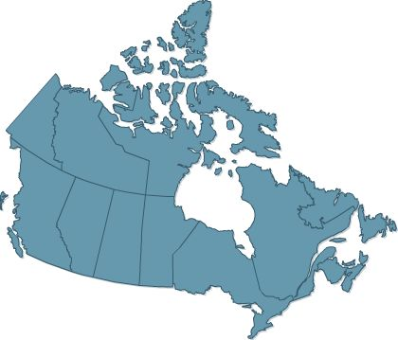

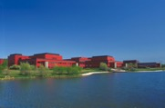
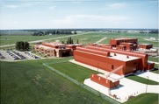
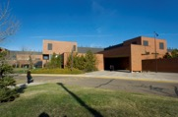
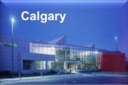


Edmonton
11 Locations
1 million+ sq ft of lab space
600+ acres of research farmland
Employees
589 FTEs
Including 73 PhDs
Devon
Vegreville
2 Subsidiaries
InnoTech Alberta Inc.
C-FER Technologies
(1999) Inc.
Operating Budget
$250 million

Slide 3
Bioindustrial and Circular Innovation
BIOINDUSTRIAL MATERIALS
Novel Utilization Of Biomass
Low Carbon Materials
Green Construction
BIOENERGY
Innovative Conversion Technology
Upgrading And Integration
Bioenergy Life Cycle Improvement
CIRCULAR ECONOMY
Product Lifecycle Circularity
Advanced Recycling Technologies
Enabling Technologies Circular Design

Slide 4
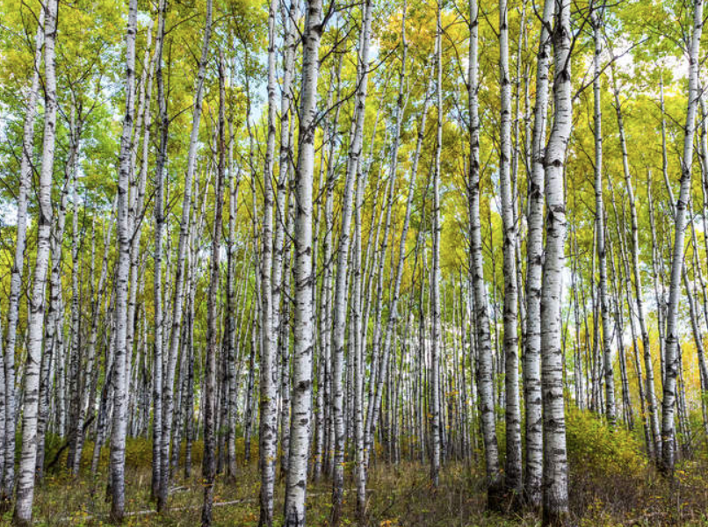
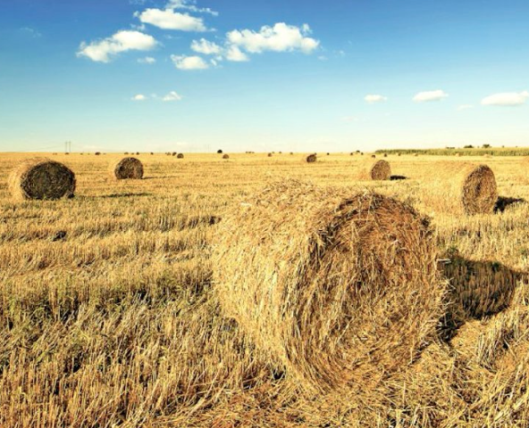

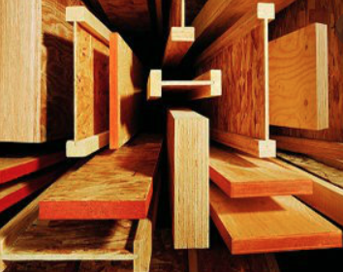
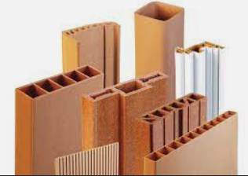
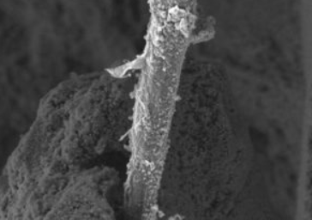
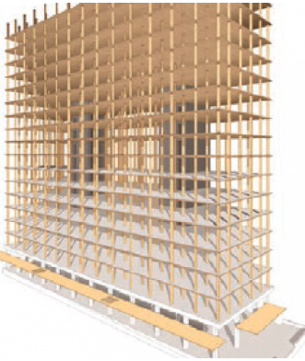
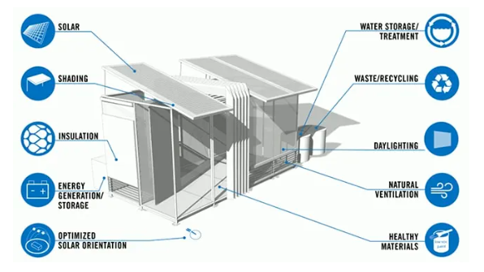
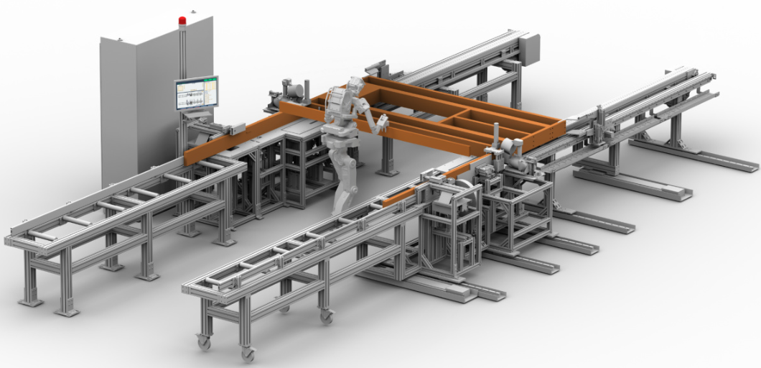
Sustainable Feedstock
Low Carbon Material
Green Construction
Underutilized Hardwood
Agricultural Residues
Plastic Waste Streams
Biofibre Composite
Sustainable Polymer
Eco-friendly Concrete
Feedstock Utilization
Value-Added Feedstock
Green Construction
Sustainable Building
Construction Industrialization
Mass Timber System

Slide 5
Building a Fundable Narrative: Essential Insights for Grant Success

Slide 6
01
Funding criteria and basic eligibility requirements

Slide 7
02
Read the guidelines and template

Slide 8
03
Plan your proposal

Slide 9
04
Tell a comprehensive story: value proposition

Slide 10
05
Know your competition

Slide 11
06
Talk about risks

Slide 12
07
Focus on one market or application

Slide 13
08
Demonstrate knowledge of the Alberta context

Slide 14
09
Importance of benefits

Slide 15
10
Speak about entire process chain

Slide 16
11
Be realistic

Slide 17
12
Be honest

Slide 18
13
Avoid marketing jargon

Slide 19
14
Reach out

Slide 20
THANK YOU!
Questions?
Jelena Sapkovskaja
Jelena.Sapkovskaja@albertainnovates.ca

